Slide 1
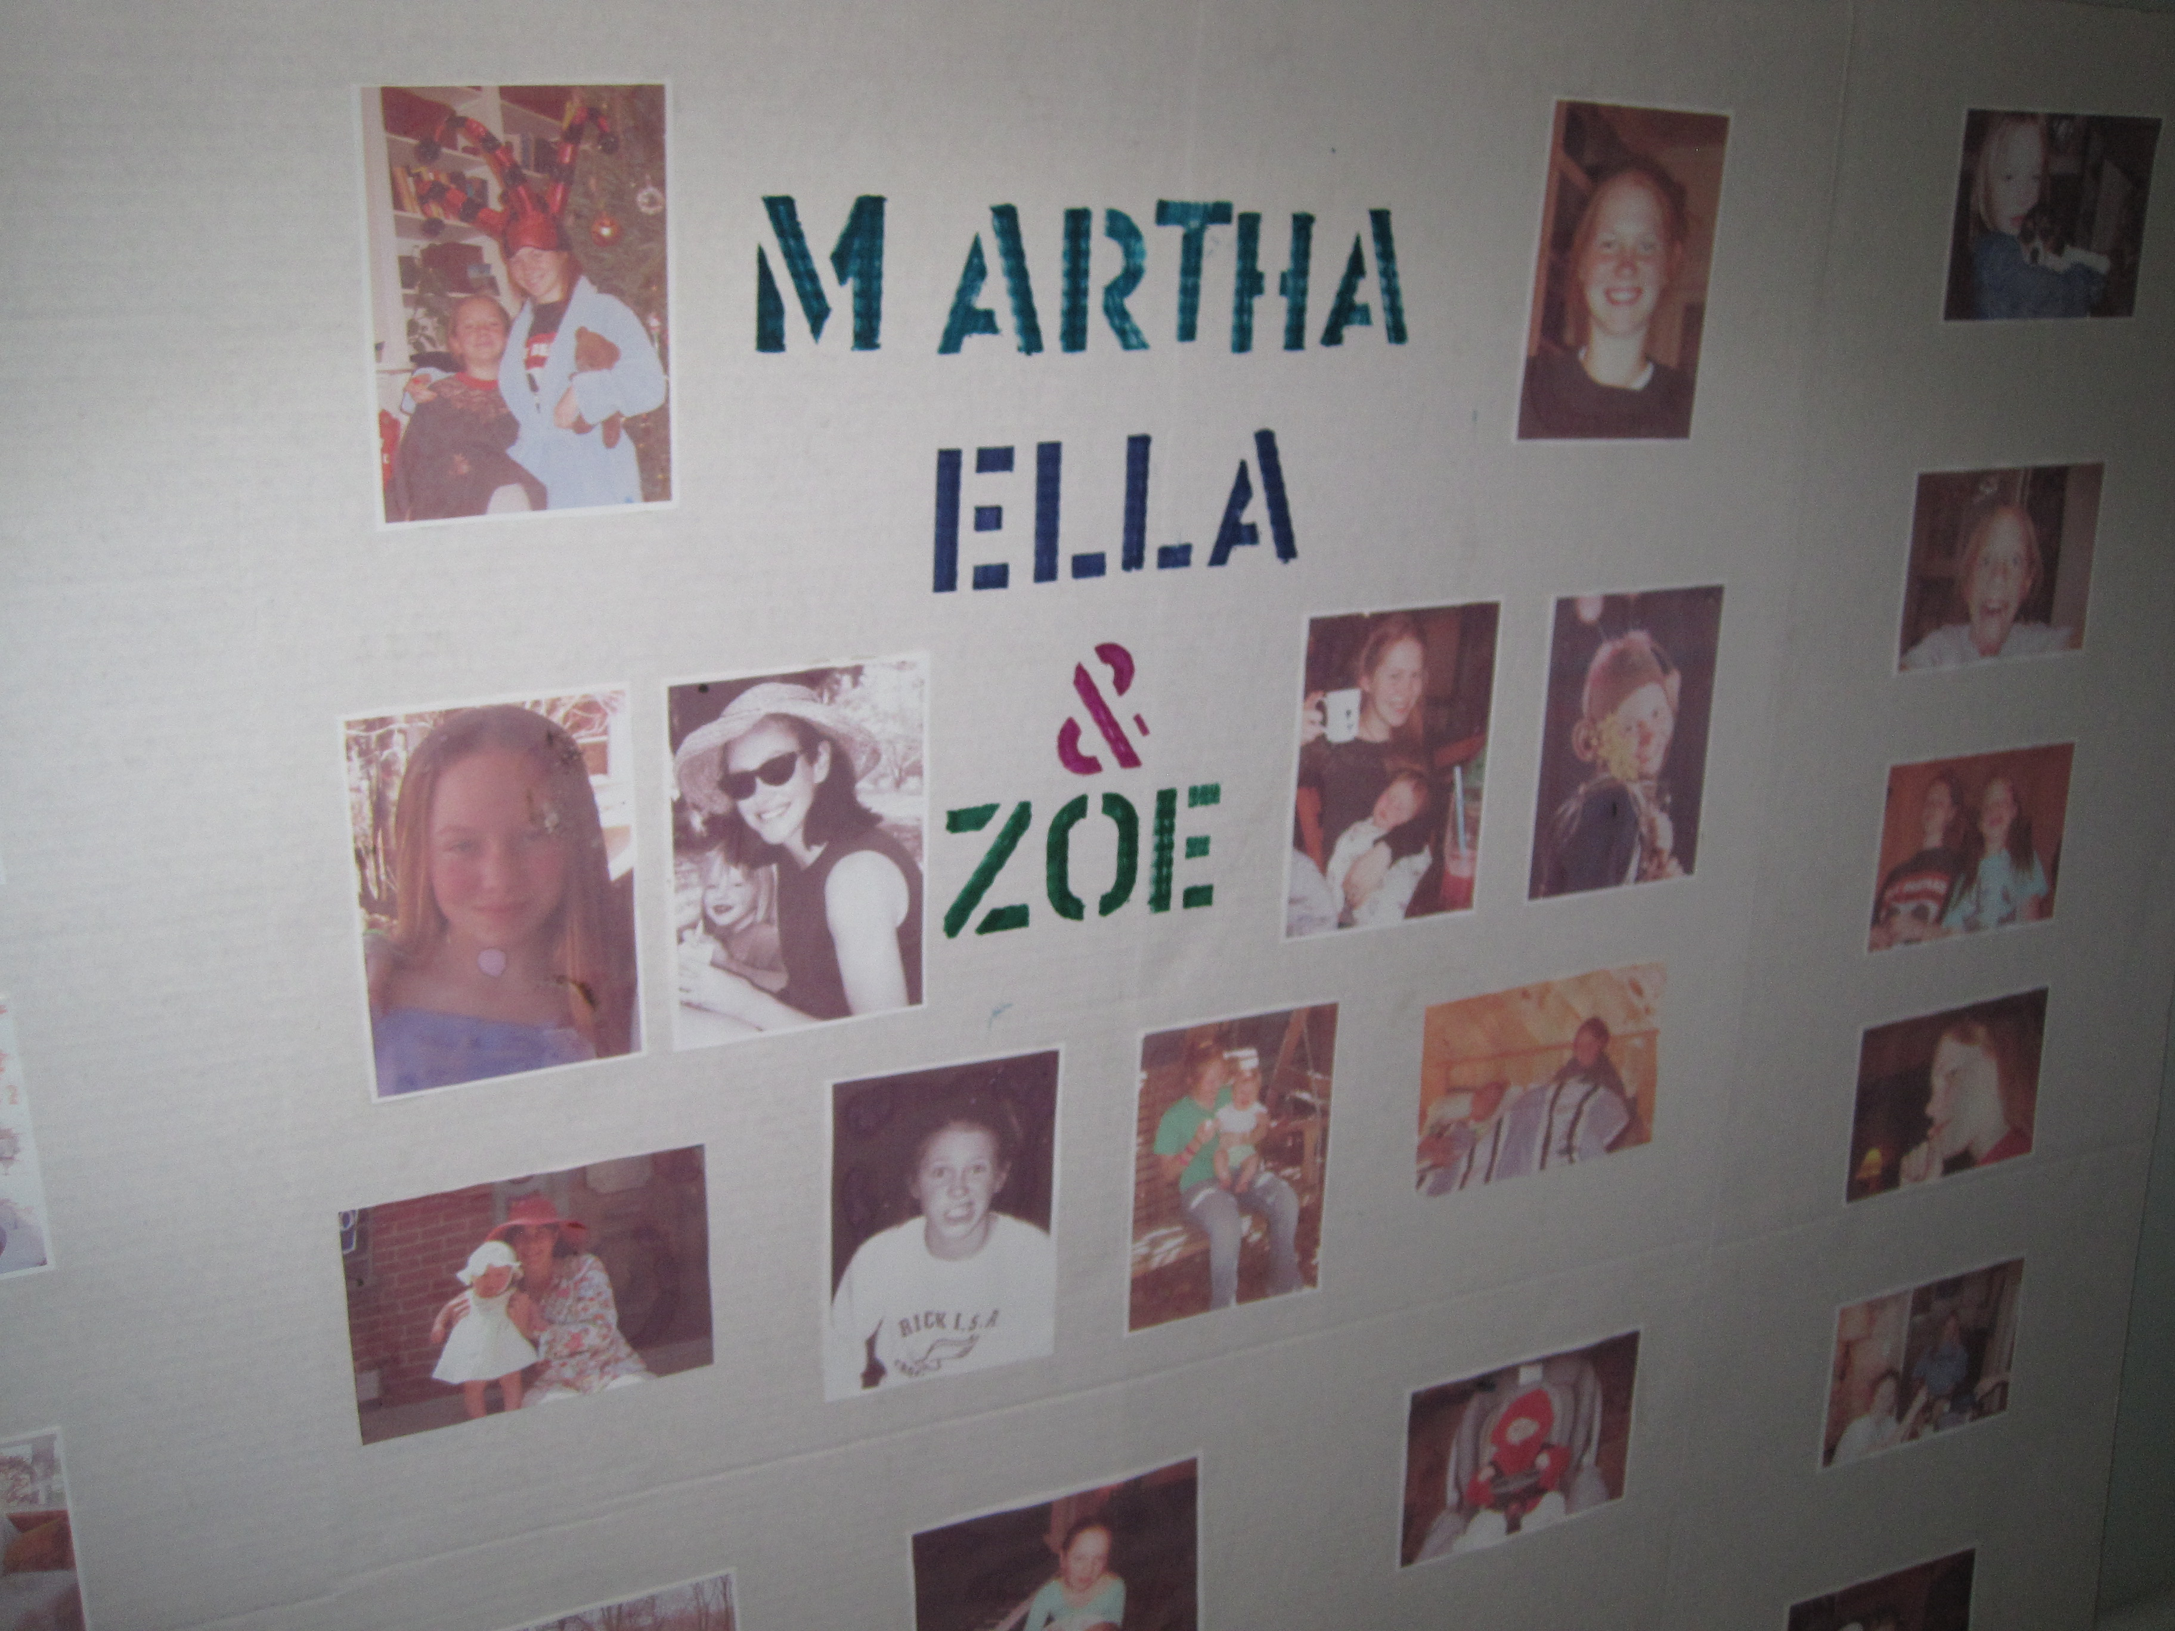
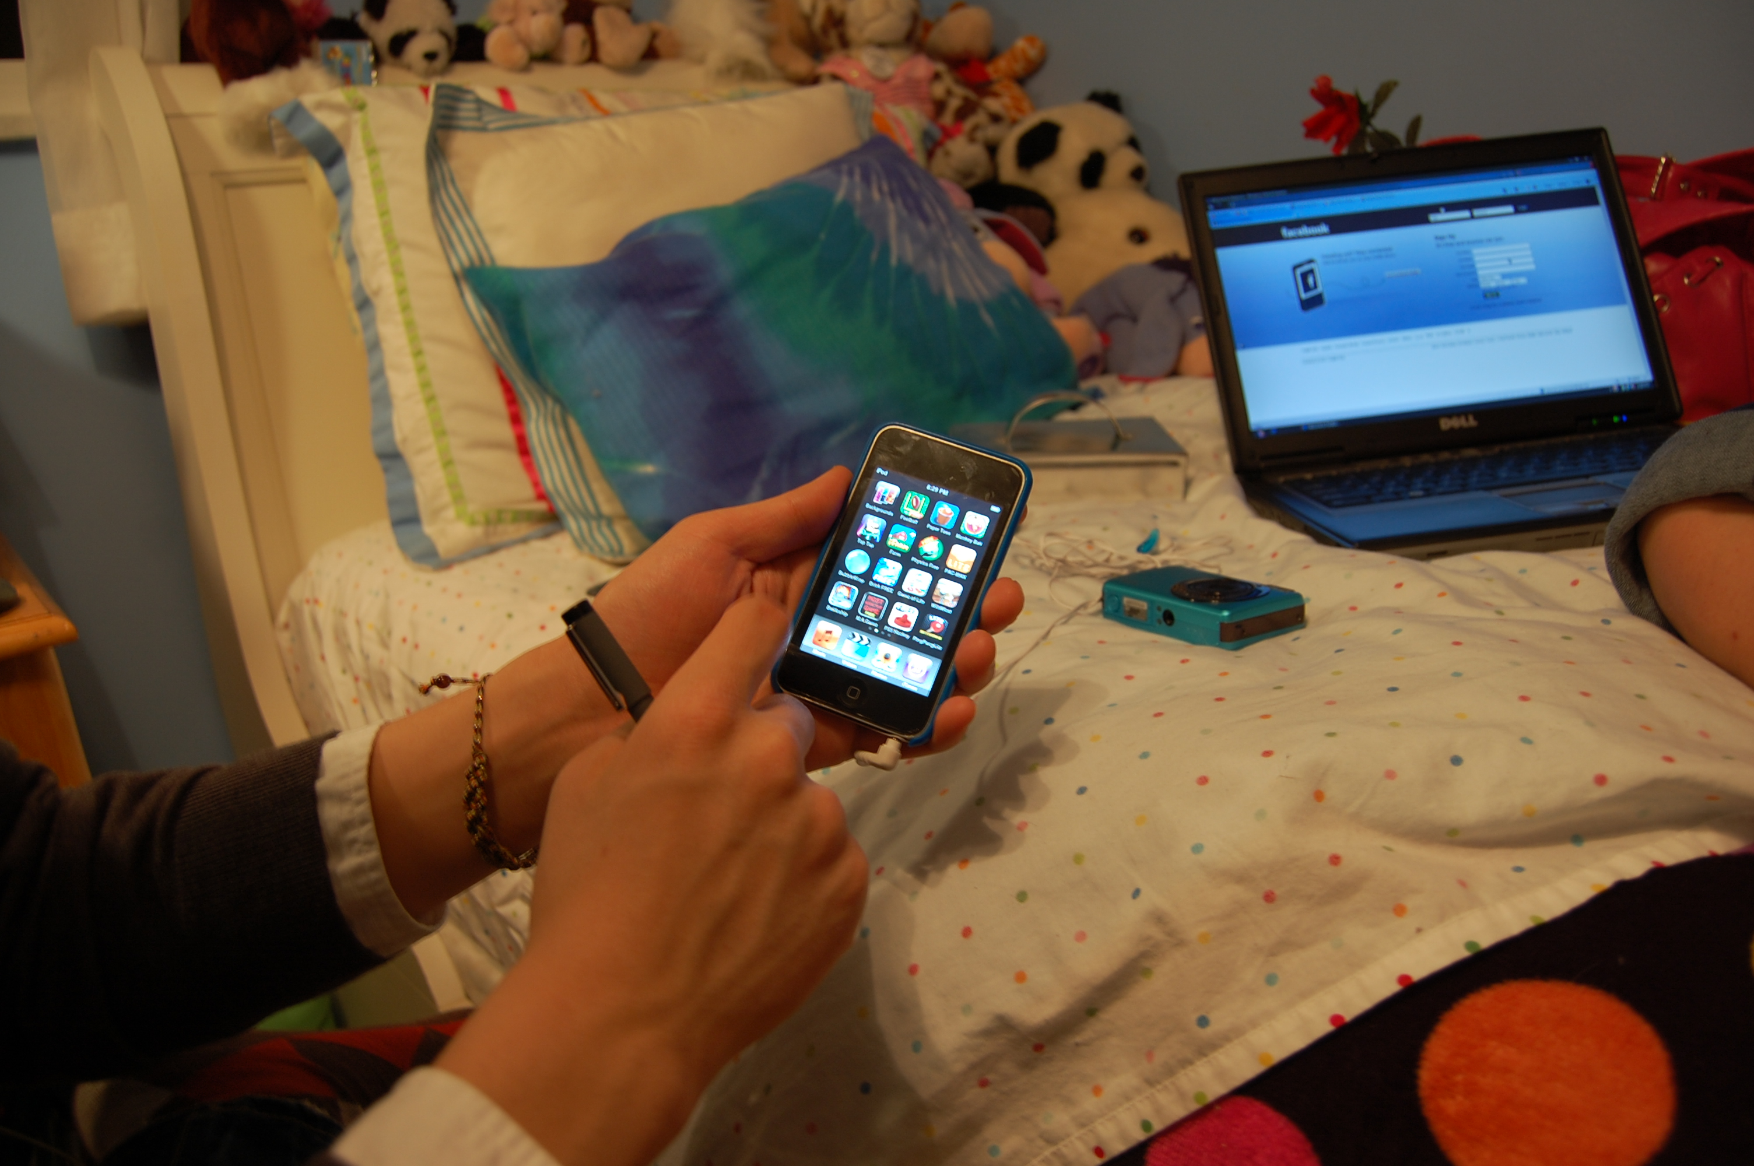
Virtual Possessions
William Odom, John Zimmerman, Jodi Forlizzi
Human-Computer Interaction Institute
Carnegie Mellon University

Slide 2
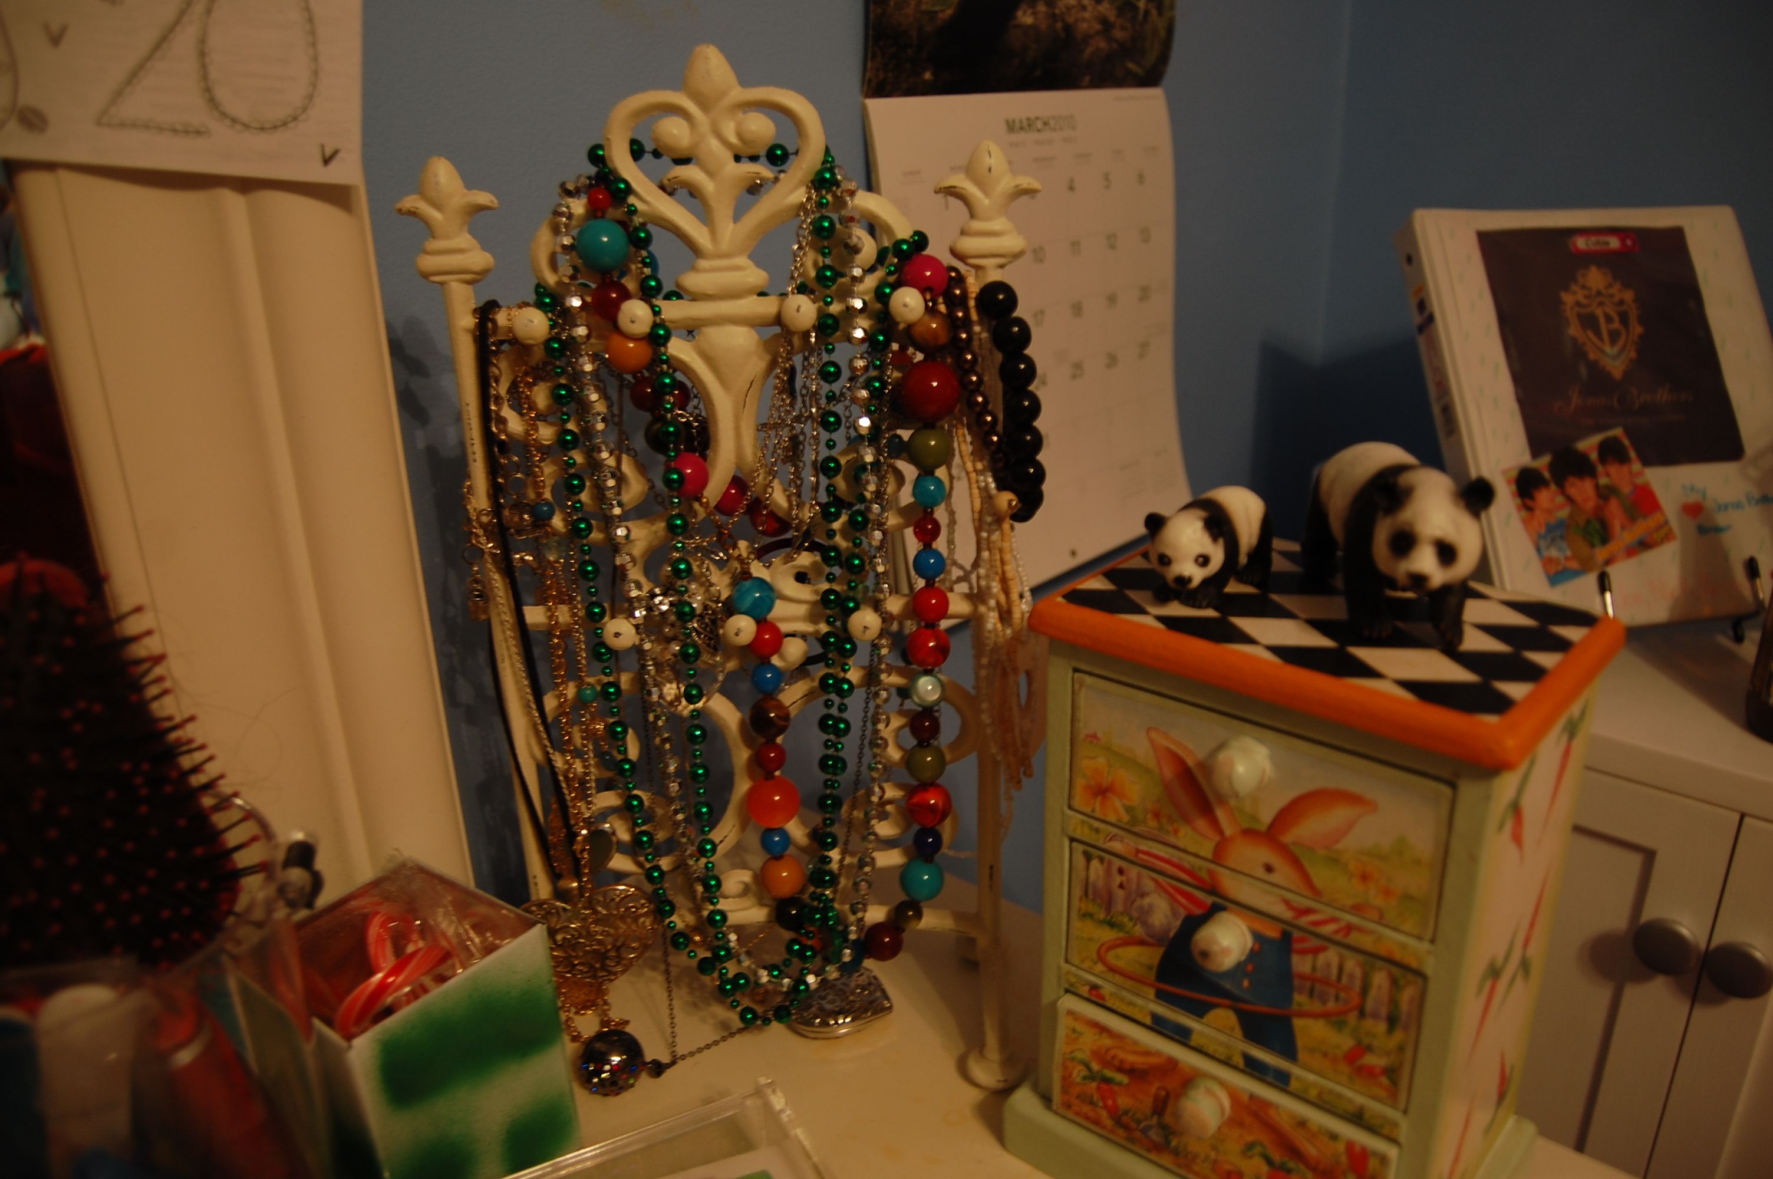
Notes:
For over a hundred years researchers in the social sciences and humanities have investigated the significance of people’s material possessions

Slide 3
Notes:
Much of this research maps how people develop attachments to their material possessions as they create and evolve a sense of self.

Slide 4
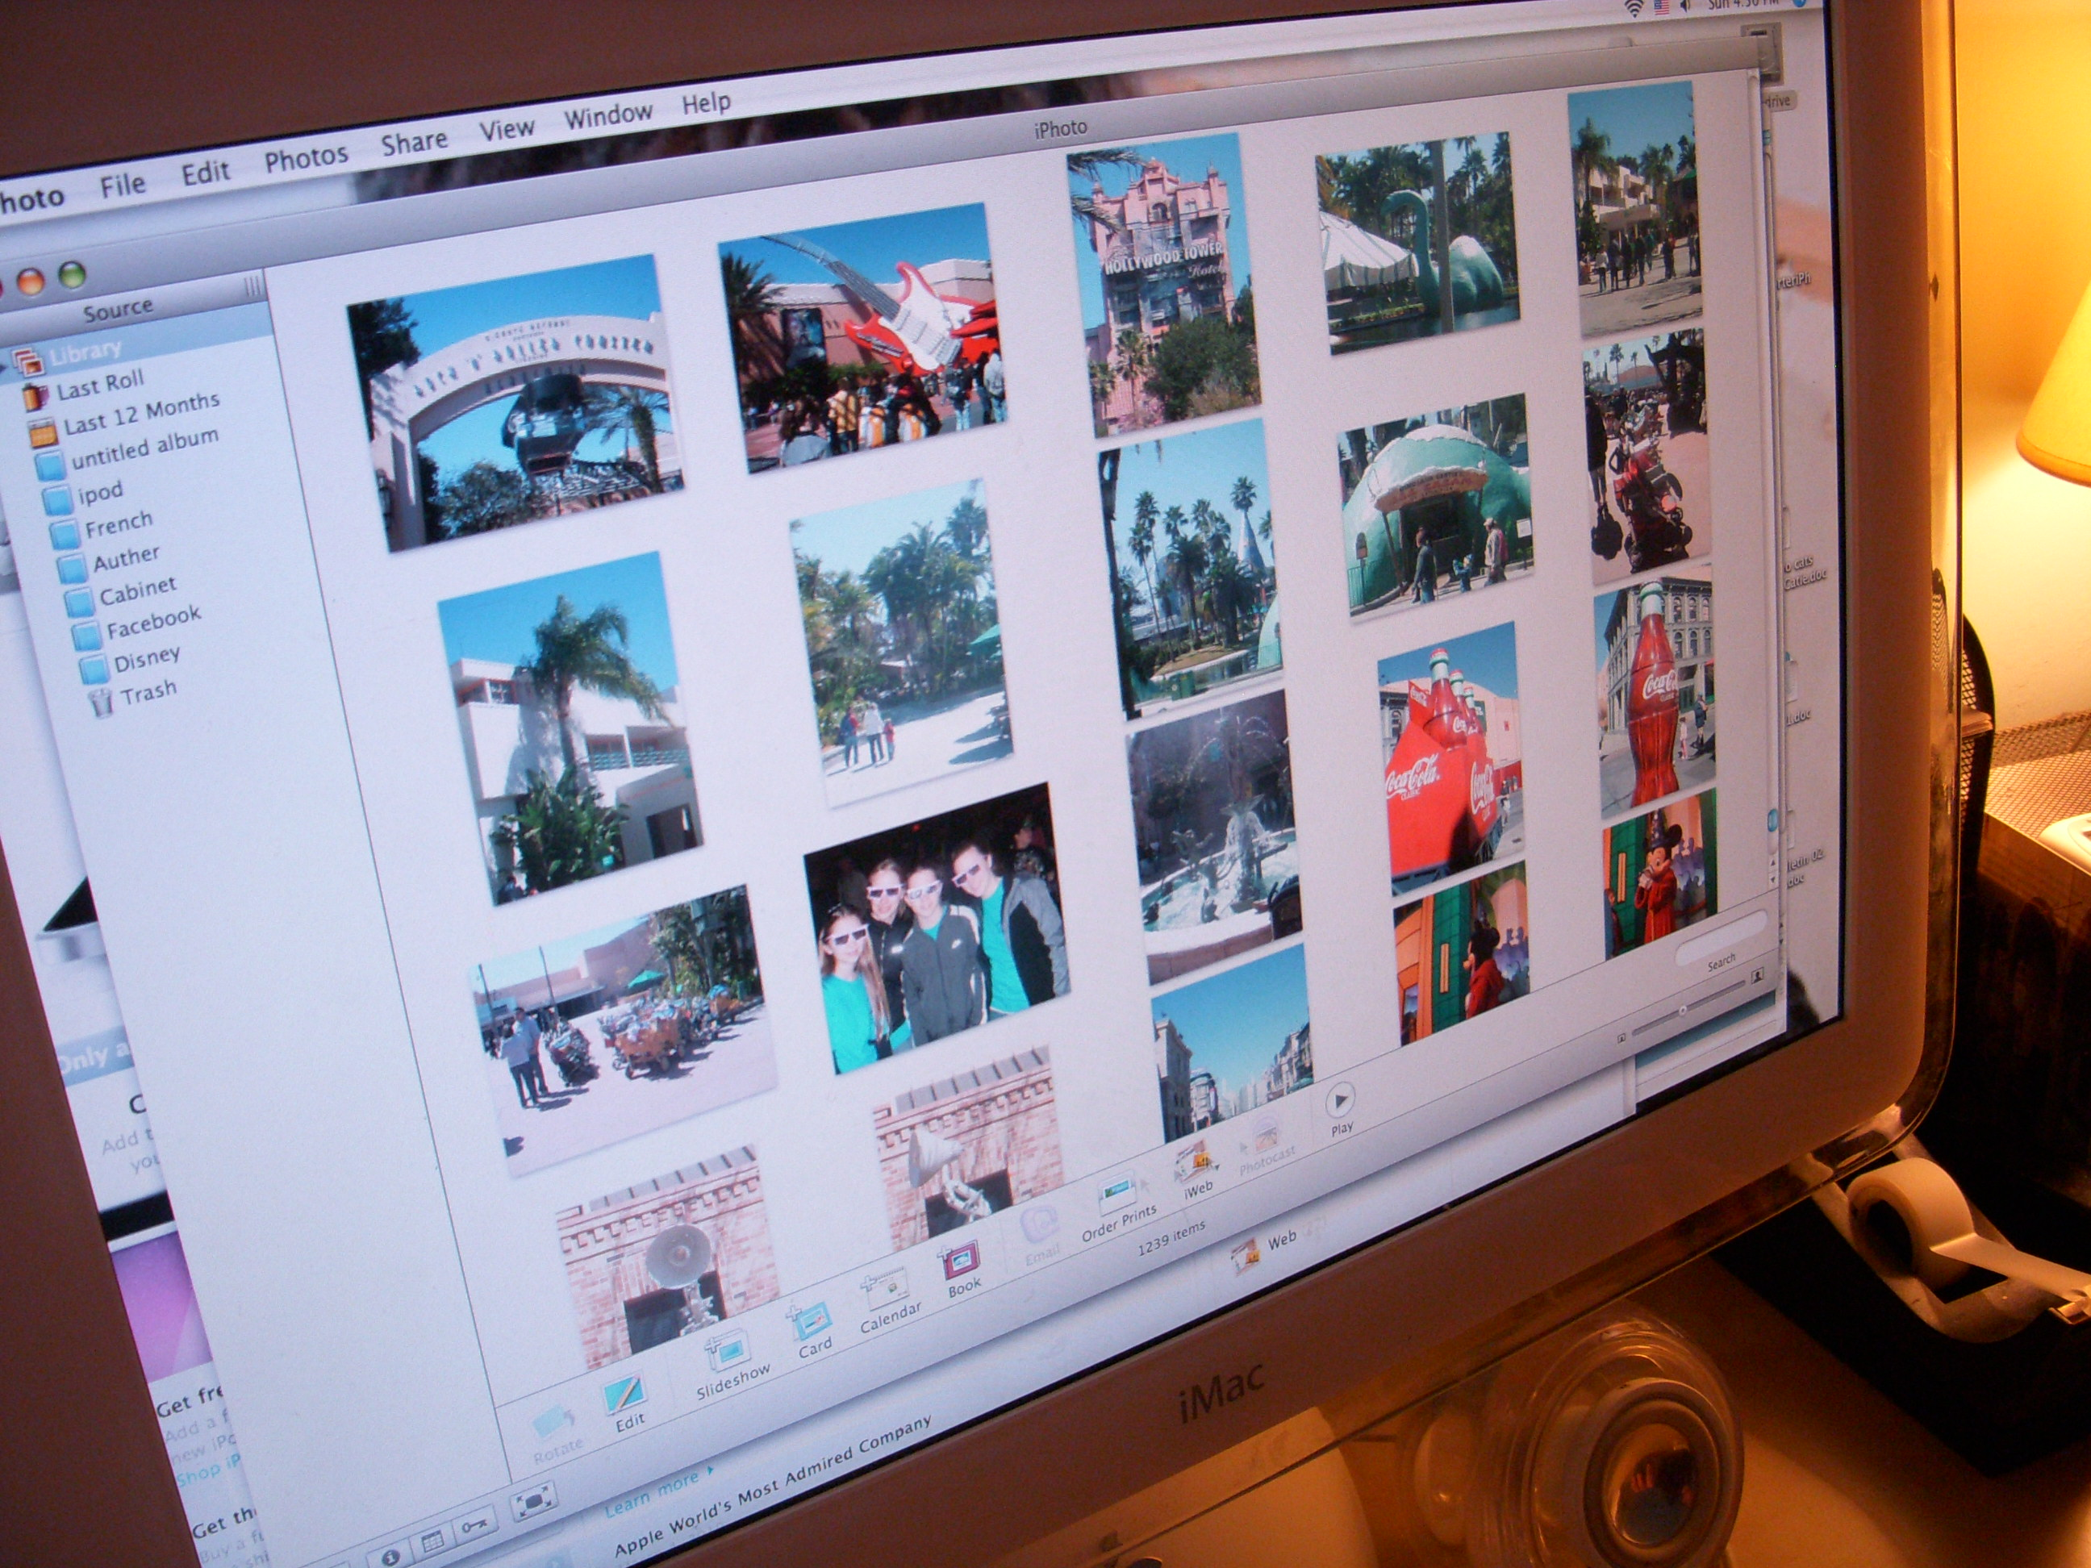
Notes:
For the last several years, people have increasingly acquired, created and interacted with virtual possessions.

Slide 5
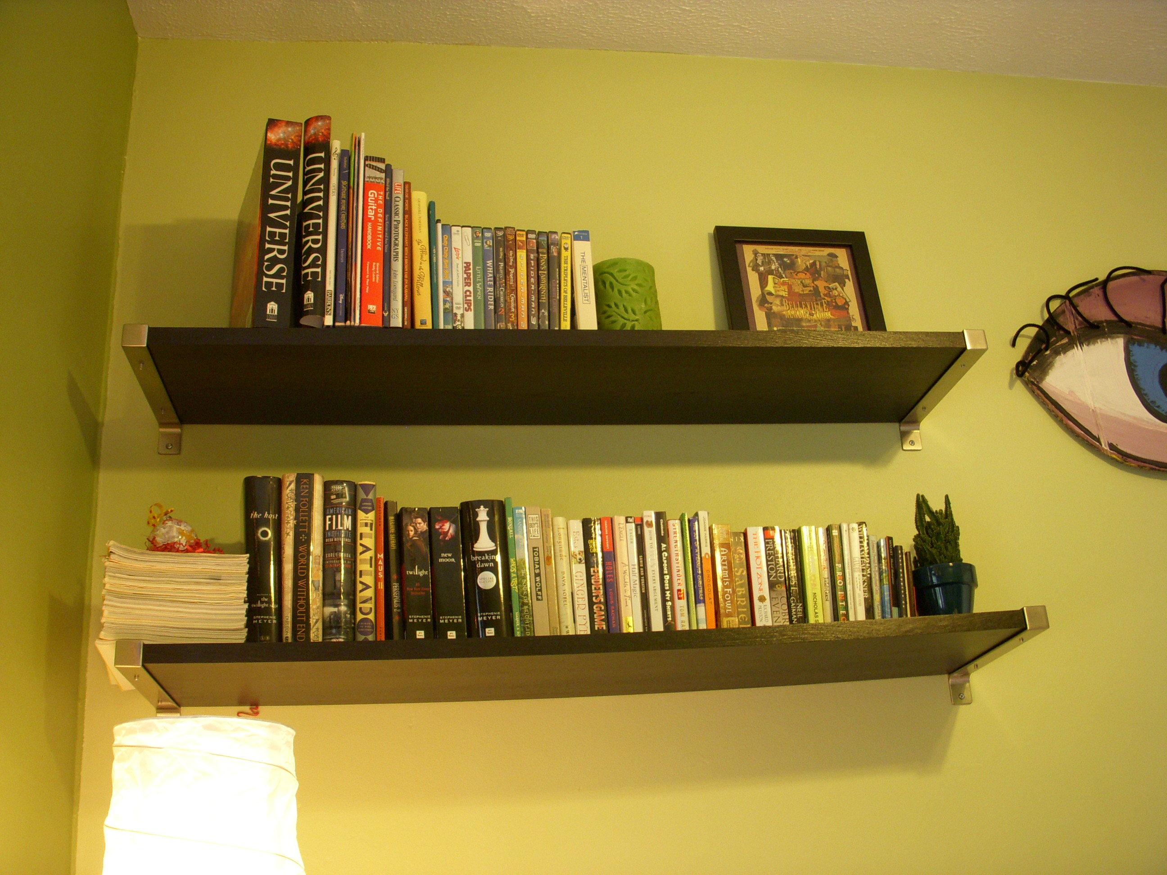
Notes:
These new possessions have two origins. First, they include material things that continue to lose their lasting material integrity, including books, music, movies, photos, plane tickets, paychecks, money, etc..

Slide 6
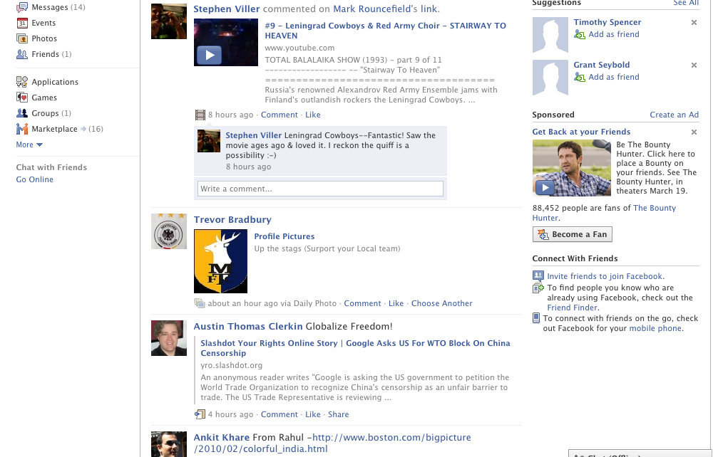
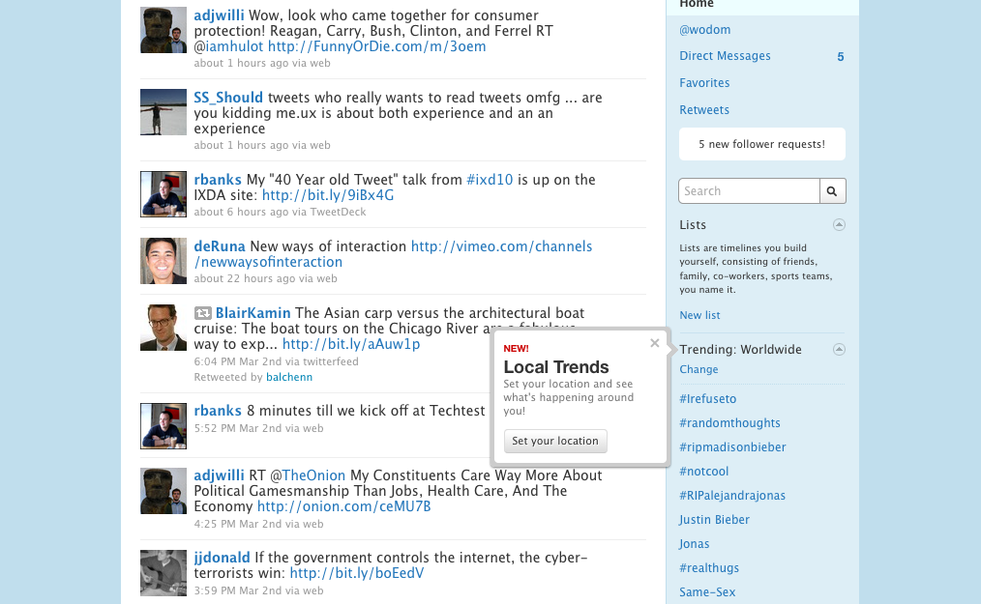
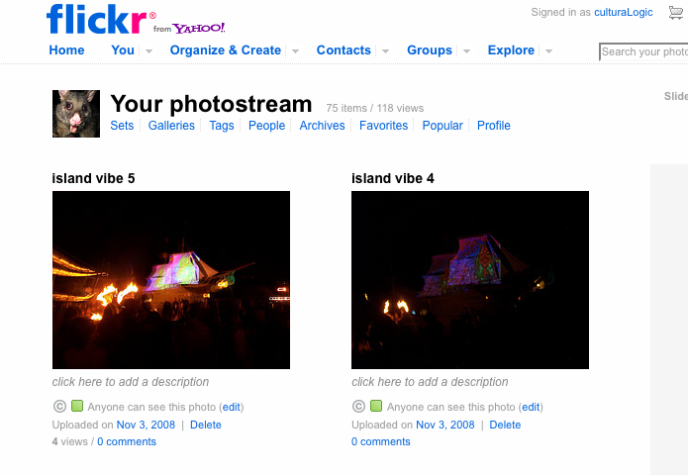
Notes:
And, second, they include new things that have never had a lasting material form, such as electronic messages including email, SMS, and status updates; social networking profiles; logs of personal behavior such as purchase histories,

Slide 7
little research has explored how people value and form
attachments to their virtual possessions
Notes:
To date, little research in the HCI community has explored how people construct value with and for attachments to their virtual possessions.

Slide 8
Notes:
The strong trend across social, cloud and mobile computing to make access to virtual possessions increasingly ubiquitous is starting to open up significant opportunities around designing systems that help people find value in their virtual possessions.

Slide 9
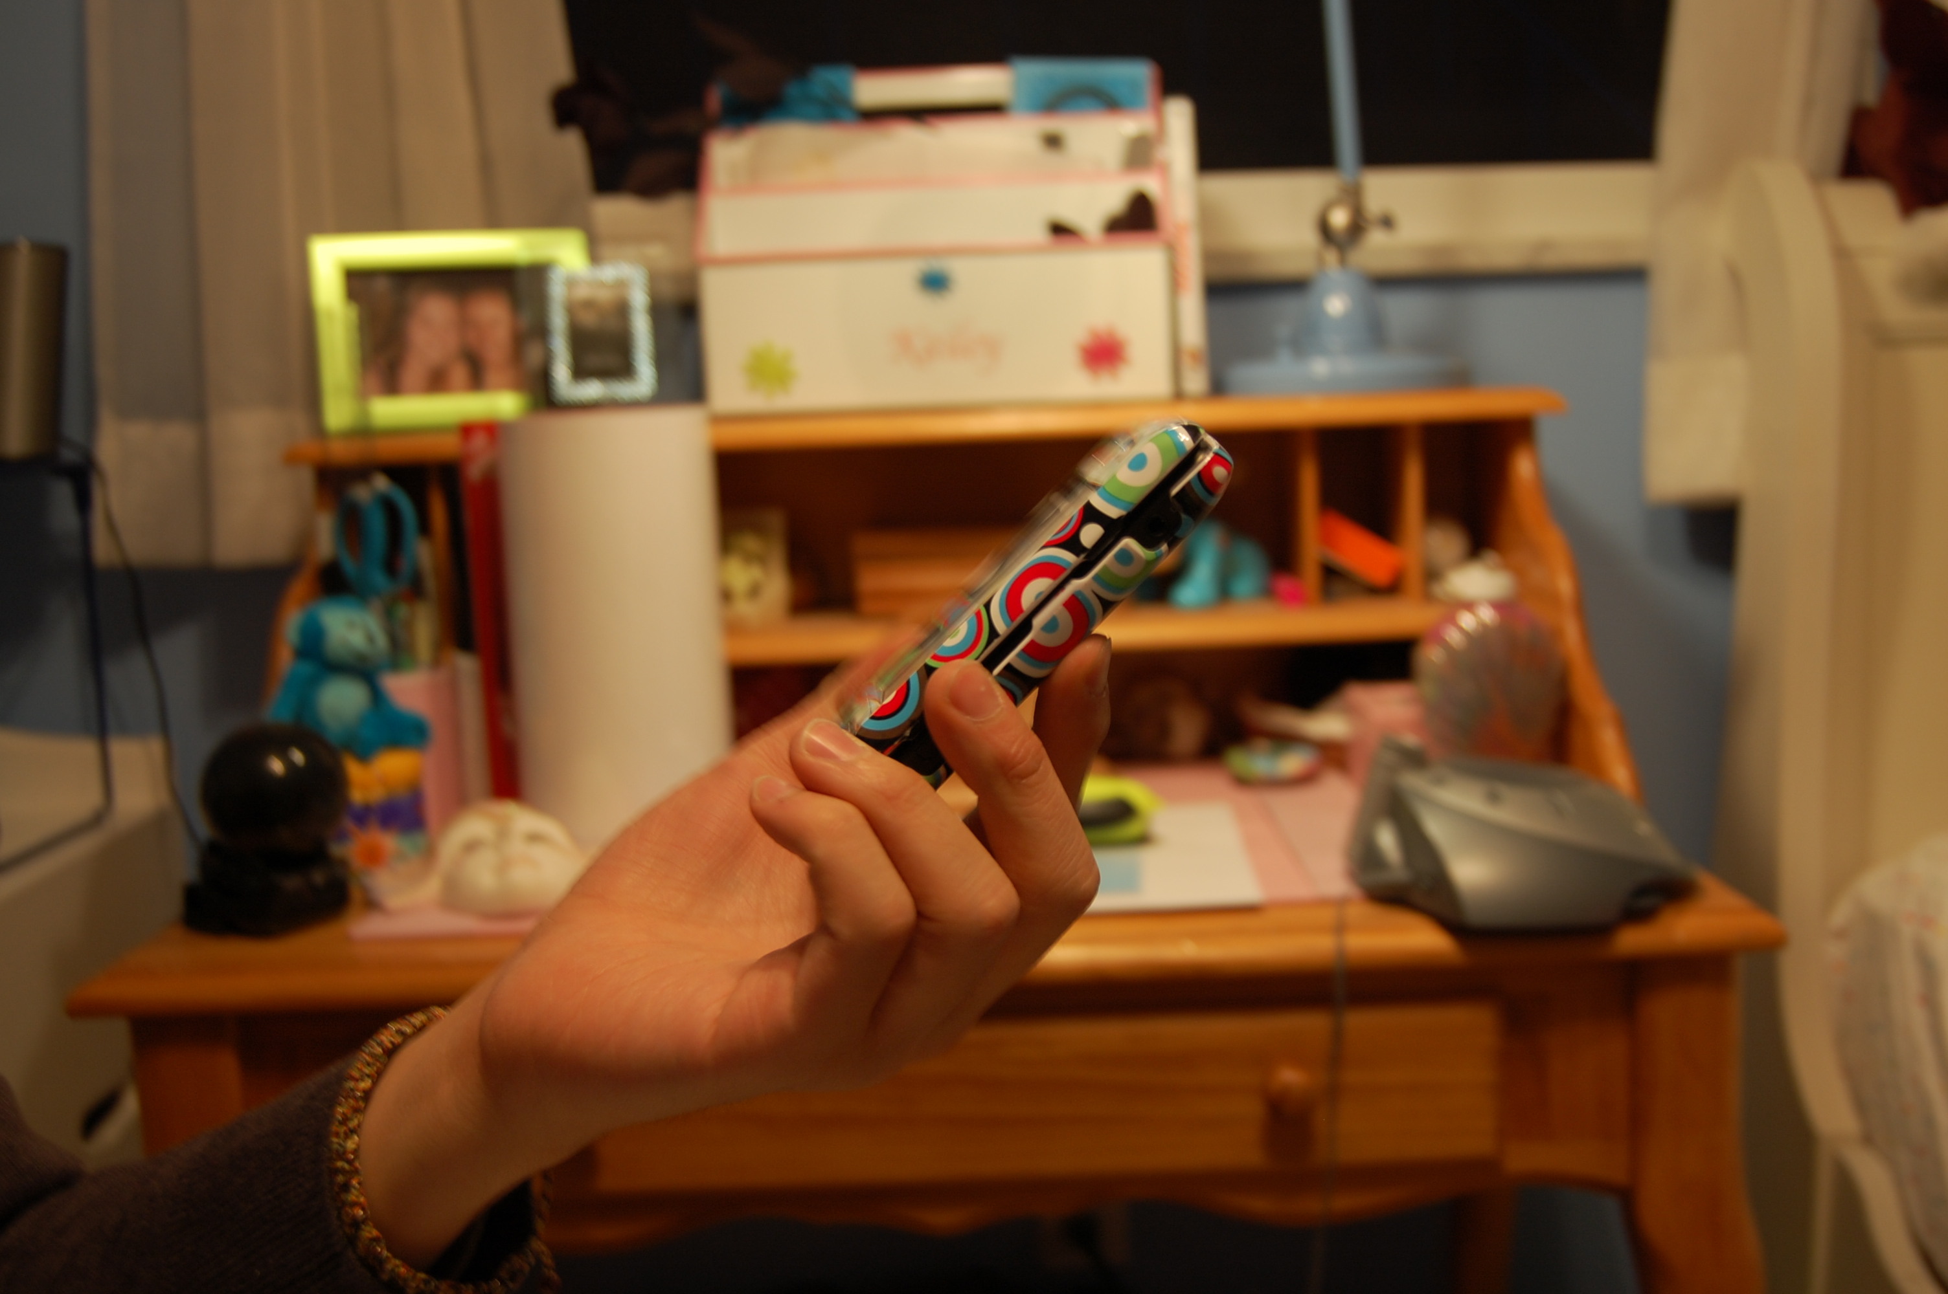
in depth interviews with 18 teenagers
what kinds of virtual things do they use?
how does value emerge with these kinds of possessions?
Notes:
To investigate this emerging design space, we conducted in depth interviews with 18 teens to explore what kinds of virtual things they use and the ways in which value is perceived to manifest in virtual things.

Slide 10
method
participants ages ranged from 12-16 years old; 7 female 11 male
1. heavily occupied in the process of constructing identity
2. engaged in digital media and online communication
3. actively define the behavior of digital products and services
William Odom, John Zimmerman, Jodi Forlizzi | Human-Computer Interaction Institute | Carnegie Mellon University
Notes:
on vanguard of social computing…

Slide 11
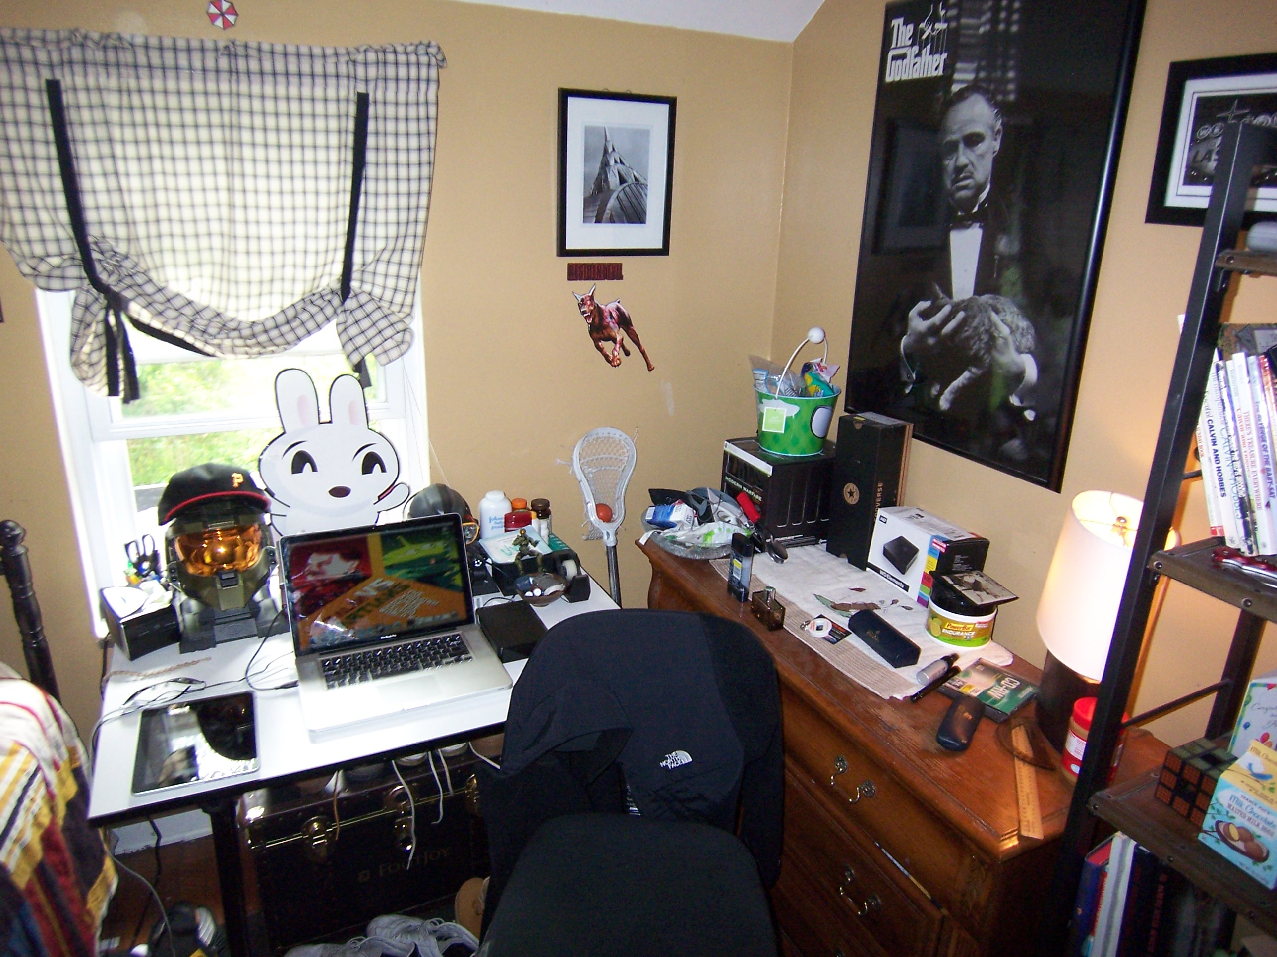
method
Notes:
Semi–structured interviews were conducted in teens’ bedrooms in order to observe their attachments to physical possessions, and to provide a basis of comparison to their virtual possessions. Participants would first give us a tour of their material possessions.

Slide 12
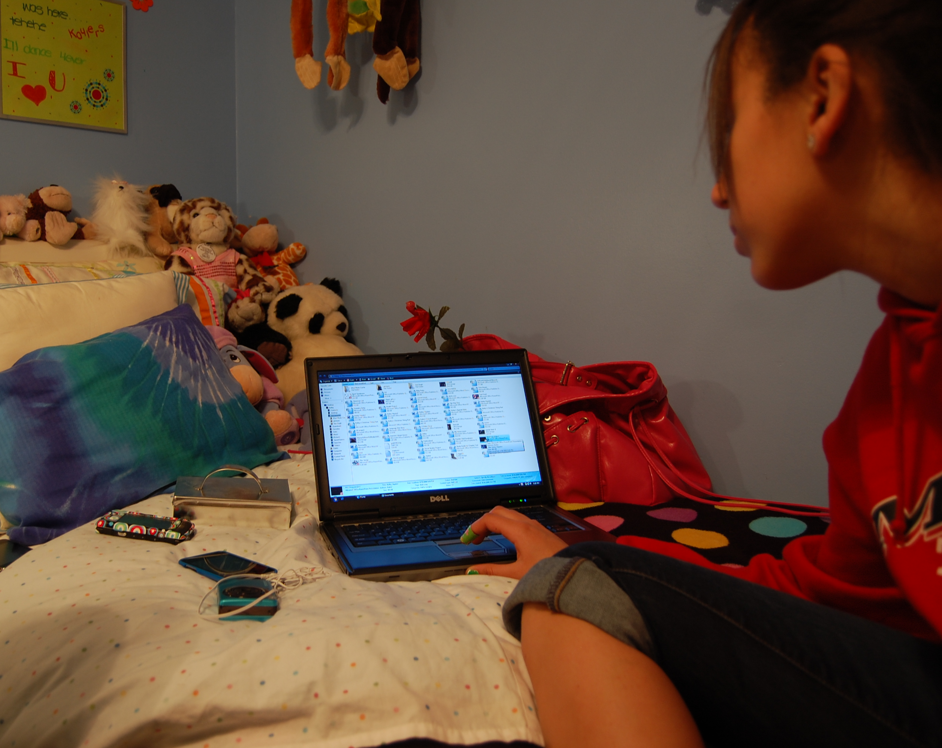
method
Notes:
This was followed by a tour of their virtual possessions, where we observed artifacts on their personal computer, phone, personal media devices, etc..

Slide 13
general findings
material possessions
photographs of family and friends
artifacts created by other friends (e.g. photo collages)
self-made artifacts (e.g. blown glass)
mementos owing to various trips
objects symbolic of achievement (e.g. framed academic or sporting awards)
William Odom, John Zimmerman, Jodi Forlizzi | Human-Computer Interaction Institute | Carnegie Mellon University
Notes:
Interviews and observations in children’s bedrooms revealed a range of material possessions valued as deeply significant. A sample of these included…

Slide 14
general findings
virtual possessions
several years worth of homework assignments
blog entries
social media data (e.g. status messages, chat logs, comments)
SMS messages
artworks
music
photos
William Odom, John Zimmerman, Jodi Forlizzi | Human-Computer Interaction Institute | Carnegie Mellon University
Notes:
Discussions with participants revealed diverse collections of virtual possessions. A sample of these kinds of things included…Now I am going to give a very brief overview of 3 thematic areas that came out in our findings…

Slide 15
expressive storage of virtual possessions
findings
drive to make virtual possessions immediately accessible
constraining storage to devices complicated this goal
strong trend toward storage on cloud computing servers
transition from local to cloud computing-based storage
William Odom, John Zimmerman, Jodi Forlizzi | Human-Computer Interaction Institute | Carnegie Mellon University
Notes:
Our observations highlighted a key shift in file storage and management practices.
overarching drive among participants to make virtual possessions immediately accessible
constraining storage to devices complicated this goal
all participants exhibited strong trend toward storage on cloud computing servers
transition from folder-based local storage to storage across cloud computing service

Slide 16
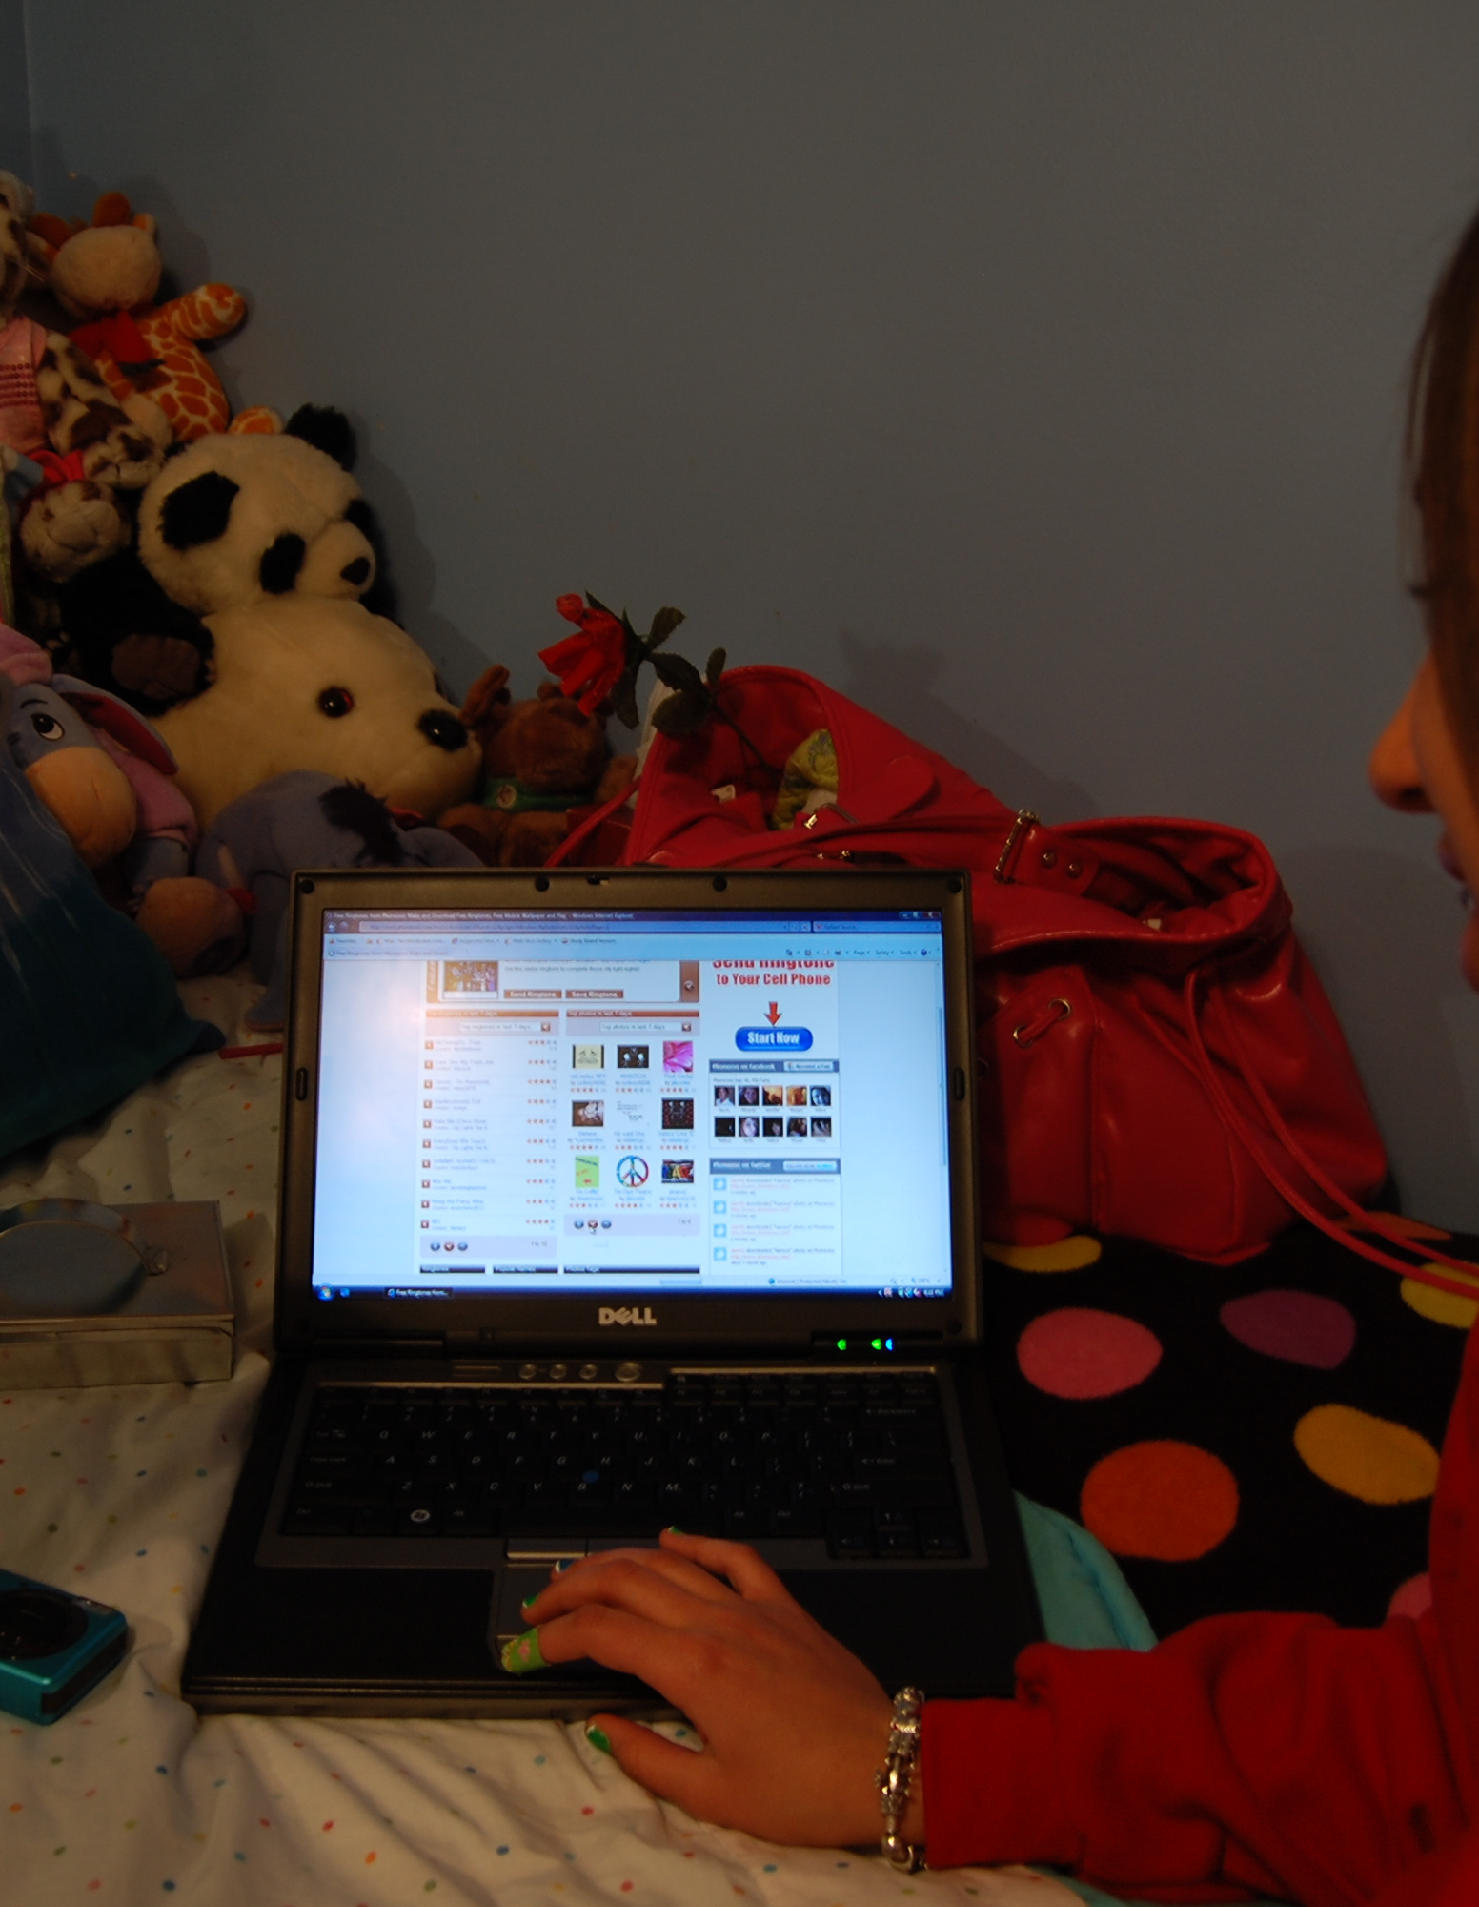
expressive storage of virtual possessions
photos uploaded to Facebook often immediately after social
findings
event often without placing on local drive
overarching drive among participants to make virtual possessions immediately accessible
constraining storage to devices complicated this goal
all participants exhibited strong trend toward storage on cloud computing servers
majority of participants had 1-4 years worth of photos
stored online through social networking services
Notes:
For example, photos were uploaded to Facebook directly, often without placing them on a local hard drive. The majority of our participants had 1-4 years worth of photos stored online through social networking services.

Slide 17
expressive storage of virtual possessions
findings
virtual possessions take on new qualities when stored in the cloud overtime
archives of homework and diary entries remained untouched
photos and social networking profiles accrued new value
William Odom, John Zimmerman, Jodi Forlizzi | Human-Computer Interaction Institute | Carnegie Mellon University
Notes:
Virtual possessions take on new qualities when stored in the cloud overtime archives of homework and diary entries remained untouched possessions like photos and social networking profiles accrued new value through comments and other social attributions. However notification of this changing status and state was crude at best.

Slide 18
expressive storage of virtual possessions
design opportunities
need to design mobile technology that makes it easier to upload to a more diversified range of cloud computing services
William Odom, John Zimmerman, Jodi Forlizzi | Human-Computer Interaction Institute | Carnegie Mellon University
Notes:
These findings suggest several design opportunities. One one hand, there is a general need to design mobile technology.. Need to design mobile technology that makes it easier to upload to a more diversified range of cloud computing services

Slide 19
expressive storage of virtual possessions
design opportunities
need to design mobile technology that makes it easier to upload to a more diversified range of cloud computing services
visualizing ongoing social histories accrued by virtual possessions
William Odom, John Zimmerman, Jodi Forlizzi | Human-Computer Interaction Institute | Carnegie Mellon University
Notes:
Designing systems that more expressively visualize ongoing social histories accrued by virtual possessions over time.

Slide 20
dynamic presentations of self
findings
material possessions present in the bedroom shifted depending on audience
with peers possessions relating to popular culture
with parents, possessions relating to personal achievement
William Odom, John Zimmerman, Jodi Forlizzi | Human-Computer Interaction Institute | Carnegie Mellon University
Notes:
material possessions present in the bedroom shifted depending on audience
with peers possessions relating to popular culture; e.g. music, magazine, movies consumed and discussed
with parents, possessions relating to personal achievement (e.g. framed awards) or photos/mementos owning to familial events

Slide 21
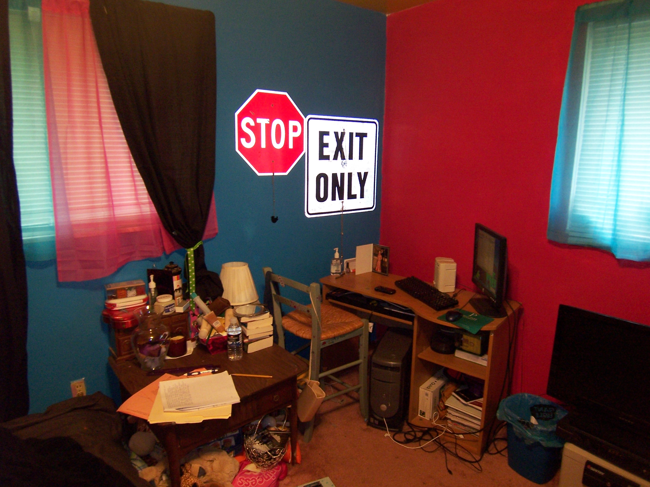
Notes:
While the bedroom was a key site for identity experimentation, it at times conflicted with the broader moral structure of the home. For example, several participants remarked being unable to display posters or artworks considered by their parents to conflict with family rules and values.

Slide 22
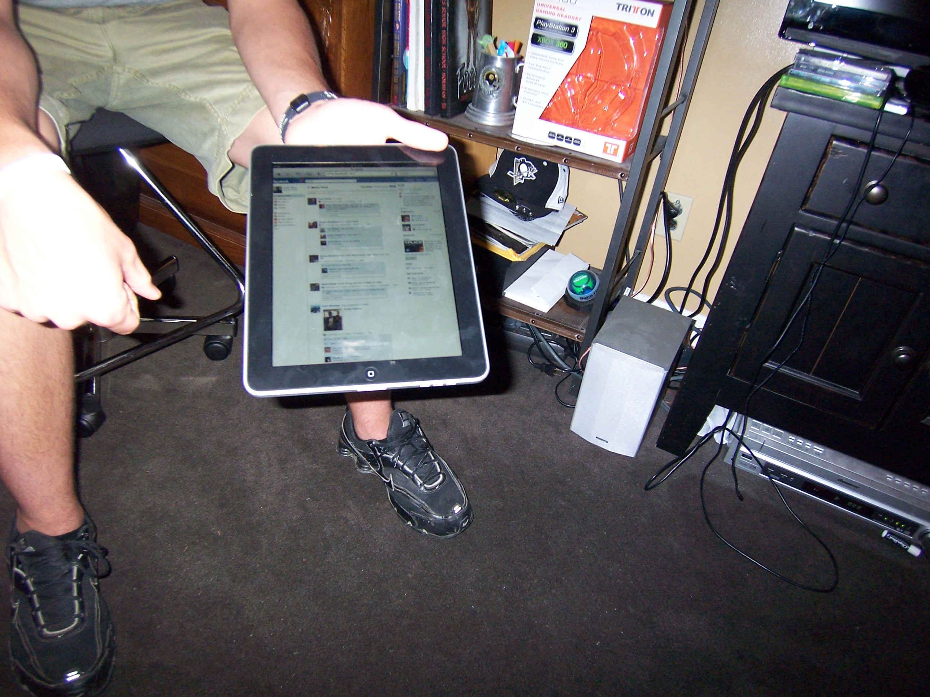
Notes:
Interestingly, personal pages on social networking sites appeared to represent the first places in which participants had total control over expressing their identity. It was apparent participants were experimenting with crafting and presenting multiple selves to different audiences through presentation of virtual possessions.

Slide 23
privacy settings changed to make only certain types of
possessions viewable to certain audiences
presentation of possessions tailored to social groups
Notes:
For example, privacy settings were changed to make only certain types of possessions viewable to certain audiences. And, as a result, the ways these things were framed and described were tailored to these particular social groups.

Slide 24
problems emerged when possessions were projected to
social groups beyond the ones they were intended for
resulted in users disassociating themselves from possessions
or permanently destroying them
Notes:
However, across our interviews, problems had arisen for participants when possessions reflecting aspects of their lives they intended to share with only a specific group were publicly projected to everyone in their network. This resulted in users disassociating themselves from possessions like photos or in some cases permanently destroying them.

Slide 25
dynamic presentations of self
findings
management of virtual possessions in online places offered opportunities to support creative experimentation with self
access privileges enable virtual possessions to be drawn in relation and presented to particular audiences
William Odom, John Zimmerman, Jodi Forlizzi | Human-Computer Interaction Institute | Carnegie Mellon University
Notes:
These insights highlight how the management of virtual possessions in online places offers opportunities to support creative experimentation with one’s sense of self. And, how access privileges afford virtual possessions with a unique quality to be drawn in relation and presented to particular audiences.

Slide 26
dynamic presentations of self
design opportunities
enable end users to create multiple displays self to be presented to different audiences
lead to assemblies of virtual possessions that project more socially appropriate aspects of self to particular audiences
William Odom, John Zimmerman, Jodi Forlizzi | Human-Computer Interaction Institute | Carnegie Mellon University
Notes:
Current tools people use to manage online privacy rites are deeply underdeveloped. This suggests major opportunities…
1. enable end users to create multiple displays of self to be presented different audiences
2. lead to assemblies of virtual possessions that project more socially appropriate aspects of self to particular audiences
…Such a system could take on greater significance as notions of one’s self expands and evolves over time.

Slide 27
leveraging virtual & material places
findings
key factor differentiating virtual from material is a lack of enduring physical presence
William Odom, John Zimmerman, Jodi Forlizzi | Human-Computer Interaction Institute | Carnegie Mellon University
Notes:
A key factor differentiating virtual possessions from material ones was a lack of enduring physical presence.

Slide 28
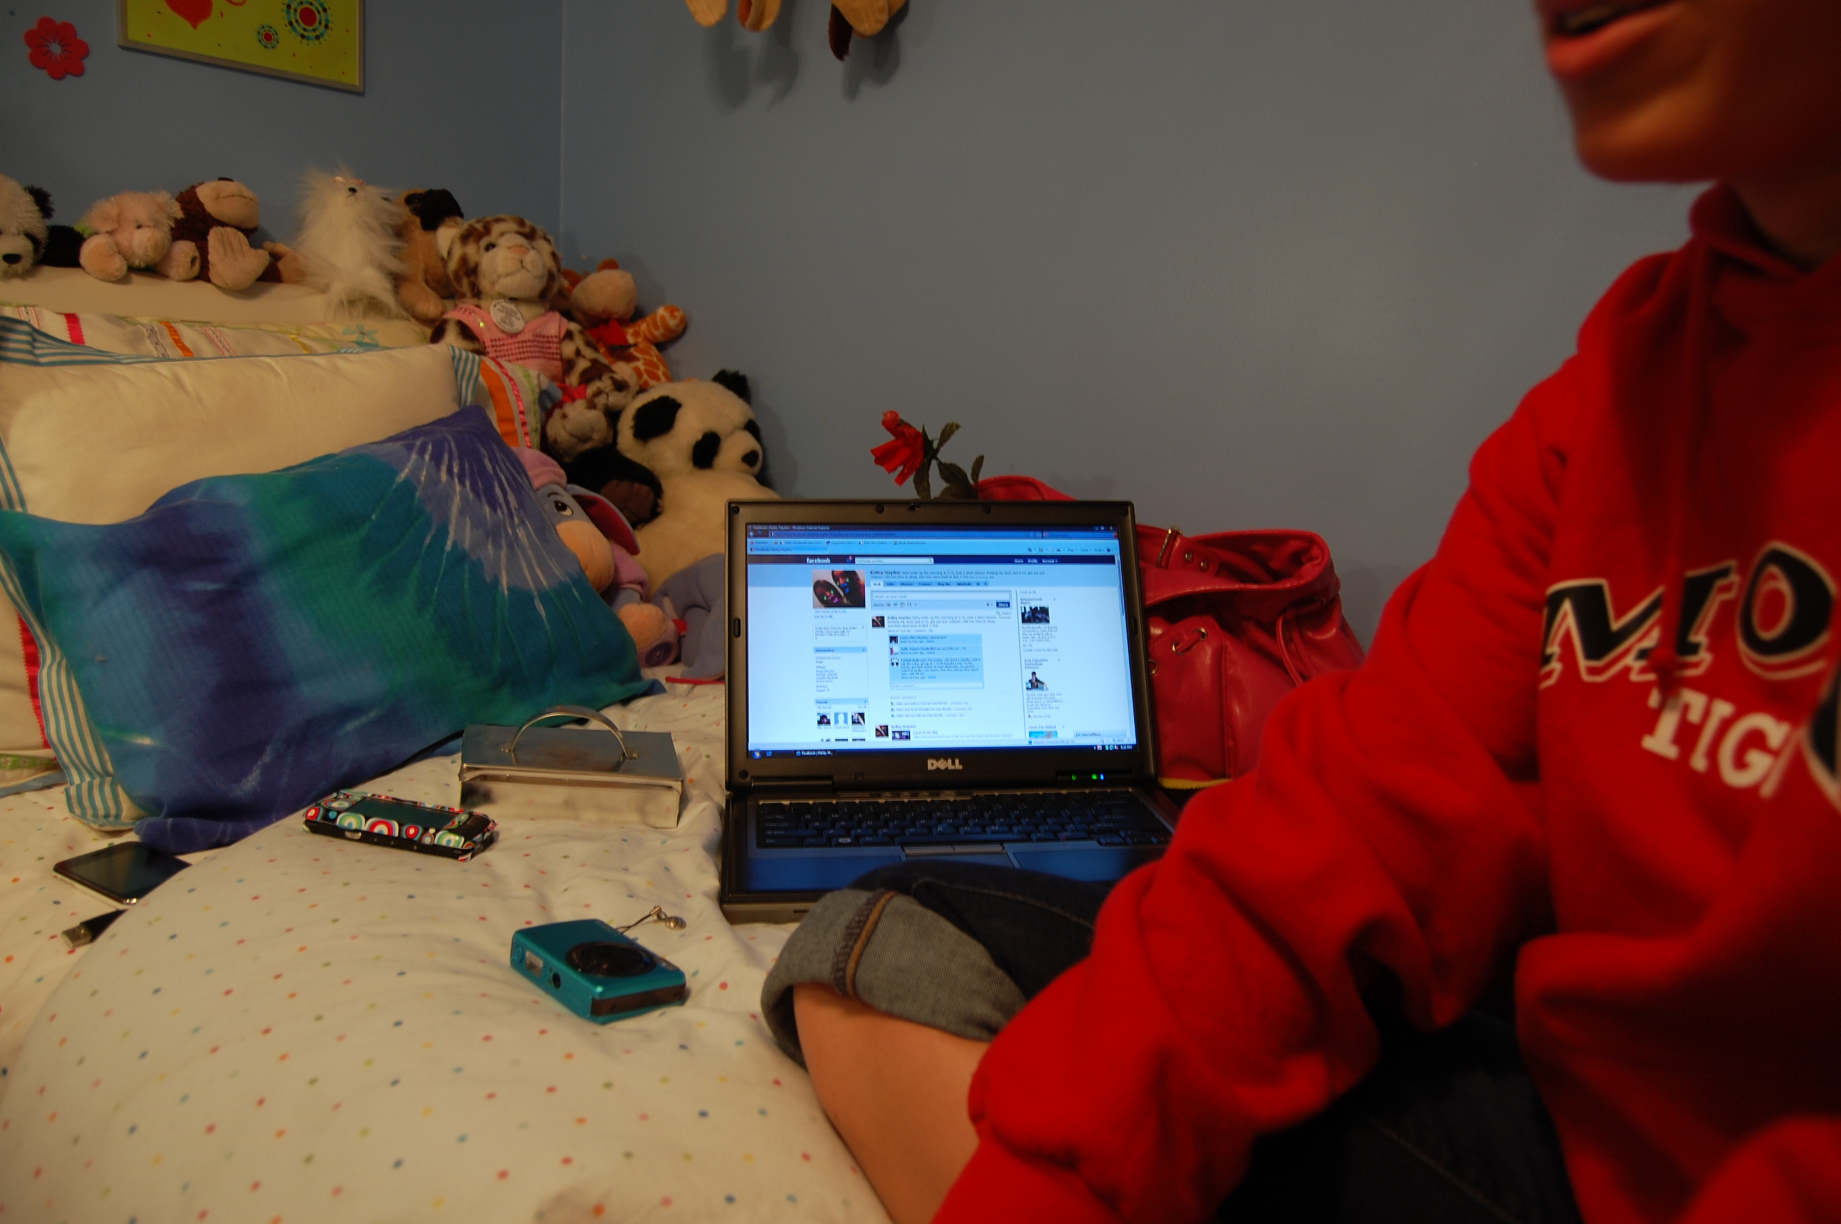
leveraging virtual & material places
to compensate participants kept their computers and phones
findings
always on, logged into and updating social media streams
key factor differentiating virtual possessions from material ones is a lack of enduring physical presence
embedded a persistent presence among other bedroom artifacts
battery life, screen size, shared use complicated these efforts
Notes:
One way participants compensated for this was by keeping their computers and mobile phones always on, logged into, and updating social networking media streams. This embedded a persistent presence of virtual possessions among other bedroom artifacts, and highlighted a desire to break down the barrier between the physical and virtual worlds.
However, limitations such as battery life, screen size, shared use, and other technical issues complicated these efforts.

Slide 29
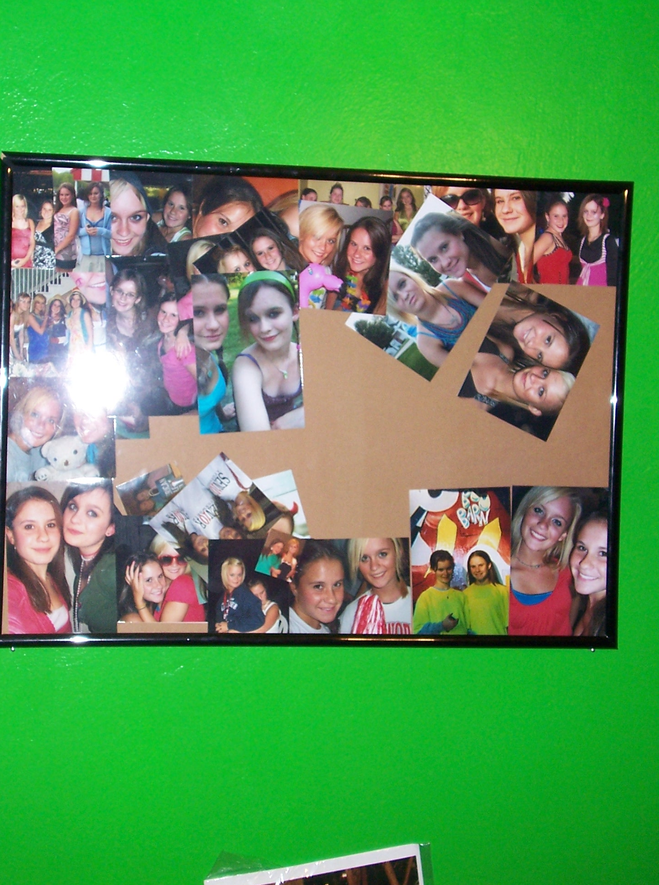
printing and displaying photos from Facebook was common
strategy to make virtual possessions present
Notes:
We also observed instances in which participants integrated virtual possessions in their bedroom by printing and displaying them. For example, we observed several participants had printed out treasured photographs and metadata from Facebook.

Slide 30
printing and displaying photos from Facebook was common
strategy to make virtual possessions present
virtual-made-material possessions focal points for reminisce
over shared experiences
Notes:
These virtual-made-material possessions often served as focal points for conversation and collective reminisce over shared experiences when in the presence of other friends in the bedroom

Slide 31
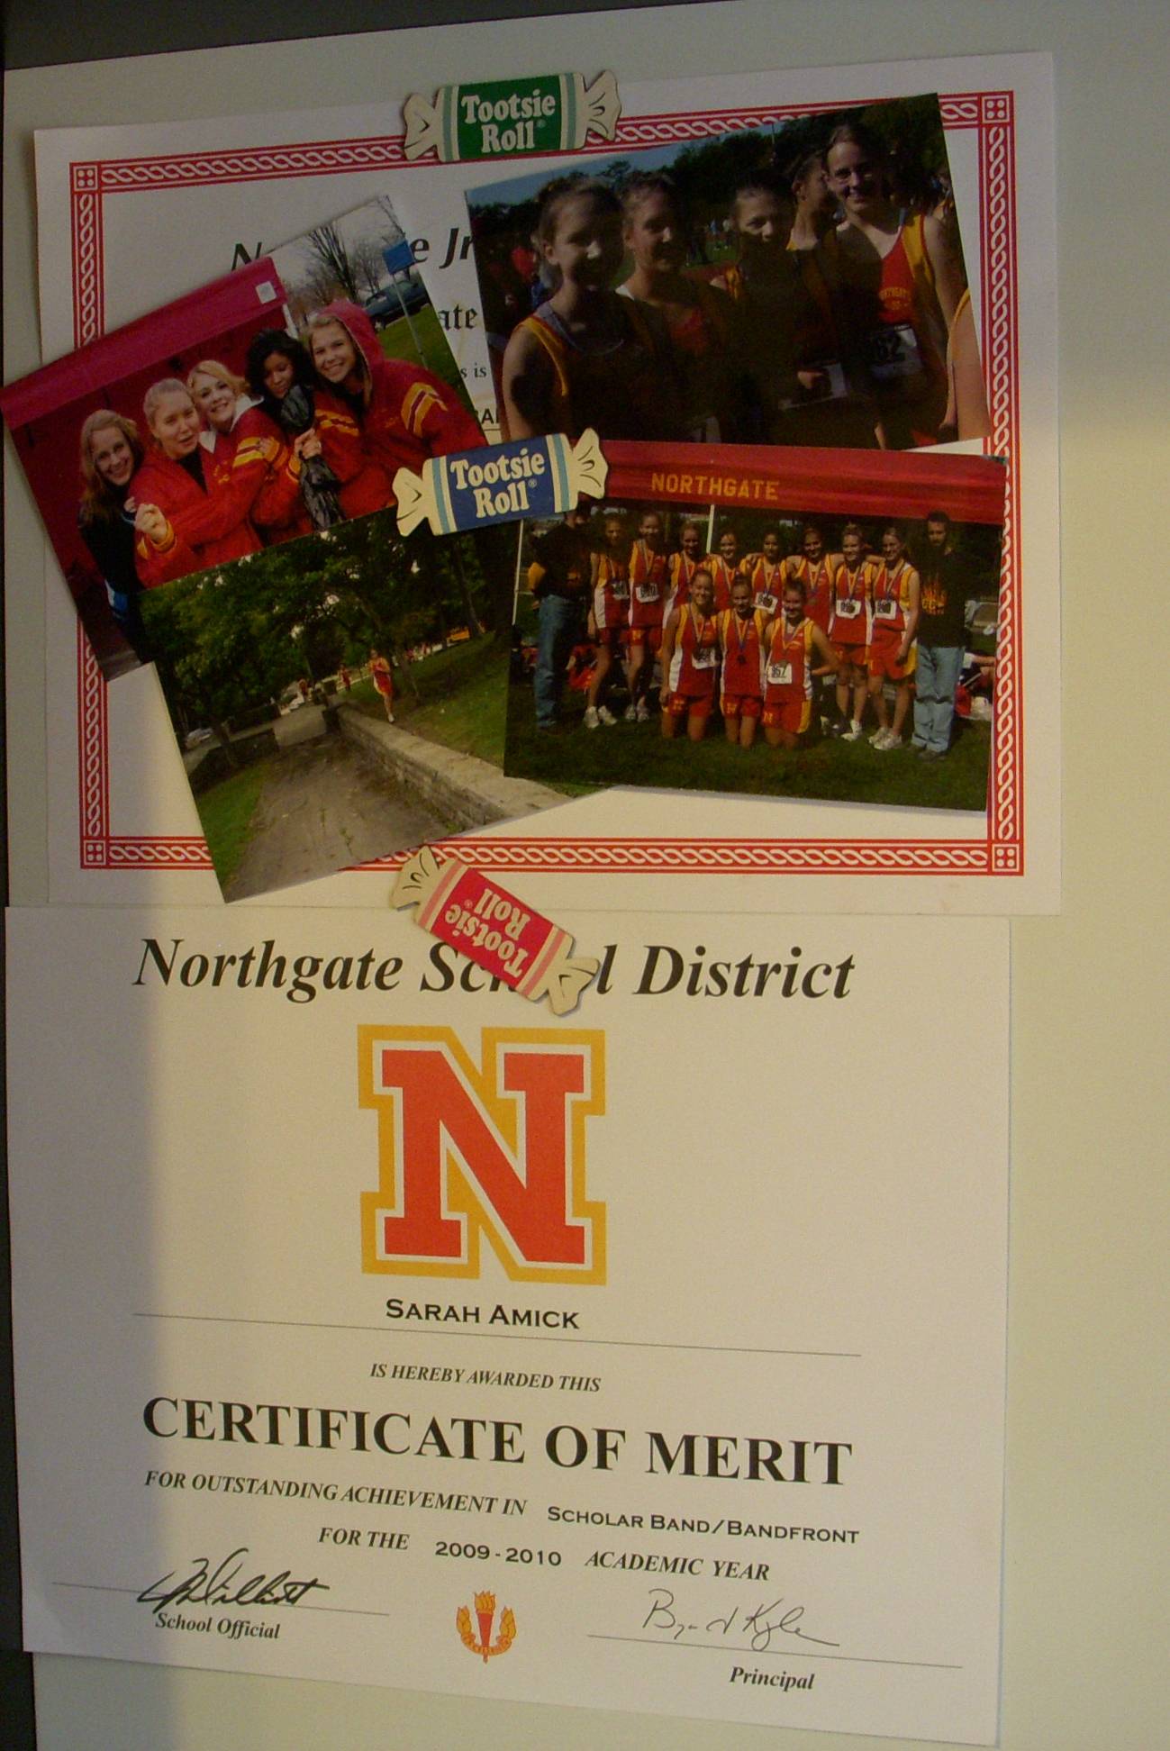
Notes:
Conversely, we also observed participants making digital copies of material possessions. Like this certificate and hand drawn sketch…

Slide 32
these material-made-virtual possessions were projected from
bedroom to broader social audiences
inscribed meaningful and unique social record of metadata
into collections in online places
Notes:
These material things were constrained to the bedroom. When virtualized, they were projected to online places where they often acquired new value through socially constructed metadata being attributed to them.

Slide 33
leveraging virtual & material places
findings
materialization and presence of chat logs, status updates and photos opened space for reflection on life experiences
projection of material-made-virtual possessions into online places opened space for new socially constructed value
William Odom, John Zimmerman, Jodi Forlizzi | Human-Computer Interaction Institute | Carnegie Mellon University
Notes:
These illustrate how value emerges as possessions move between material and virtual places. On one hand, …

Slide 34
leveraging virtual & material places
design opportunities
amplifying material presence of virtual possessions in way more rich, enduring and dynamic
collaboratively attribute metadata to archives of virtual possessions as their meaning and value grows over time
William Odom, John Zimmerman, Jodi Forlizzi | Human-Computer Interaction Institute | Carnegie Mellon University
Notes:
These instances all seem to suggest…There are much larger opportunities to design systems that amplify the material presence of virtual possessions in way more rich, enduring and dynamic.
As well as, opportunities to support collaborative development of socially constructed metadata to archives of virtual possessions as their meaning and value grows over time

Slide 35
future work
expressive storage of virtual possessions
dynamic presentations of self
movement between virtual and material places
William Odom, John Zimmerman, Jodi Forlizzi | Human-Computer Interaction Institute | Carnegie Mellon University
Notes:
In future work, we plan to develop prototypes based on these opportunity areas to critically explore future systems aimed at engaging people with their virtual possessions in more valuable, and ultimately meaningful, ways.

Slide 36
acknowledgments
this work is partly supported by
Hajin Choi, Lee Hillman, James Liu, Kami Neumiller, Amritha Prasad, Aditya Sharma, and Alena Tesone for their assistance in data collection.
William Odom, John Zimmerman, Jodi Forlizzi | Human-Computer Interaction Institute | Carnegie Mellon University

Slide 37
Virtual Possessions
William Odom, John Zimmerman, Jodi Forlizzi
Carnegie Mellon University

Slide 39
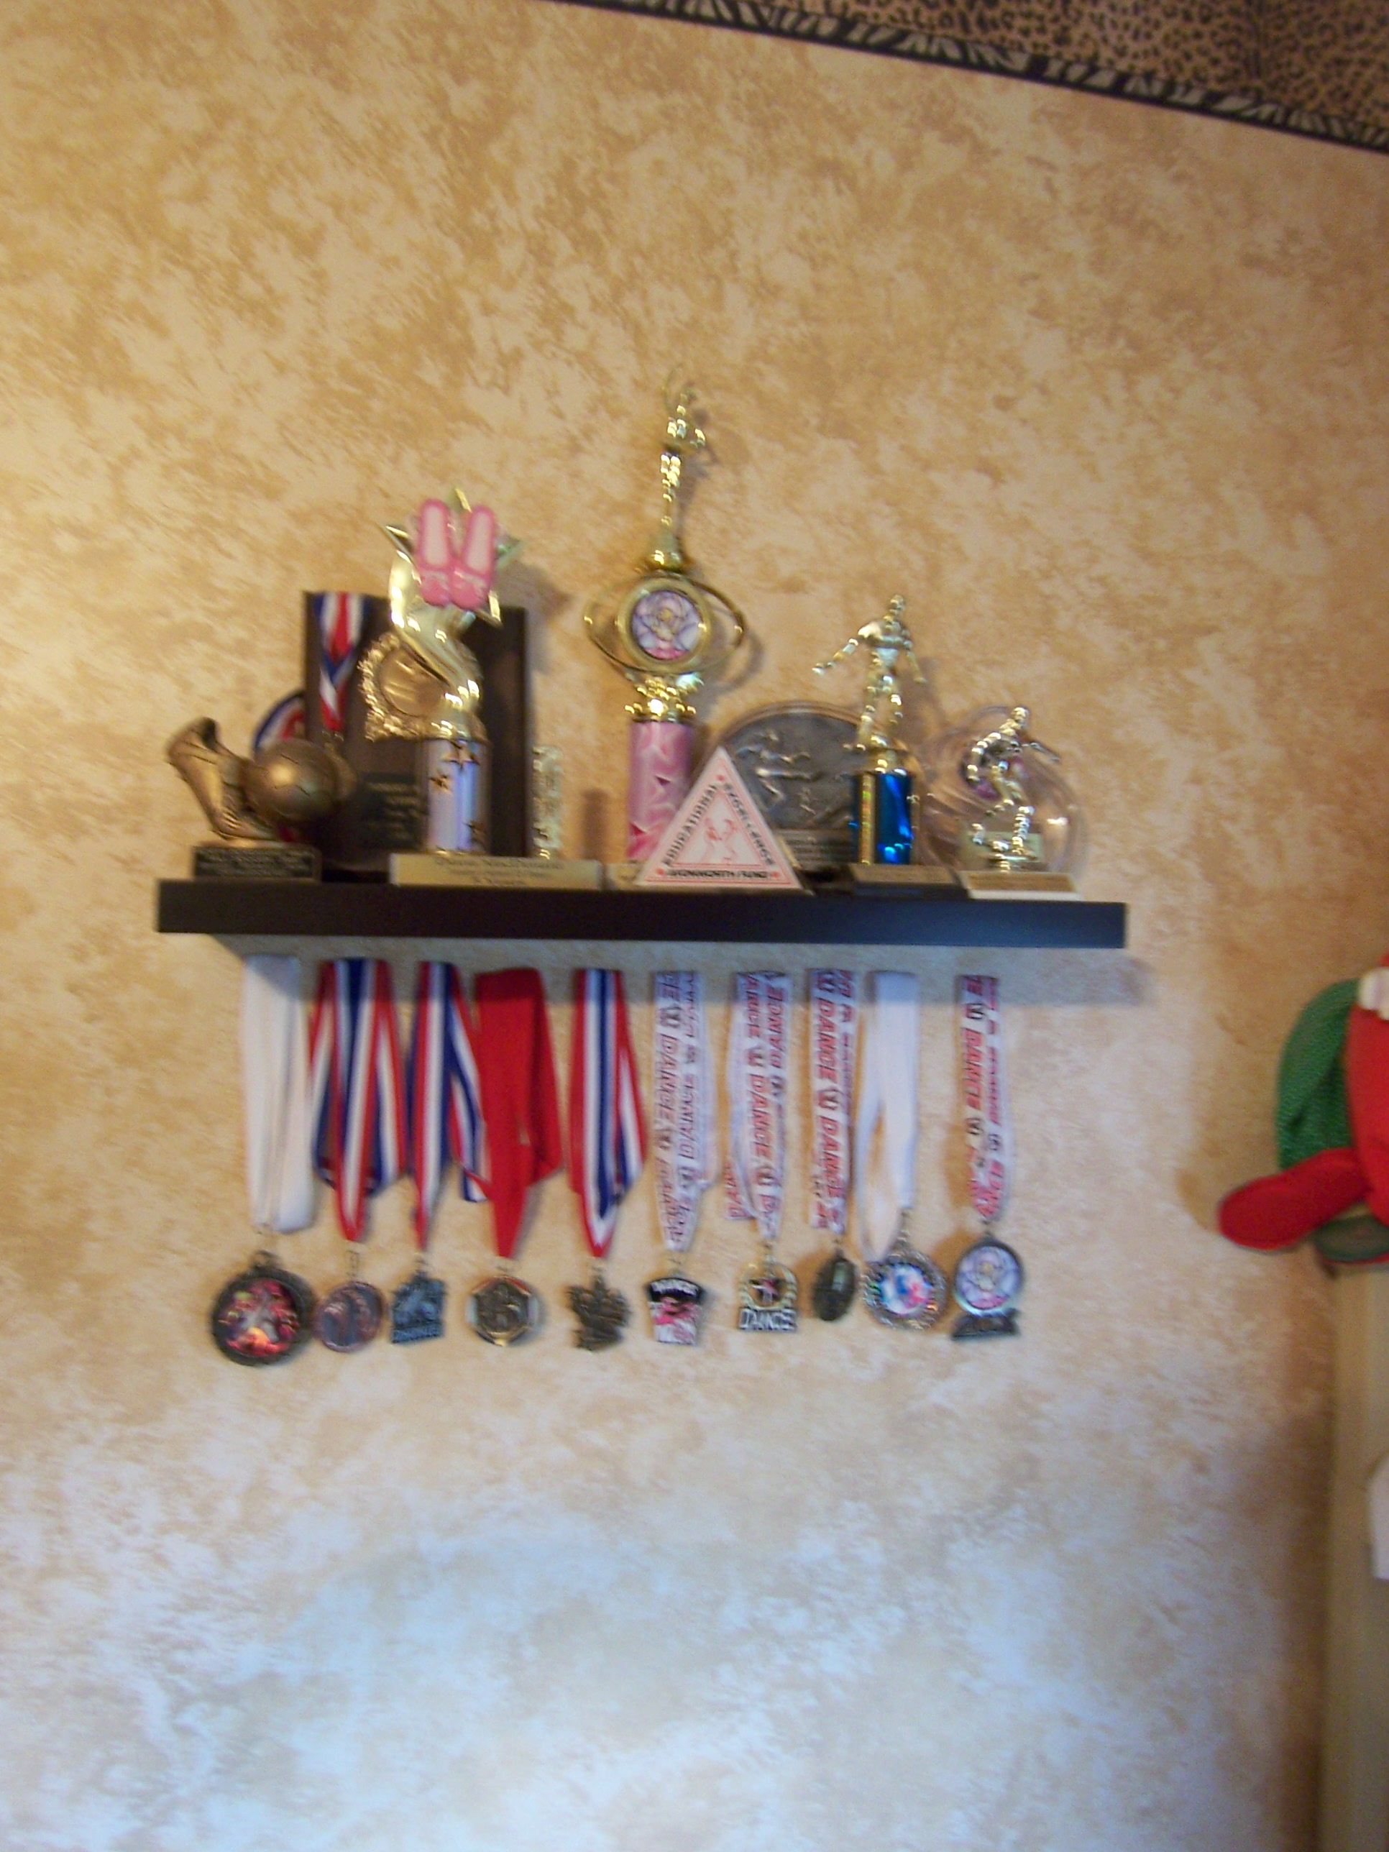
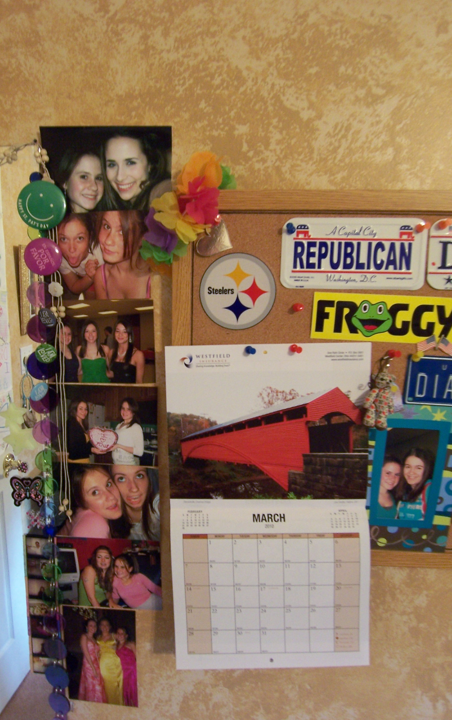
Notes:
Teens surround themselves with precious possessions, representing a material infrastructure where they can experiment with their identity through their display of self to their parents and friends [1]. One important activity for teens is access and display of media such as music, movies, celebrities, etc., as a way of authoring their space and communicating values and desires

