Slide 1
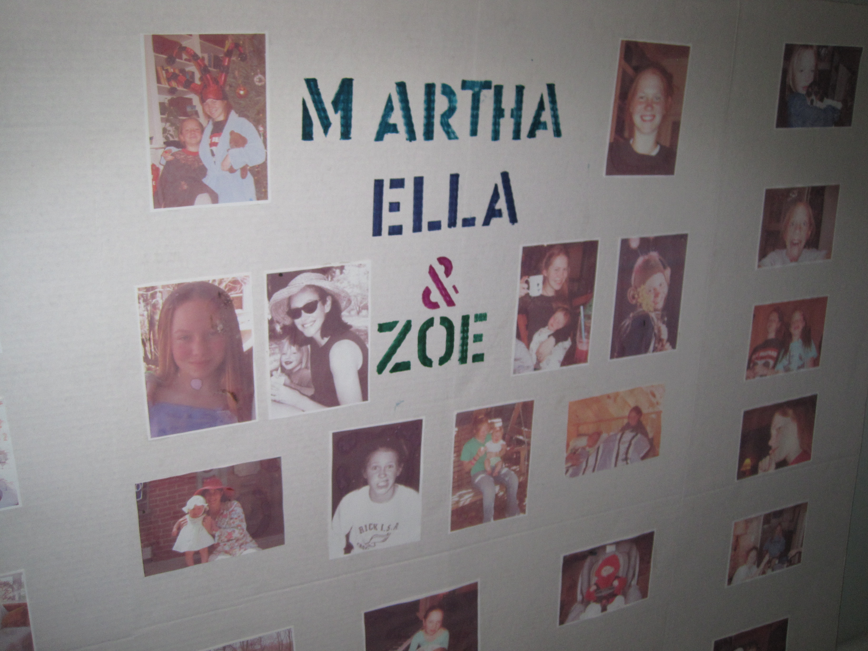
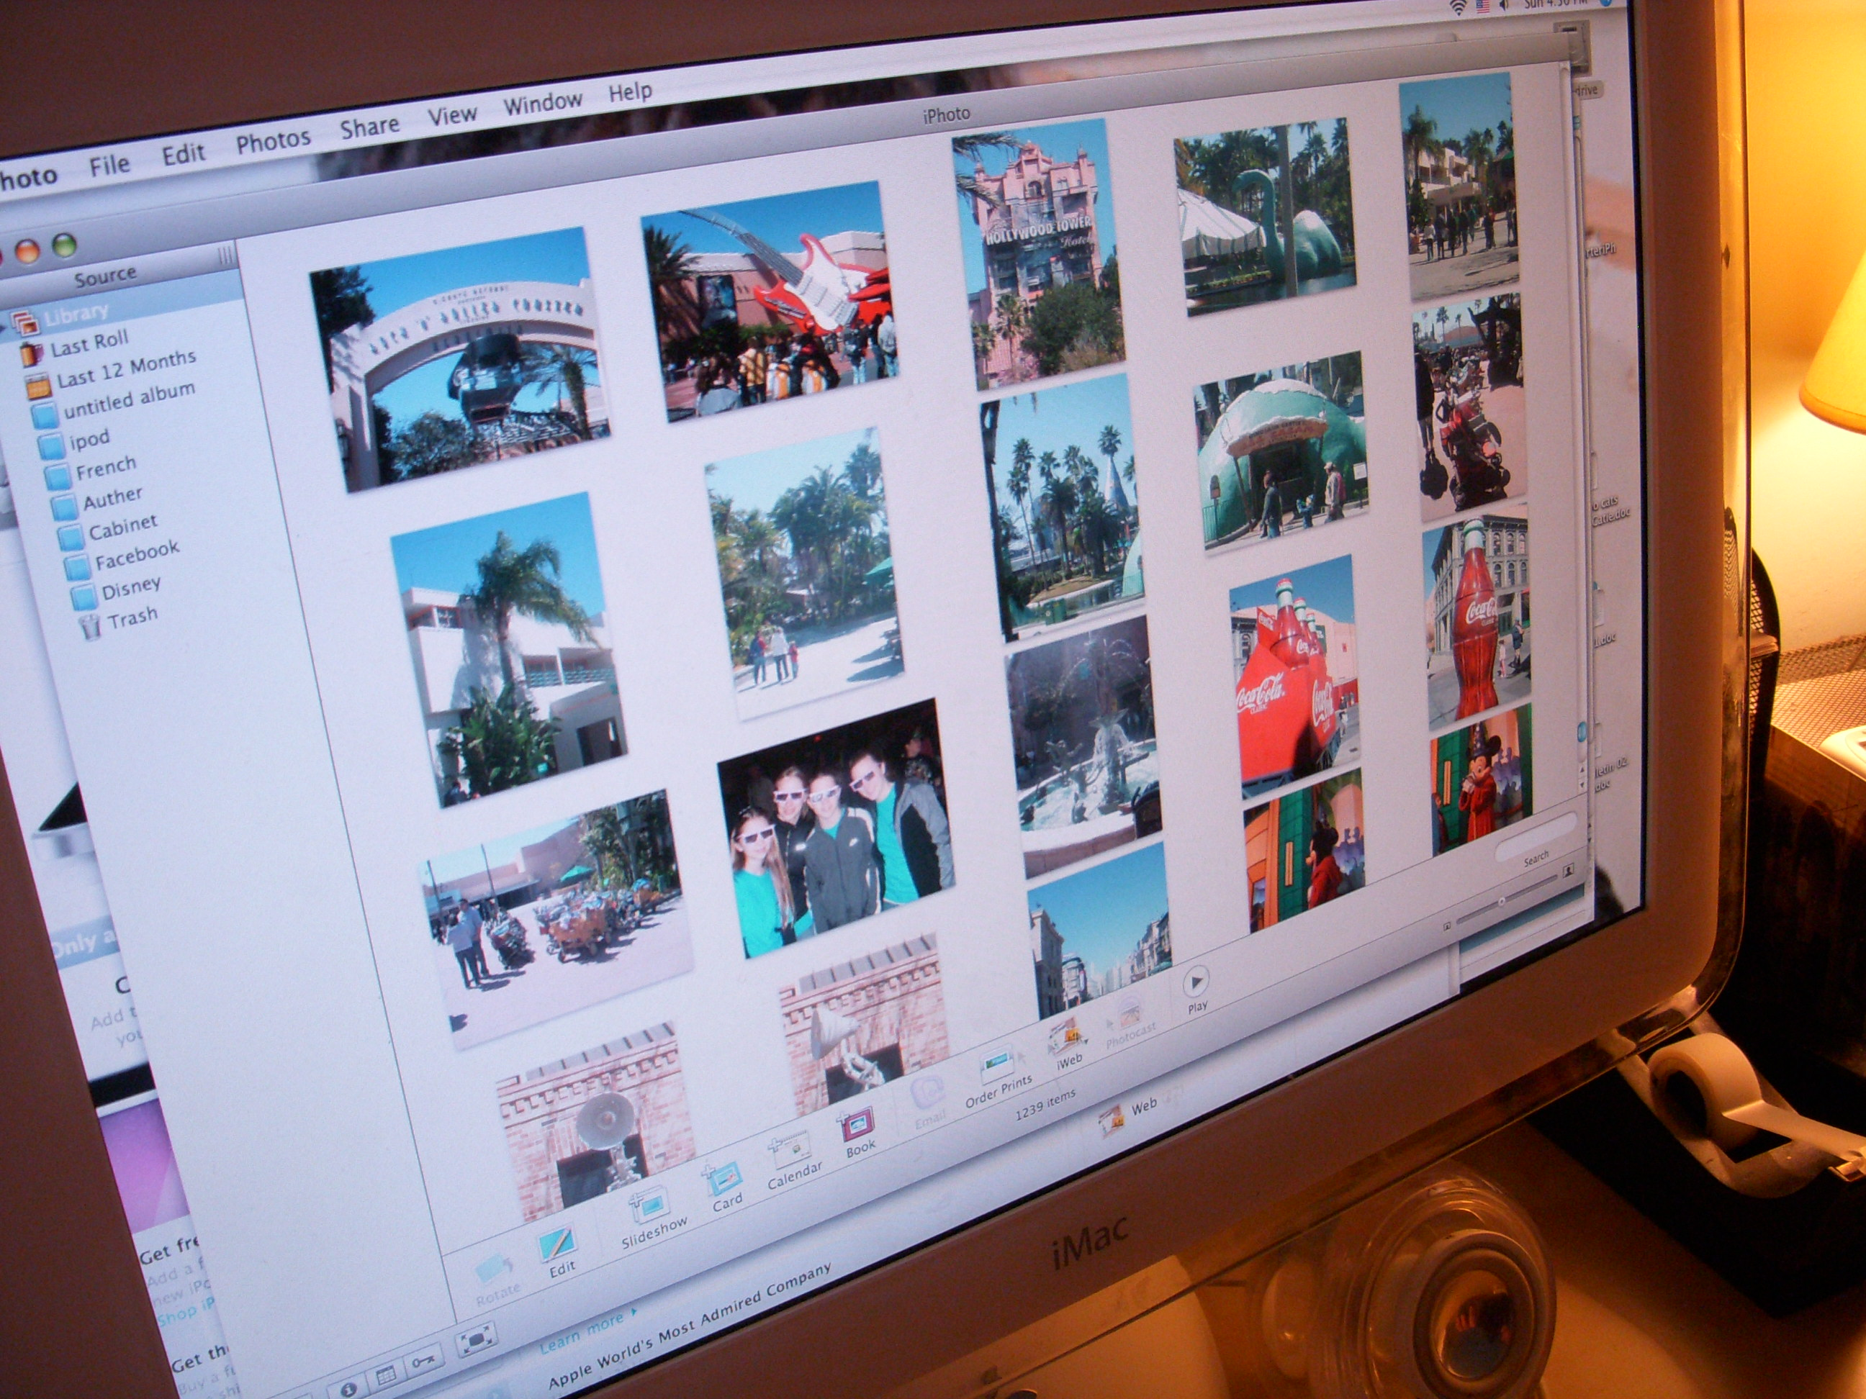
Teenagers and Their Virtual Possessions: Design Opportunities and Issues
William Odom, John Zimmerman, Jodi Forlizzi
Human-Computer Interaction Institute
Carnegie Mellon University
William Odom, John Zimmerman, Jodi Forlizzi | Human-Computer Interaction Institute | Carnegie Mellon University

Slide 2
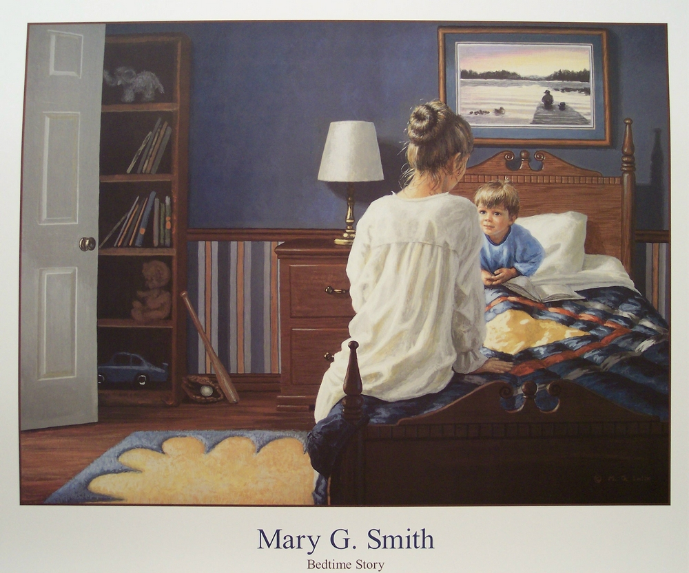
Notes:
Many parents confess a strong attachment to the books they read to their children, often holding onto them long after their children have left home.

Slide 3
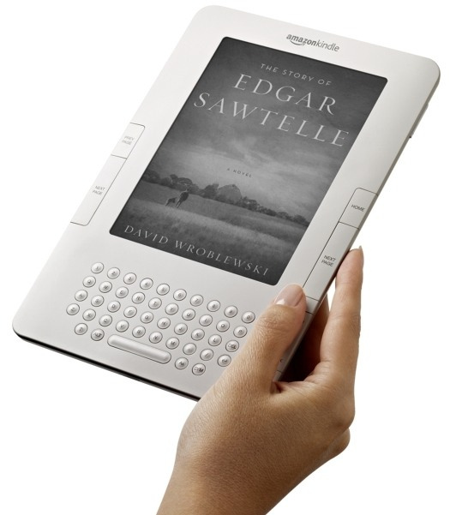
Notes:
If e-readers replace physical books, will parents who read digital stories to their children instead develop an attachment to a particular device or digital file?

Slide 4
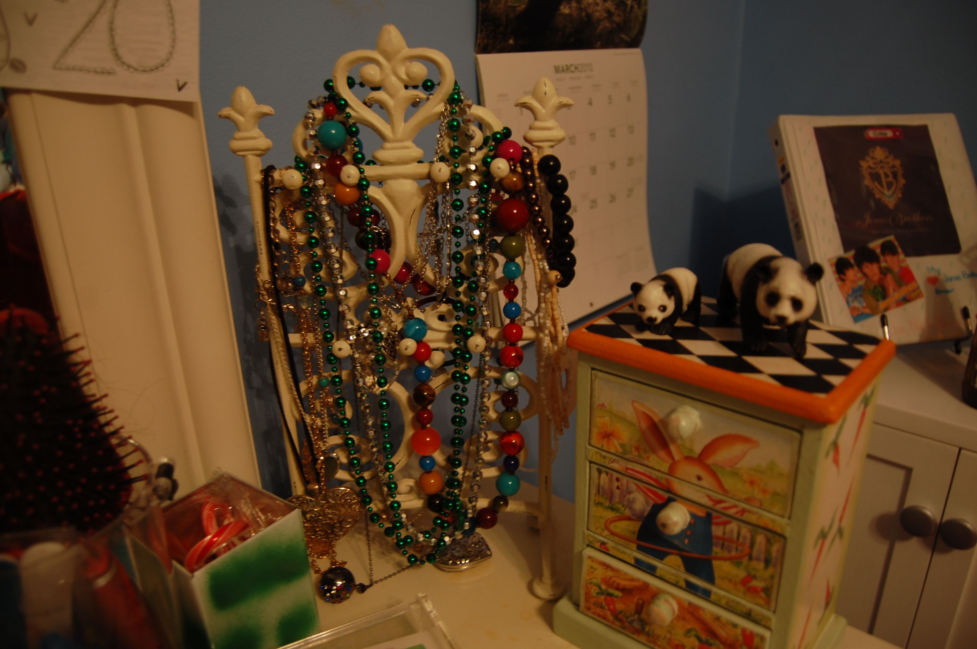
William Odom, John Zimmerman, Jodi Forlizzi | Human-Computer Interaction Institute | Carnegie Mellon University
Notes:
For over a hundred years researchers across many disciplines have investigated the significance of people’s material possessions

Slide 5
William Odom, John Zimmerman, Jodi Forlizzi | Human-Computer Interaction Institute | Carnegie Mellon University
Notes:
Much of this research maps how people develop attachments to their material possessions as they create and evolve a sense of self.

Slide 6
William Odom, John Zimmerman, Jodi Forlizzi | Human-Computer Interaction Institute | Carnegie Mellon University
Notes:
For the last several years, people have increasingly acquired virtual possessions.

Slide 7
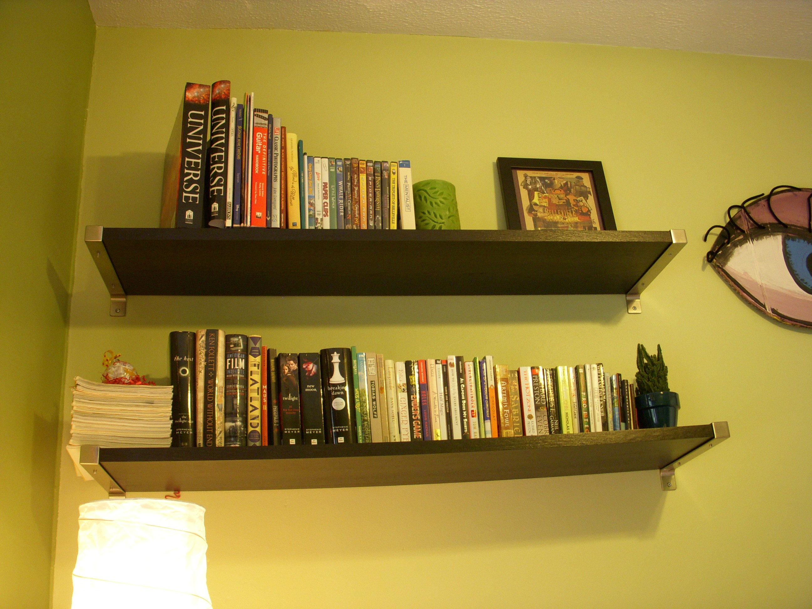
William Odom, John Zimmerman, Jodi Forlizzi | Human-Computer Interaction Institute | Carnegie Mellon University
Notes:
These new possessions have two origins. On one hand, they include things that were traditionally material, such as books, photos, and money.

Slide 8
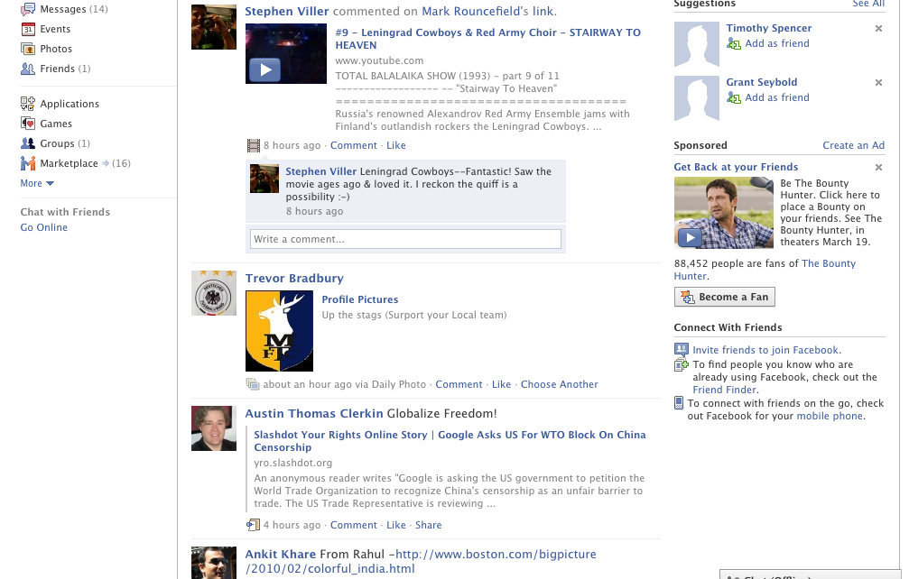
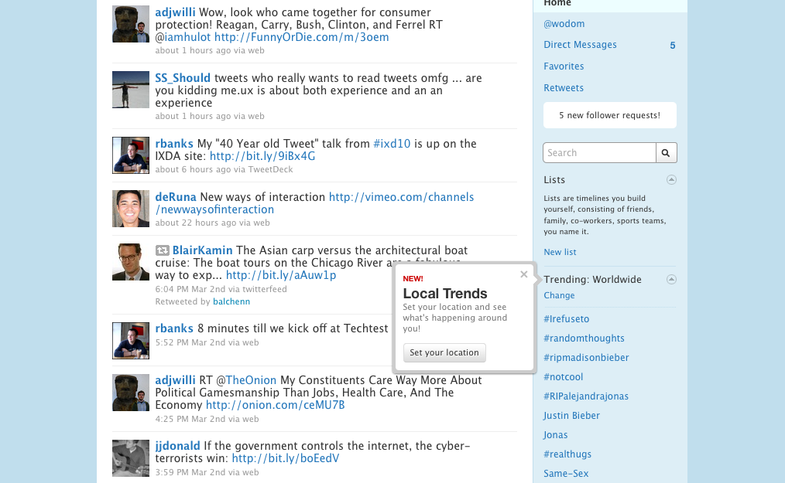
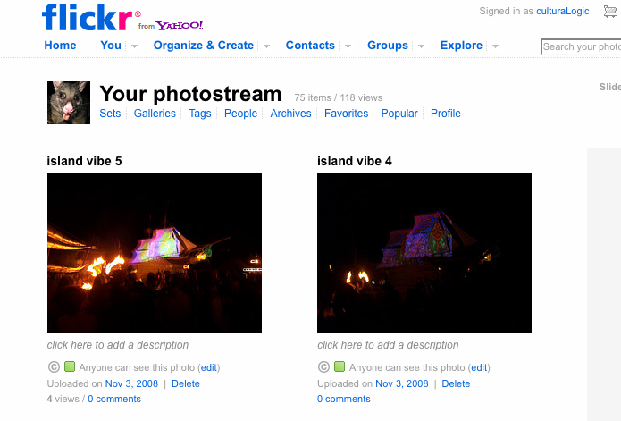
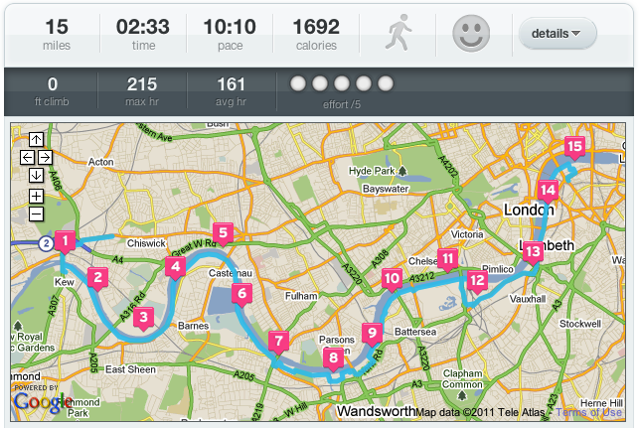
William Odom, John Zimmerman, Jodi Forlizzi | Human-Computer Interaction Institute | Carnegie Mellon University
Notes:
They also include new things that never had a material form, such as electronic messages, social networking profiles, and even personal GPS traces. Little research has explored how people construct value with and form attachments to.

Slide 9
William Odom, John Zimmerman, Jodi Forlizzi | Human-Computer Interaction Institute | Carnegie Mellon University
Notes:
AT the same time, new opportunities are emerging as cloud and mobile computing increasingly making access to virtual possessions available.

Slide 10
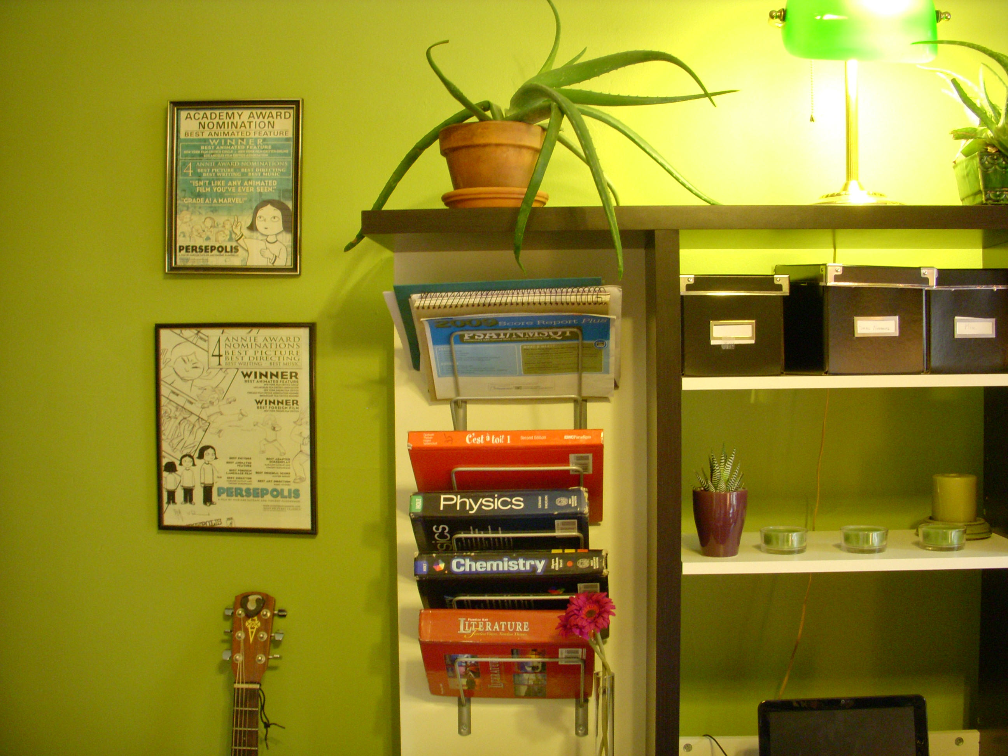
method
21 teenagers | 9 female 11 male
1. heavily occupied in the process of constructing identity
Steele & Brown, 1995
2. engaged in digital media and online communication
Ito et al., 2010
3. actively define the behavior of digital products and services
boyd, 2007
William Odom, John Zimmerman, Jodi Forlizzi | Human-Computer Interaction Institute | Carnegie Mellon University
Notes:
To investigate this emerging space, we conducted interviews with 21 teens to explore what kinds of virtual things they use and how they form attachments to them.They are clearly not the only population to explore but presented an interesting one in that they are: <read slide> Beyond these points, teens are engaged engaged in the very real work of grappling with who they are and who they want to become, and this work is fluidly happening across virtual and physical environments.

Slide 11
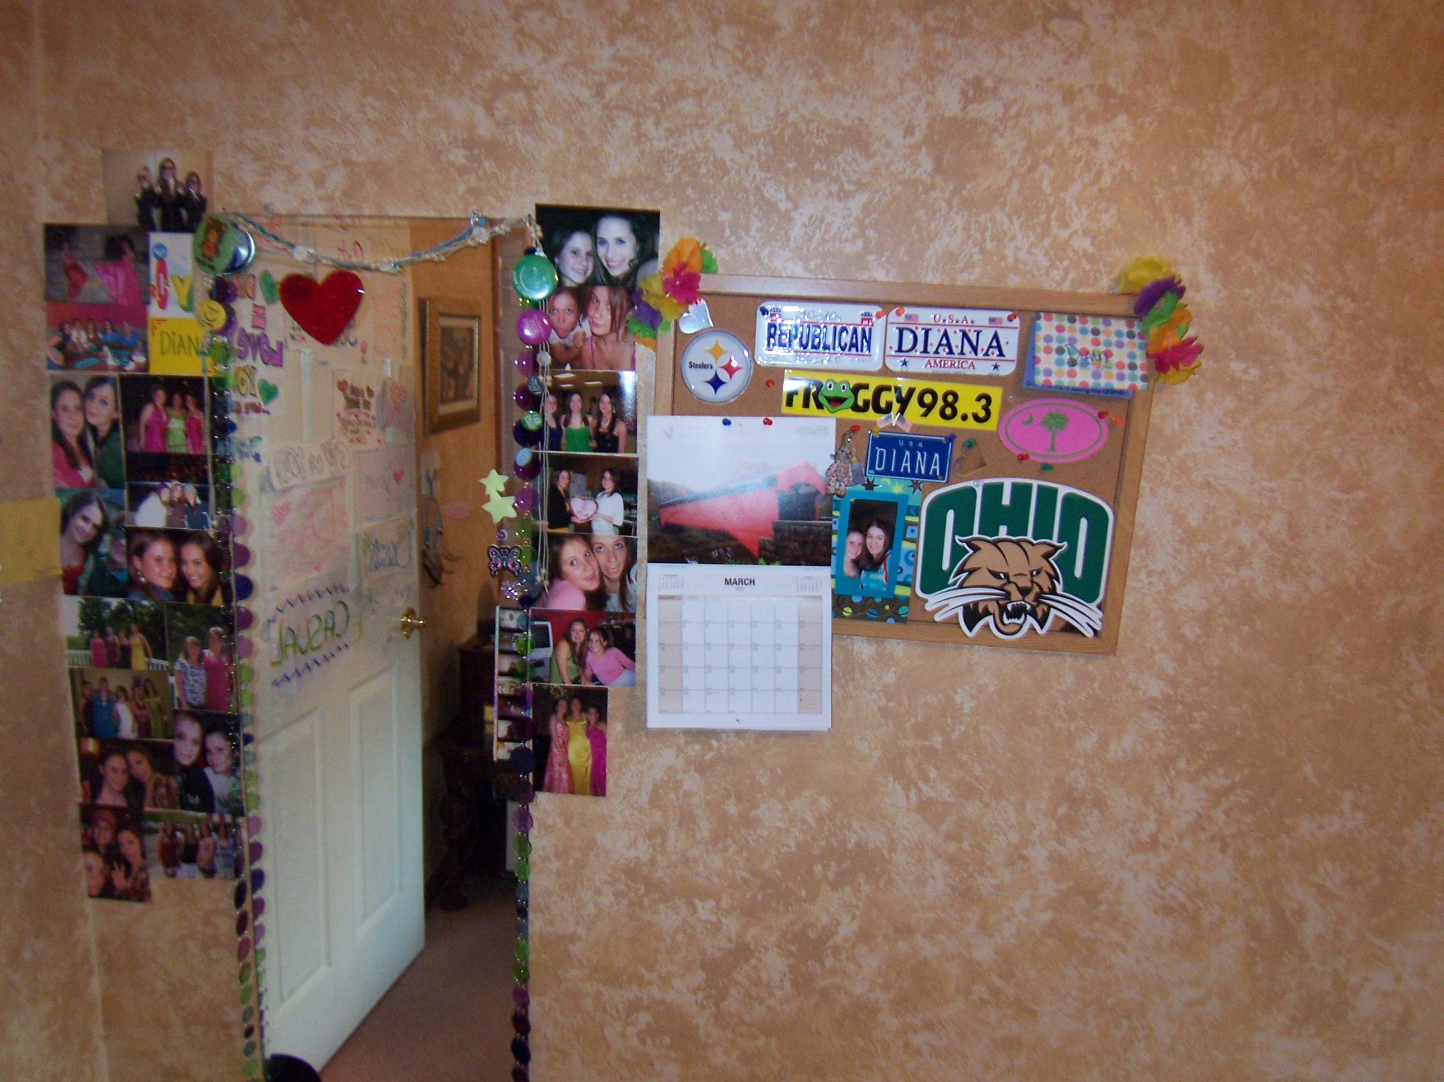
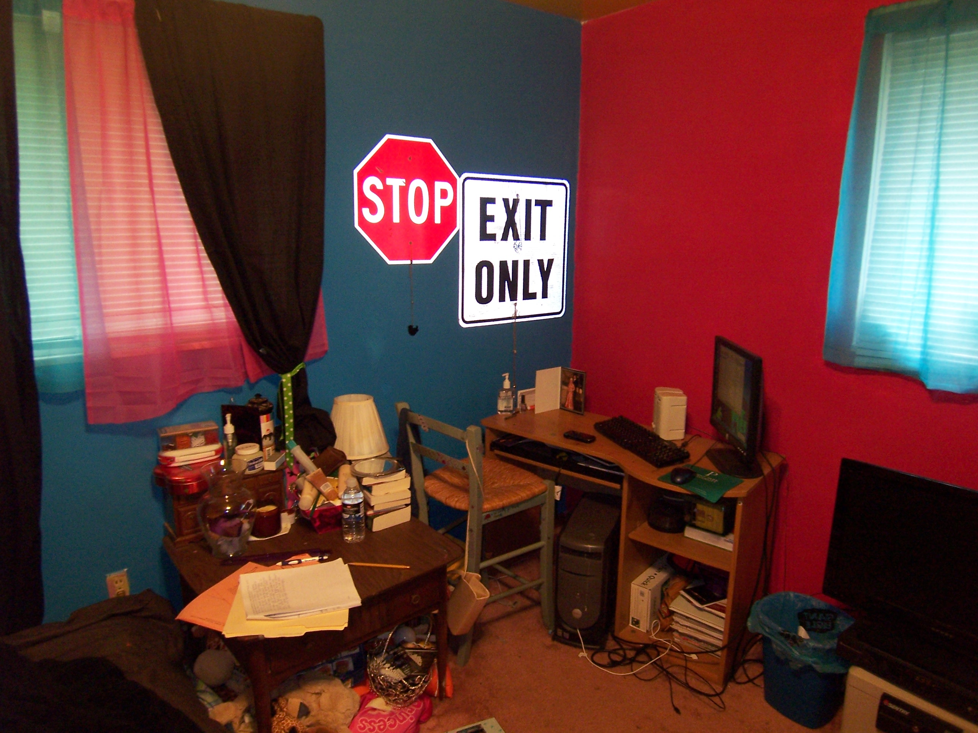
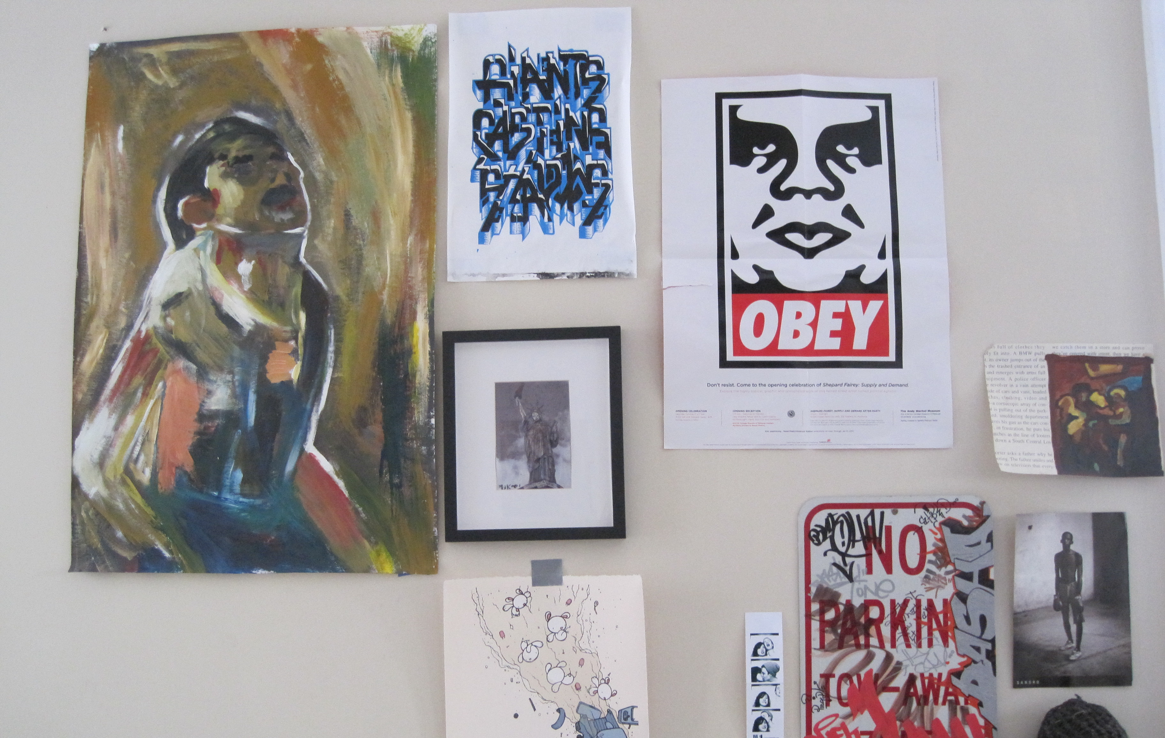
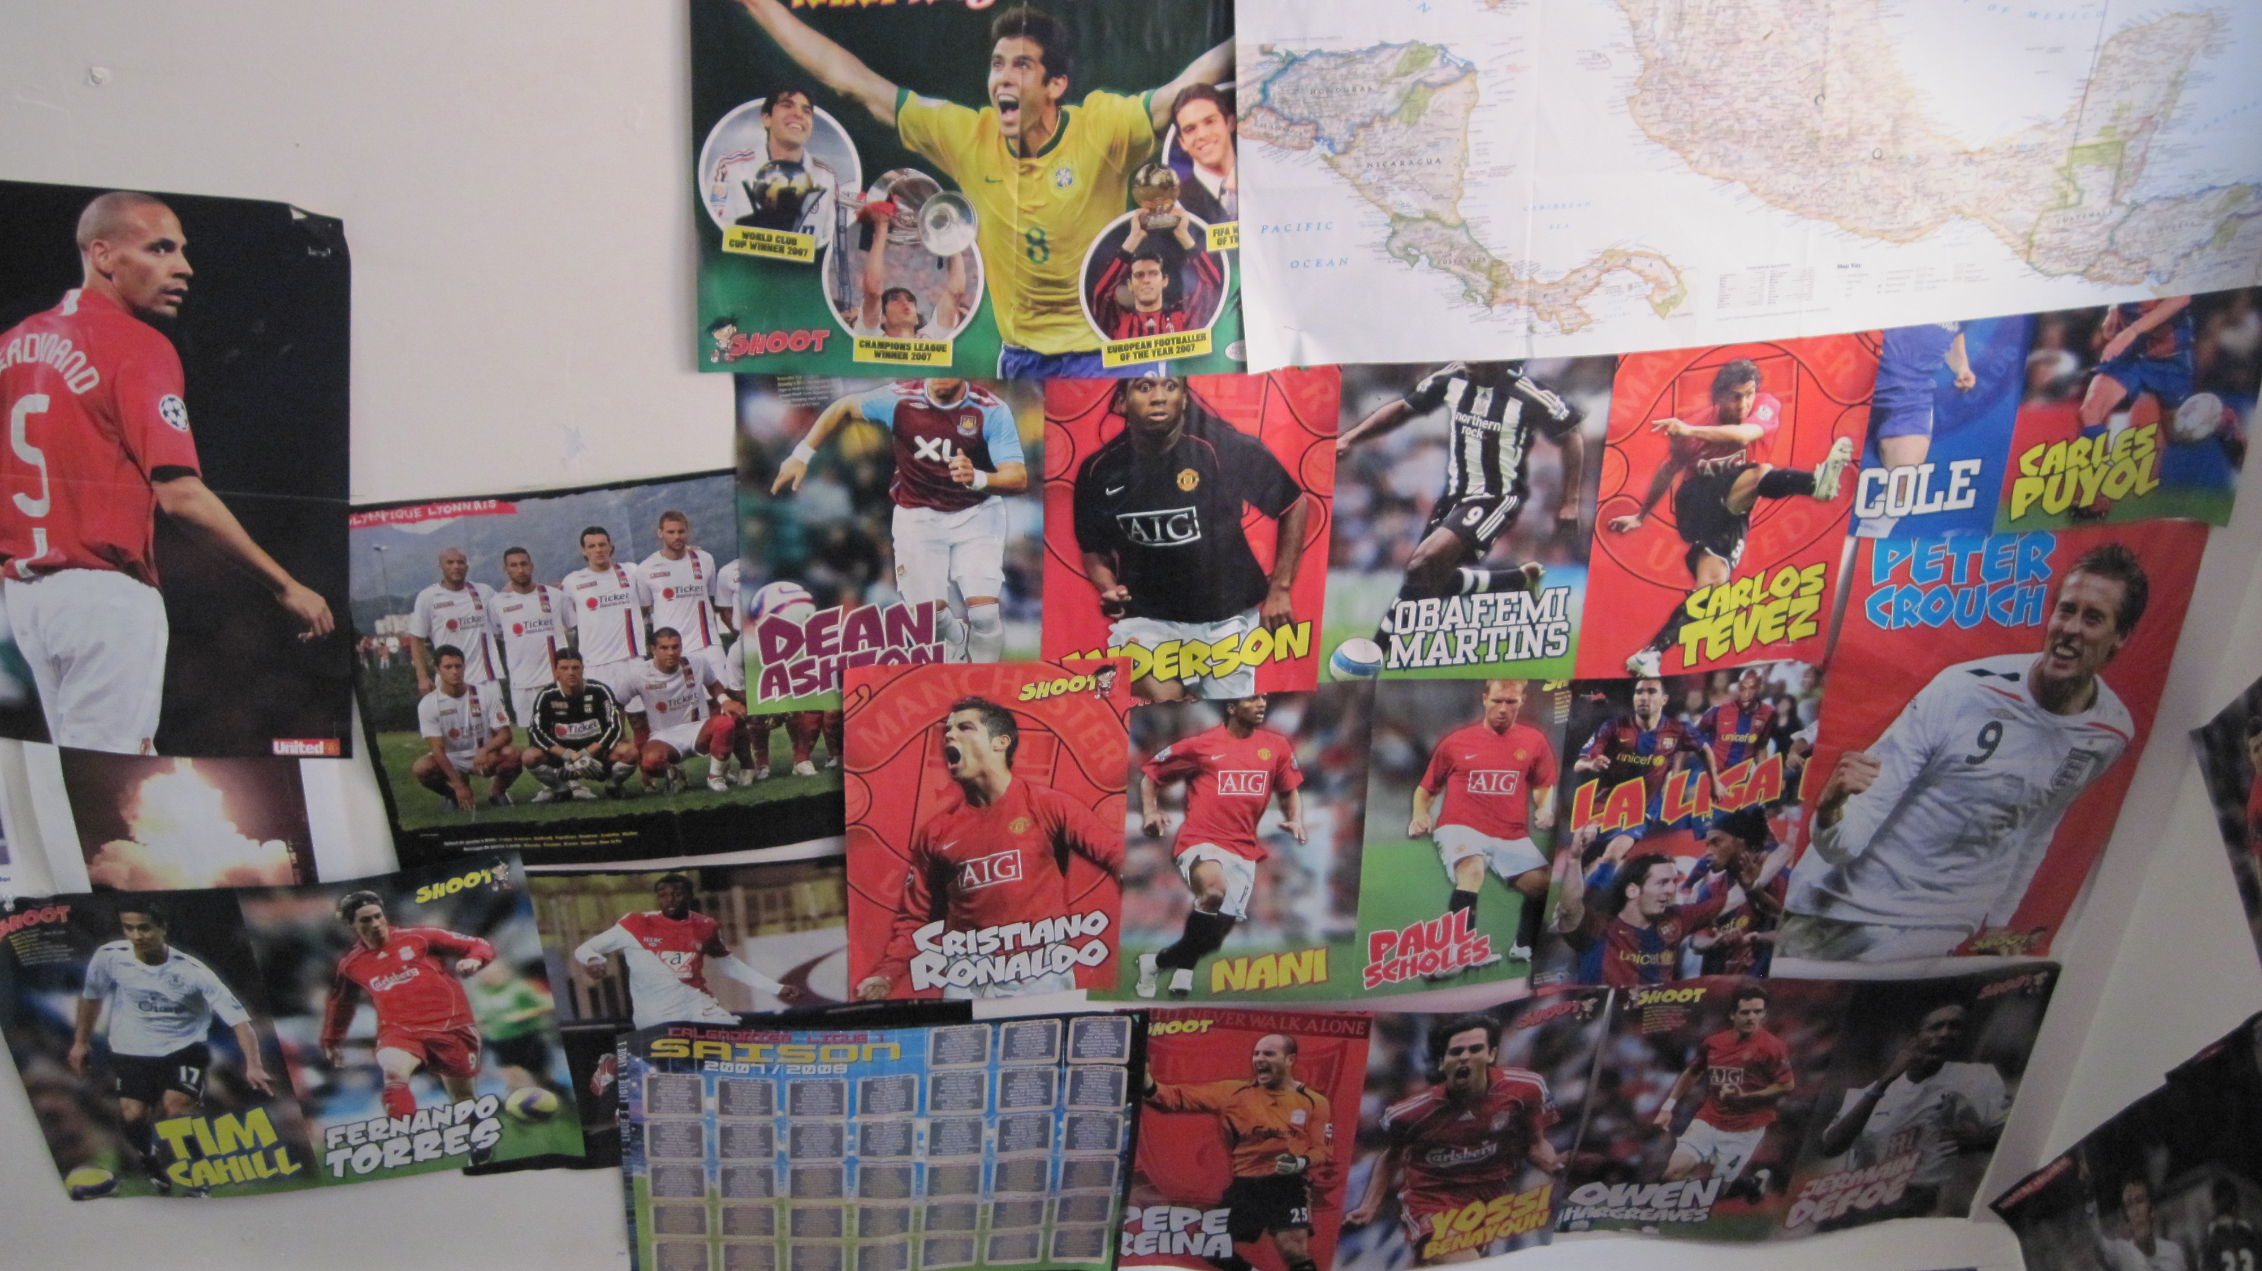
method
method
William Odom, John Zimmerman, Jodi Forlizzi | Human-Computer Interaction Institute | Carnegie Mellon University
Notes:
And, the bedroom is extremely important in teen life. It is where they keep their precious possessions and experiment with their identity through displaying them to parents and peers.

Slide 12
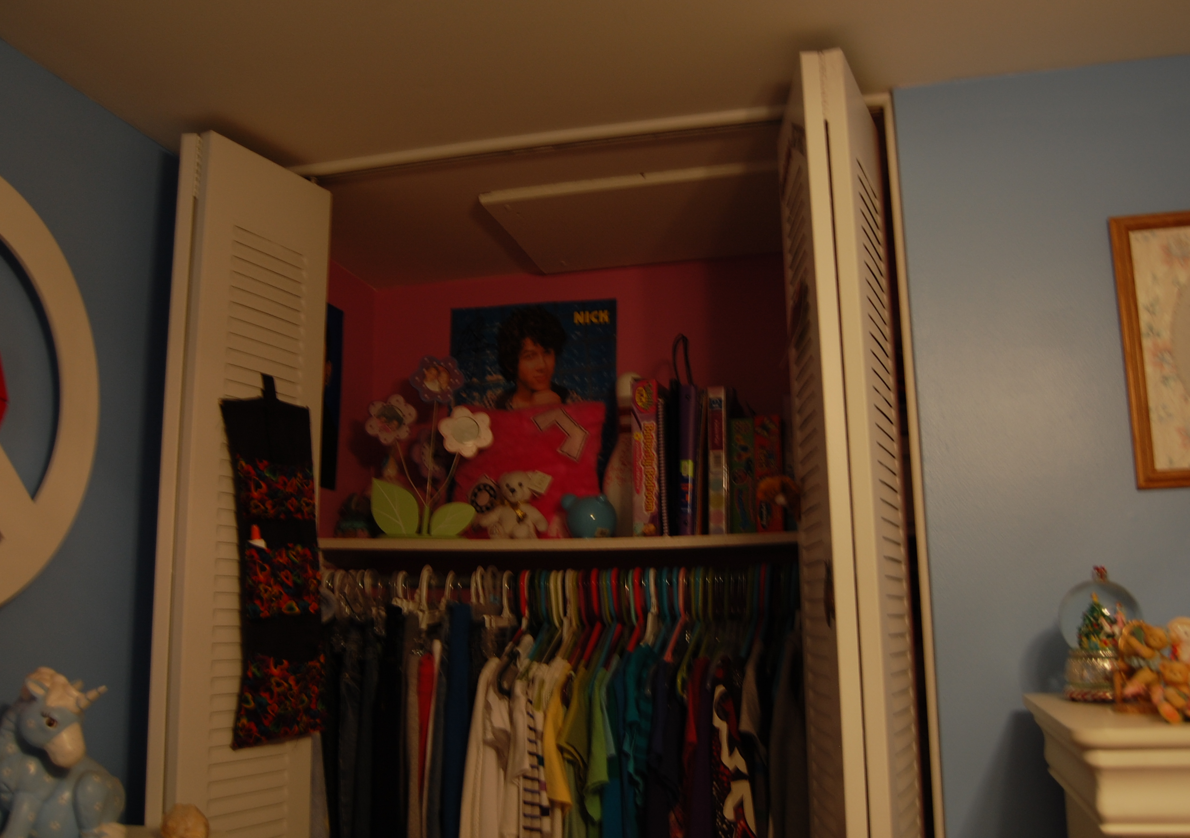
William Odom, John Zimmerman, Jodi Forlizzi | Human-Computer Interaction Institute | Carnegie Mellon University
Notes:
For example this teen had constructed a ‘shrine’ to the teen celebrity Nick Jonas last year. Her tastes had since changed and she moved parts of the shrine to be inconspicuously stored in her closet. Most teens shared stories of how their shifting tastes, and values associated with them, created a continuing re-authorship of their bedroom.

Slide 13
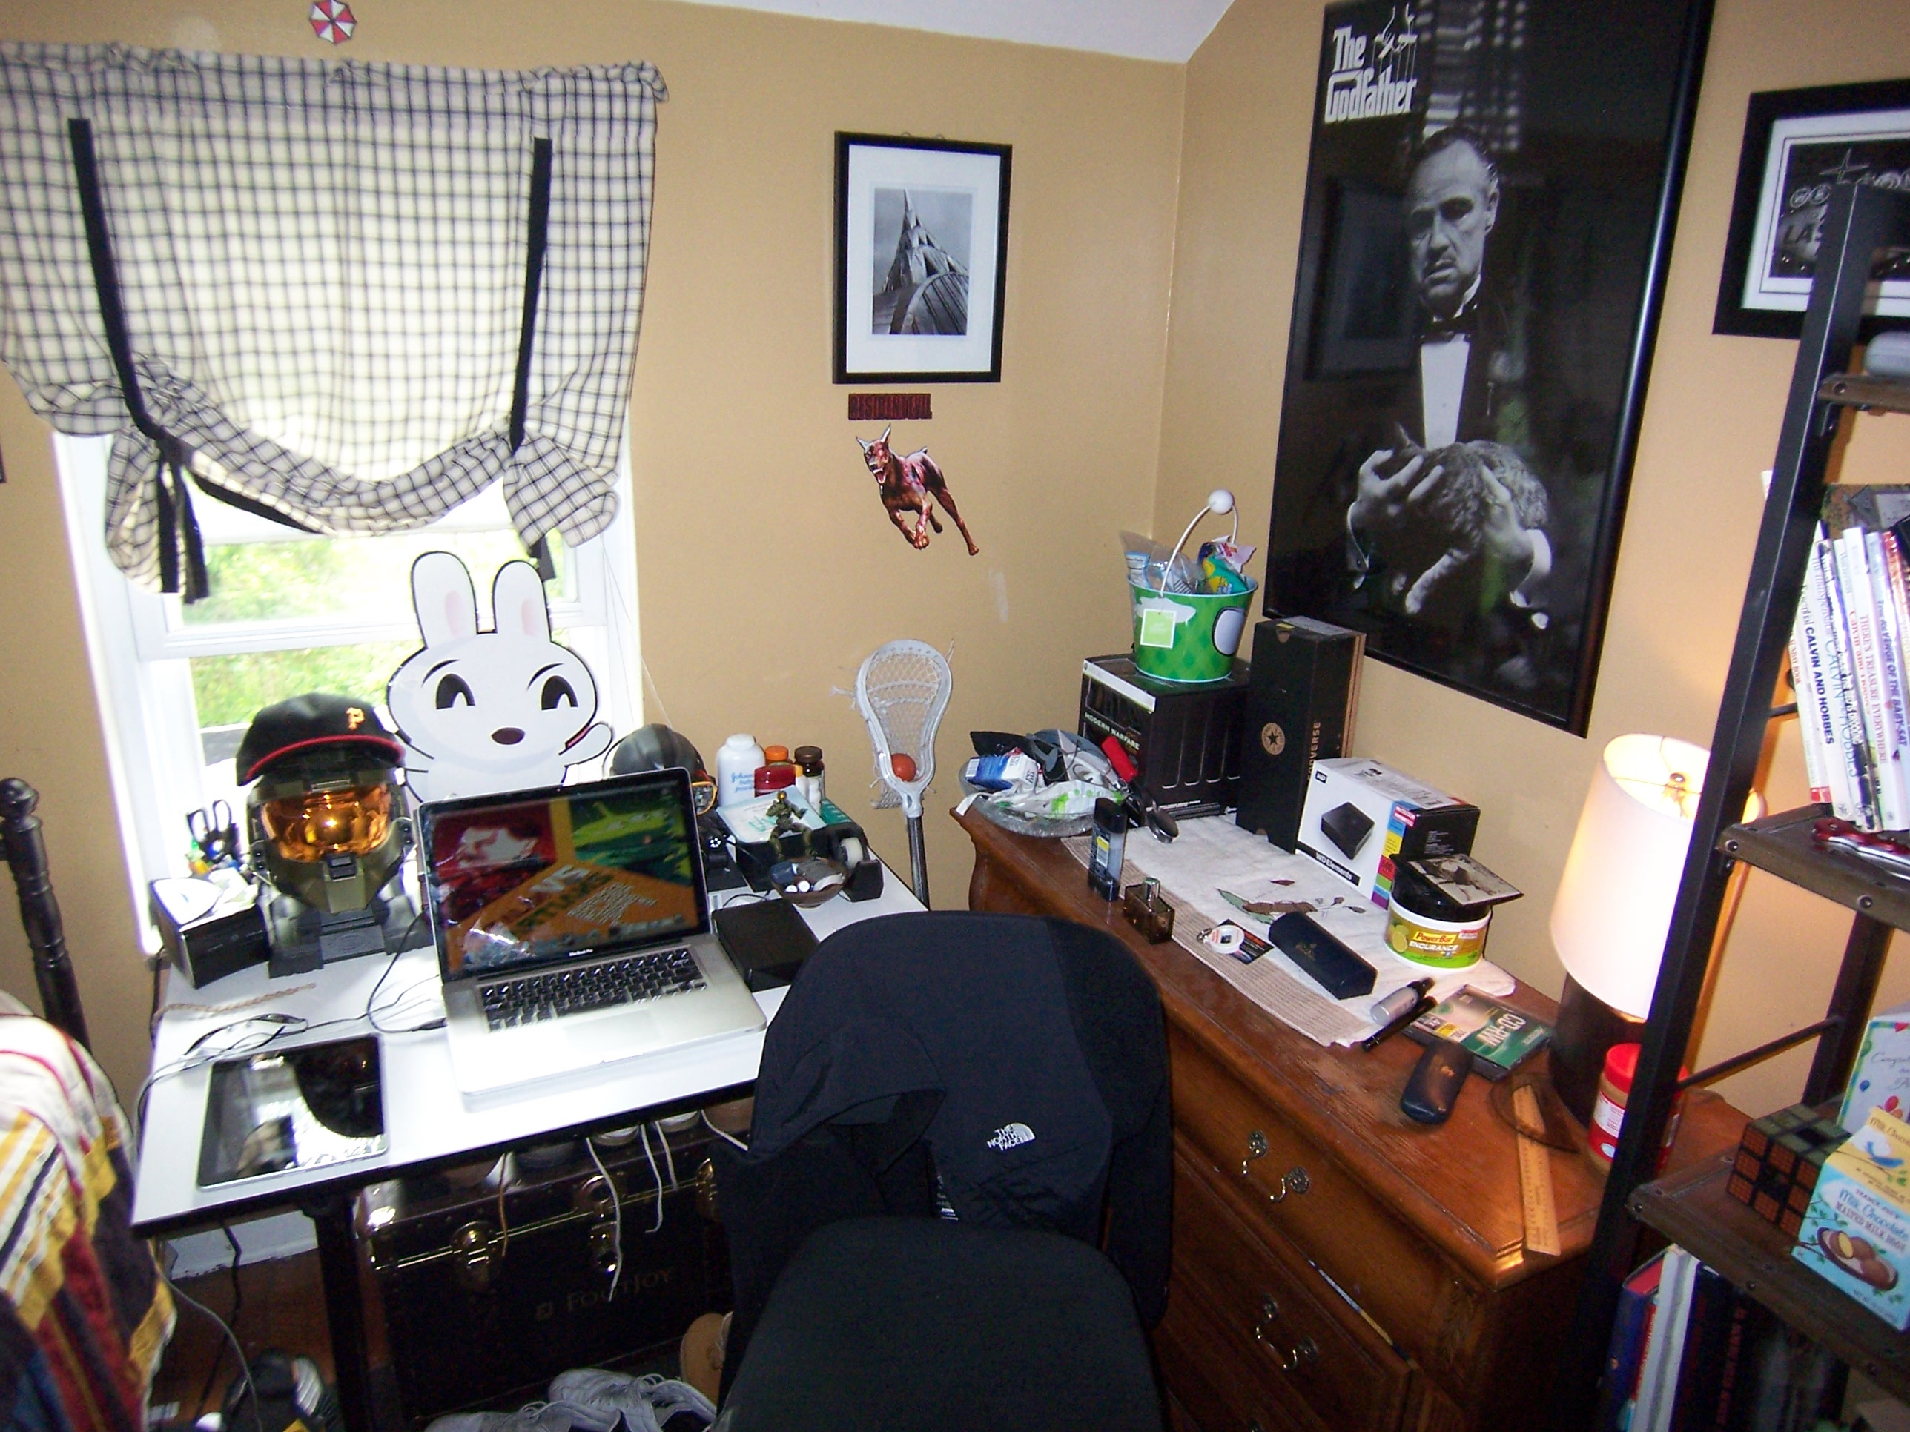
method
William Odom, John Zimmerman, Jodi Forlizzi | Human-Computer Interaction Institute | Carnegie Mellon University
Notes:
So, teens would first give us a tour of their material possessions and different spaces in the bedroom.

Slide 14
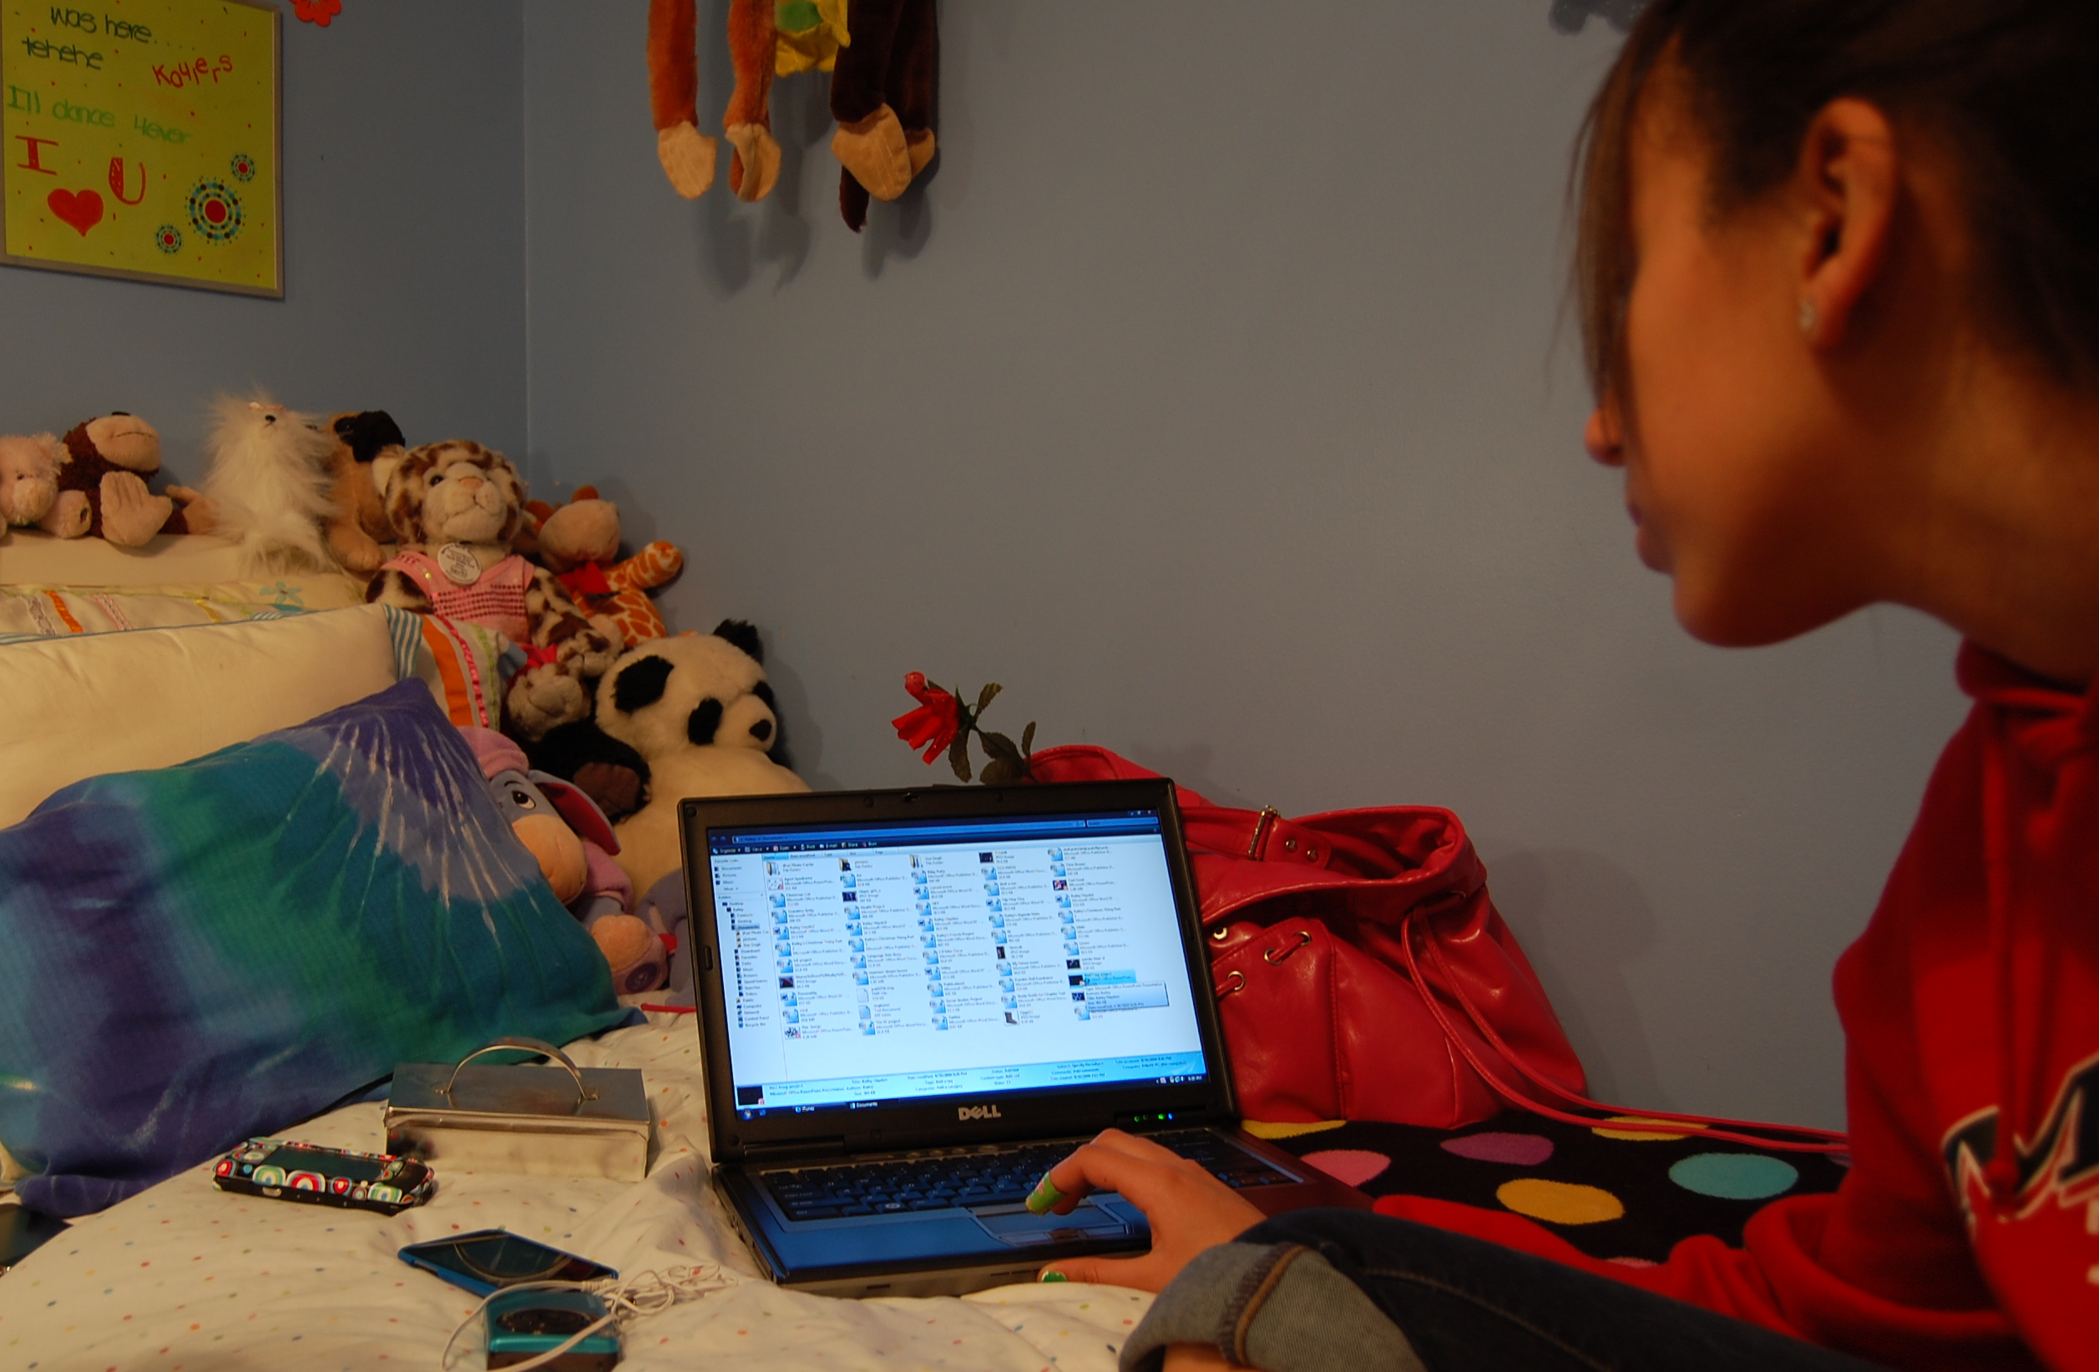
method
William Odom, John Zimmerman, Jodi Forlizzi | Human-Computer Interaction Institute | Carnegie Mellon University
Notes:
This was followed by a tour of their virtual possessions, which was often access through several digital devices.

Slide 15
findings
Notes:
Now I am going to describe a very small subset of our findings.

Slide 16
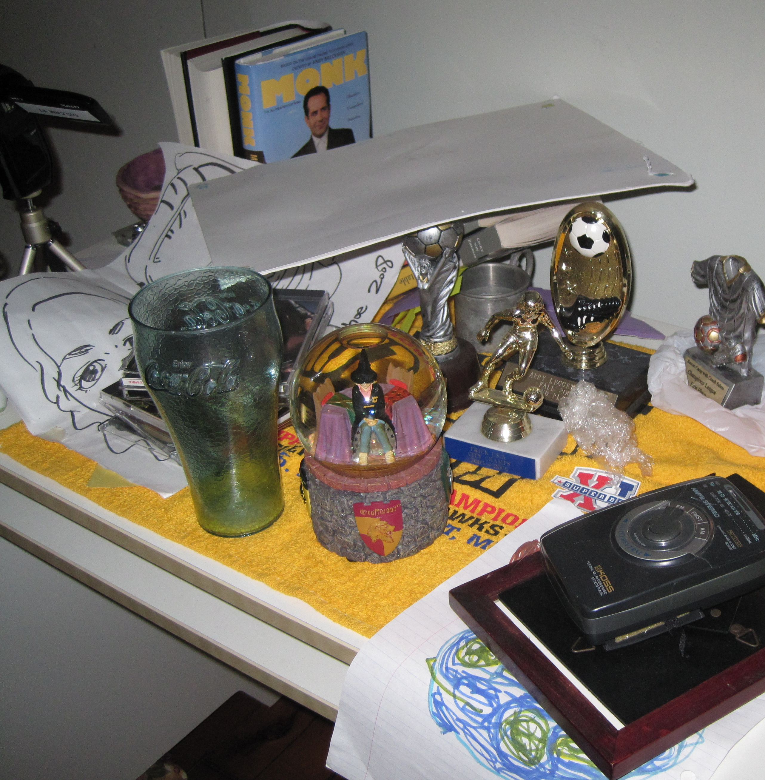
presentation of self in online places
William Odom, John Zimmerman, Jodi Forlizzi | Human-Computer Interaction Institute | Carnegie Mellon University
Notes:
While bedroom was this space for self exploration, some possessions conflicted with the broader domestic values. And, several teens described feeling considerably more in control over social networking sites. For example While the trophies Michelle prominently featured in her bedroom were acceptable, she was forbidden to have photos of boyfriend on display.

Slide 17
presentation of self in online places
“…I put [photos of boyfriend] there [on Facebook] because it’s me, but a part of me I don’t need to share with everyone.”
William Odom, John Zimmerman, Jodi Forlizzi | Human-Computer Interaction Institute | Carnegie Mellon University
Notes:
Here she says “…Almost everything [in my bedroom] is important. It all represents me. …but there’s also stuff that I could never have here. …I put it on Facebook because it’s me, but a part of me I don’t need to share with everyone.”
One example of how teens used their online places to experiment with presenting different aspects of their self to different audiences [[with a somewhat greater range of flexibility than their material environments]]

Slide 18
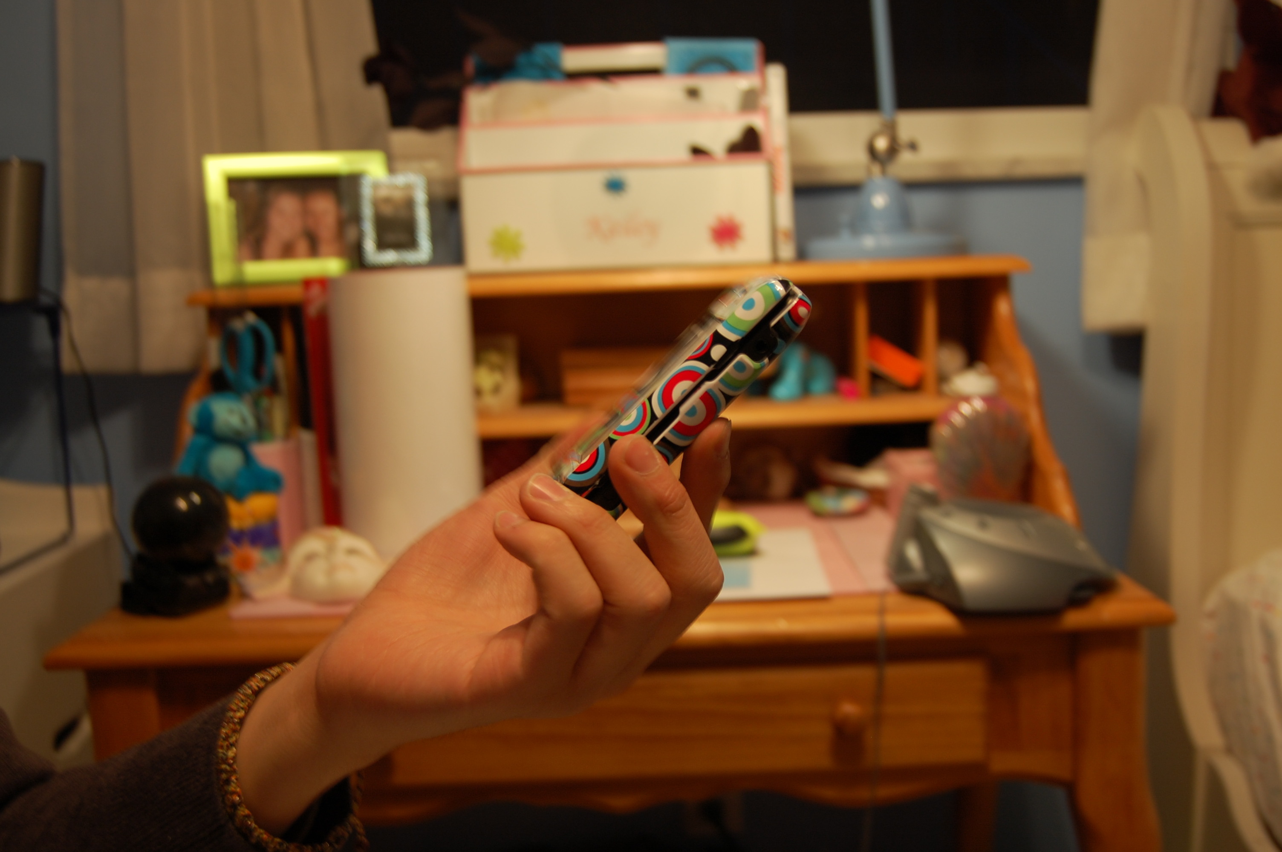
forms of metadata
William Odom, John Zimmerman, Jodi Forlizzi | Human-Computer Interaction Institute | Carnegie Mellon University
Notes:
In our study metadata emerged as a defining aspect of virtual possessions. Before jumping straight into the field examples, I want to first offer a quick example to help contextualize them. Take this digital photo for example.

Slide 19
forms of metadata
text
human
‘likes’
social tags
comments
links
photos
William Odom, John Zimmerman, Jodi Forlizzi | Human-Computer Interaction Institute | Carnegie Mellon University
Notes:
When posted online it could acquire human produced metadata, such as lightweight: ‘likes’, tags to other people and comments which themselves could be text, links to other content, or photos

Slide 20
forms of metadata
text
human
‘likes’
social tags
comments
links
photos
timestamp
geotag
views
machine
William Odom, John Zimmerman, Jodi Forlizzi | Human-Computer Interaction Institute | Carnegie Mellon University
Notes:
It could also acquire machine-produced metadata which could include the number of times viewed, geotags, and a timestamp from when it was created or exchanged.
Clearly this is just a sample, but with these ideas in mind I’ll now describe a few different field examples of how new value was constructed with metadata.

Slide 21
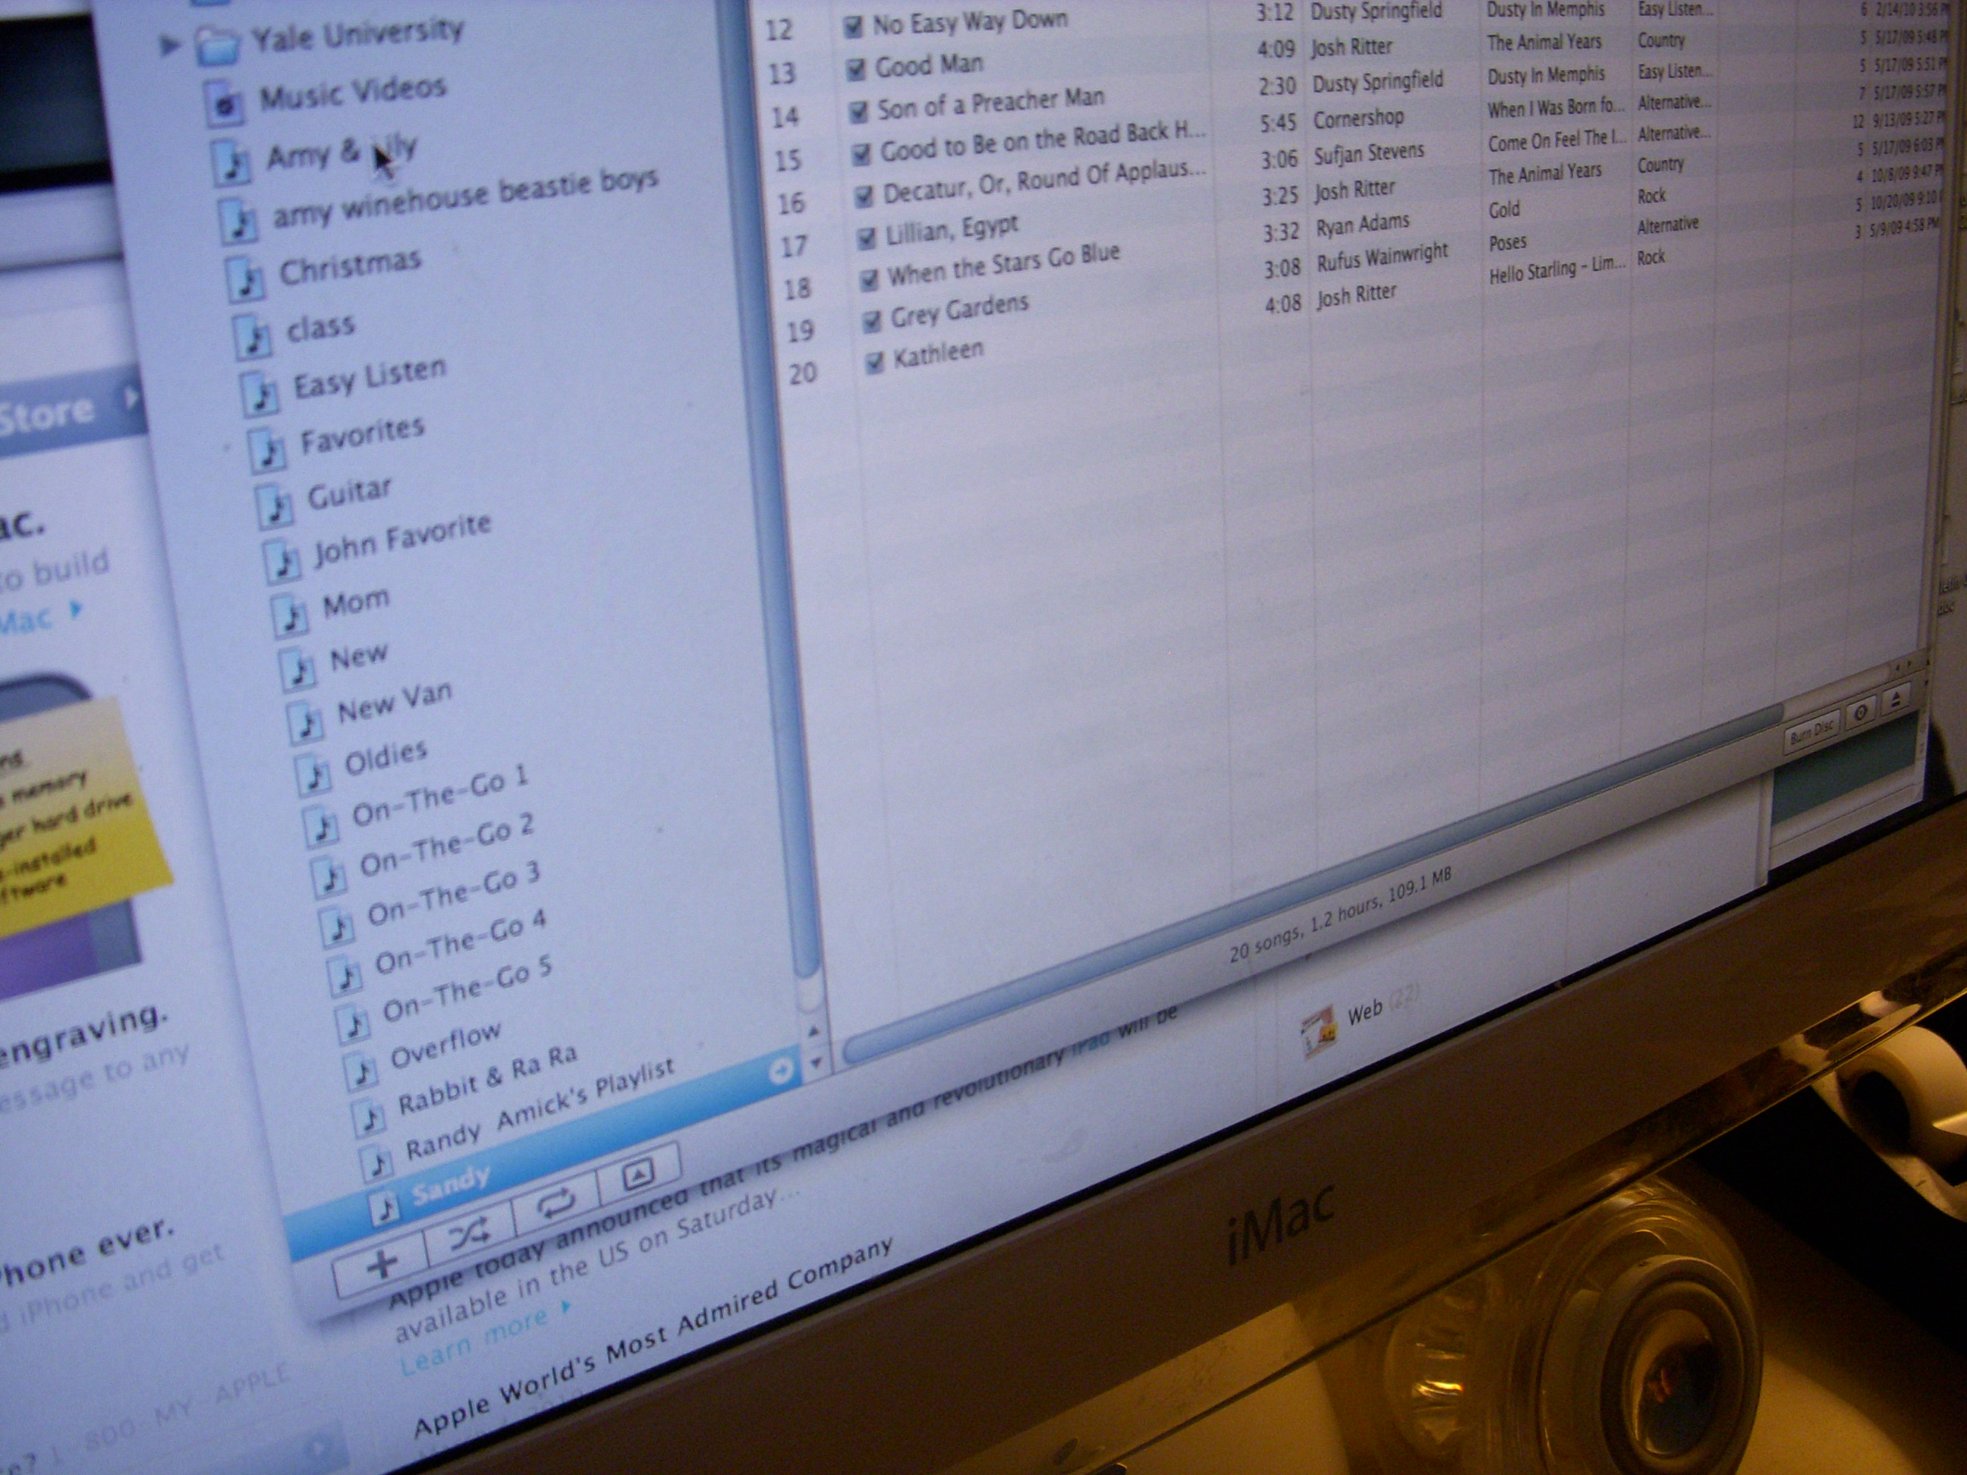
human-produced metadata
“[my photo will] come up on her iPod and it makes it different in her library from everything else.” (Frank)
William Odom, John Zimmerman, Jodi Forlizzi | Human-Computer Interaction Institute | Carnegie Mellon University
Notes:
First I’ll describe an example of human-produced metadata. We found teens gave and received music playlists and sometimes modified metadata as a part of this practice.
Here Frank describes replacing album art images of songs with photos from events he attended with his girlfriend.. Here he says, “…before I give her a mix [CD] of songs, I go in the info and put a photo of us together. …[my photo will] come up on her iPod and it makes it different in her library from everything else”

Slide 22
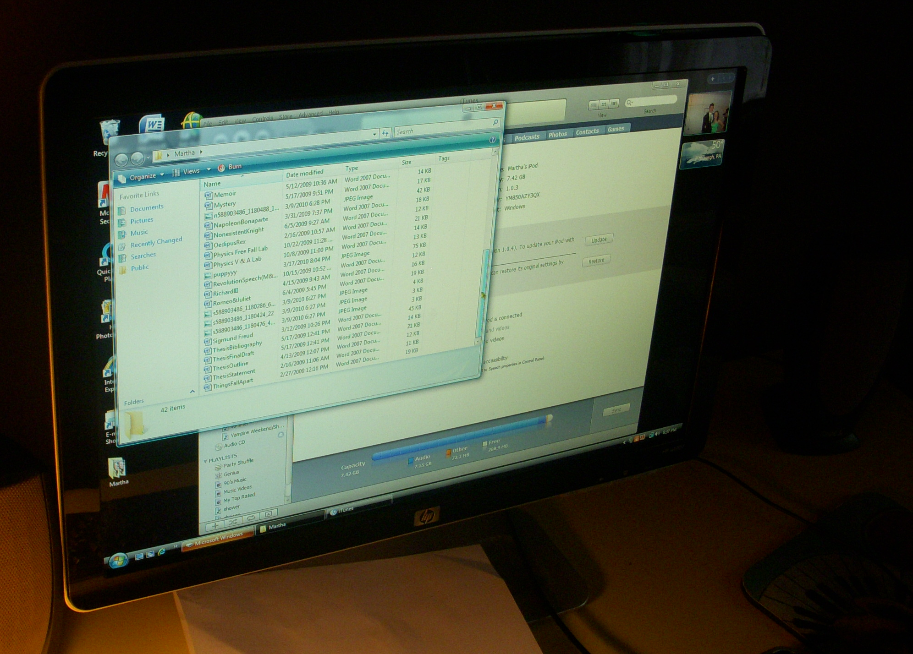
machine-produced metadata
“…it’s interesting to see how you’ve changed through how often you listened to things and when you last did.” (Kate)
William Odom, John Zimmerman, Jodi Forlizzi | Human-Computer Interaction Institute | Carnegie Mellon University
Notes:
Some teens had collections of all of the music they had ever owned. Their music libraries had created machine-produced metadata detailing when and how often songs had been played. Here Kate describes how she has songs in her collection she listened to over the past 5 years. She says “the things I like change and I change too, and it’s interesting <read quote>” On a side, it’s interesting something as low resolution as frequency on playlist can be a valued resource for teens exploring aspects of who they were in ways quite different than a photograph.

Slide 23
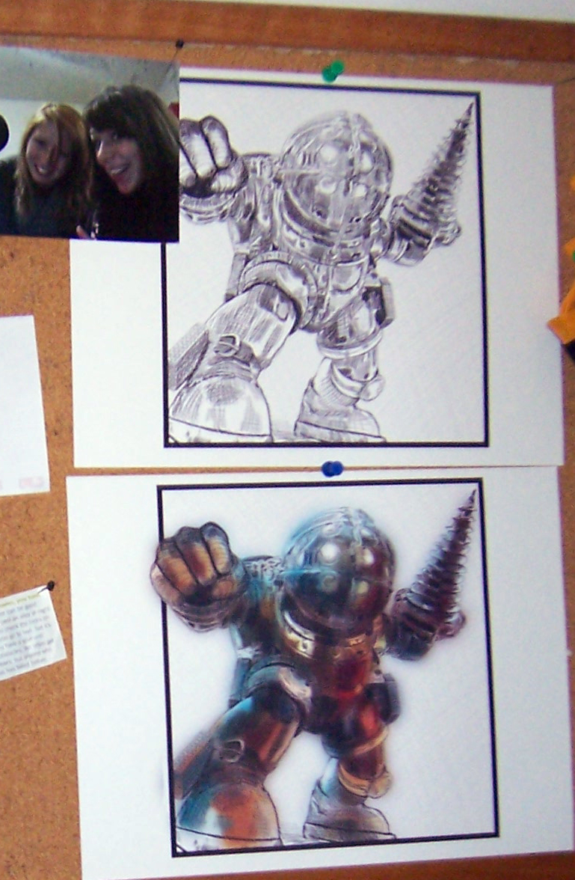
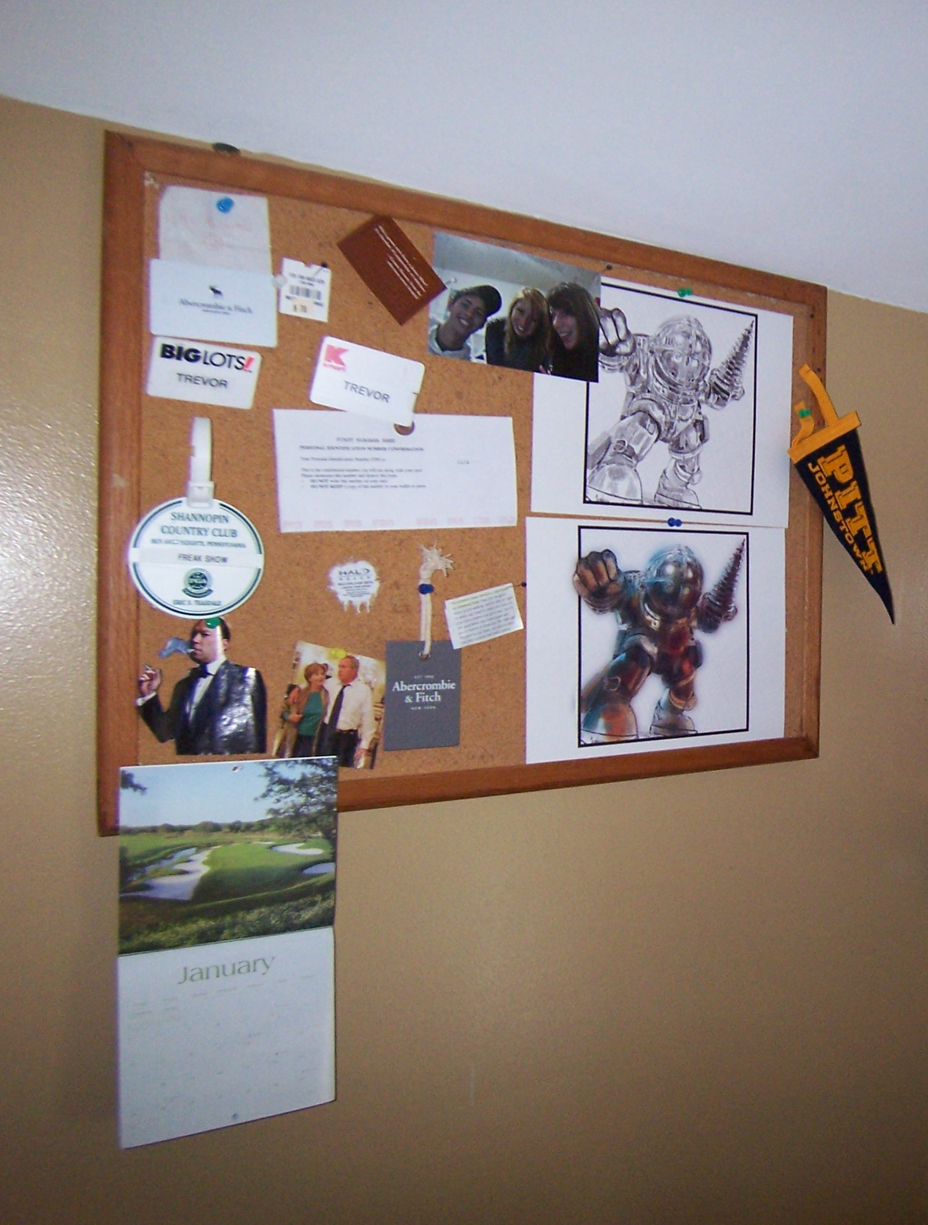
moving between virtual & material
William Odom, John Zimmerman, Jodi Forlizzi | Human-Computer Interaction Institute | Carnegie Mellon University
Notes:
Finally, We observed several examples of possessions transitioning between material and virtual forms. For instance, Bill described hand sketched drawings of his Halo avatar which were on display in his bedroom that took digital photos of and uploaded to Facebook.

Slide 24
moving between virtual & material
“…now I think about [online comments] when I look at [the original drawings] in my room.” (Bill)
William Odom, John Zimmerman, Jodi Forlizzi | Human-Computer Interaction Institute | Carnegie Mellon University
Notes:
As a result several people in his social network left many different kinds of comments on them, which as you can see from the quote, he now thinks about when he enters the room.
This shows how online places were used to extend precious material possessions beyond the bedroom to other social groups, and in this case, how the metadata they acquired shaped how material possessions themselves were perceived.

Slide 25
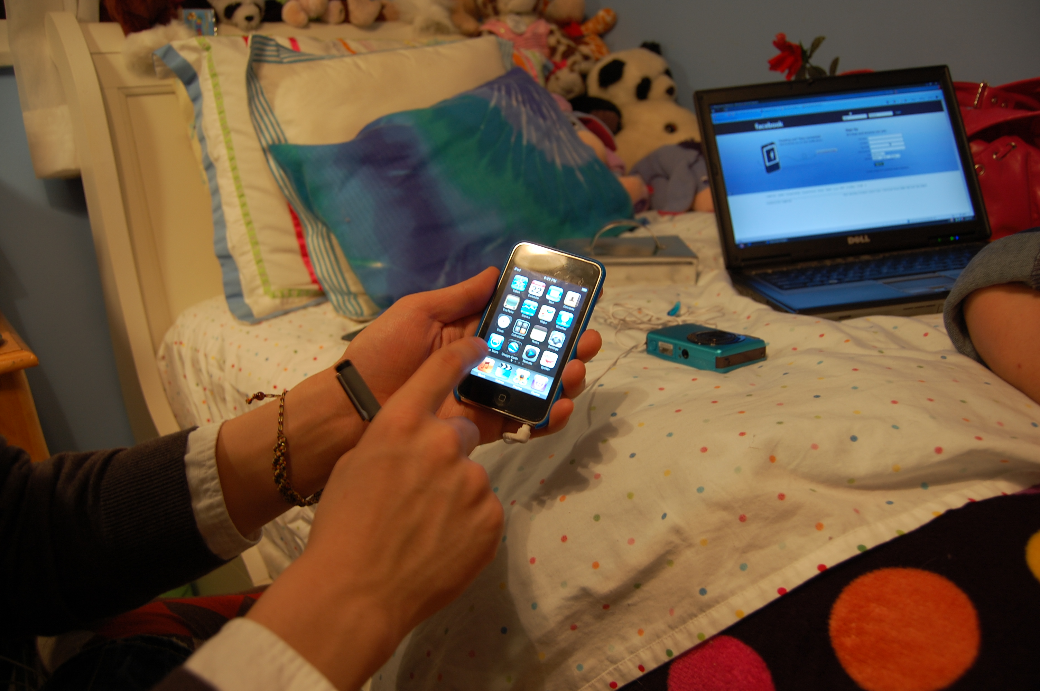
design opportunities and issues
accrual of metadata
curation of self and social affiliations
paradoxes and consequences
William Odom, John Zimmerman, Jodi Forlizzi | Human-Computer Interaction Institute | Carnegie Mellon University
Notes:
Now I am going to mention a few design opportunities and issues suggested by the findings, however there are many more detailed in the paper.

Slide 26
accrual of metadata
William Odom, John Zimmerman, Jodi Forlizzi | Human-Computer Interaction Institute | Carnegie Mellon University
Notes:
The ability to have and hold onto metadata made appeared to make virtual things more valuable, and it was used in several ways.

Slide 27
accrual of metadata
used to make virtual possessions more expressive
helped connect to experiences
resource for sharing, editing and developing histories
William Odom, John Zimmerman, Jodi Forlizzi | Human-Computer Interaction Institute | Carnegie Mellon University
Notes:
Teens used metadata to make virtual possessions more personalized. To better connect virtual things to particular experiences and to develop histories around them.

Slide 28
machine & human-produced metadata
design opportunities
tools enabling people to personalize their virtual things
better mechanisms for recording different kinds of metadata
William Odom, John Zimmerman, Jodi Forlizzi | Human-Computer Interaction Institute | Carnegie Mellon University
Notes:
Creating new tools that leverage both human and machine-produced metadata as resources for people to make their virtual things more reflective of self, relationships or experiences. Personalizing music collections is an obvious area from the field examples. Better contextualizing collections of content…
There also seems to be an opportunity for making better mechanisms for capturing these diverse kinds of metadata. This starts to raise questions around how do we collect and make these things accessible in appropriate ways?

Slide 29
virtual proxies of material things
design opportunities
attributing metadata to physical things
acquire rich personal and shared histories over time
William Odom, John Zimmerman, Jodi Forlizzi | Human-Computer Interaction Institute | Carnegie Mellon University
Notes:
We also found teens put virtual copies of precious material things in online places to make them available to different audiences and acquire new social metadata. There is an opp for attributing metadata to physical things. In a sense these virtual proxies could collect different kinds of metadata and potentially create rich personal or shared histories of a thing.
Just some of many possibilities. But importantly the structures needed for capturing this kind of metadata are currently not in place to make them possible.

Slide 30
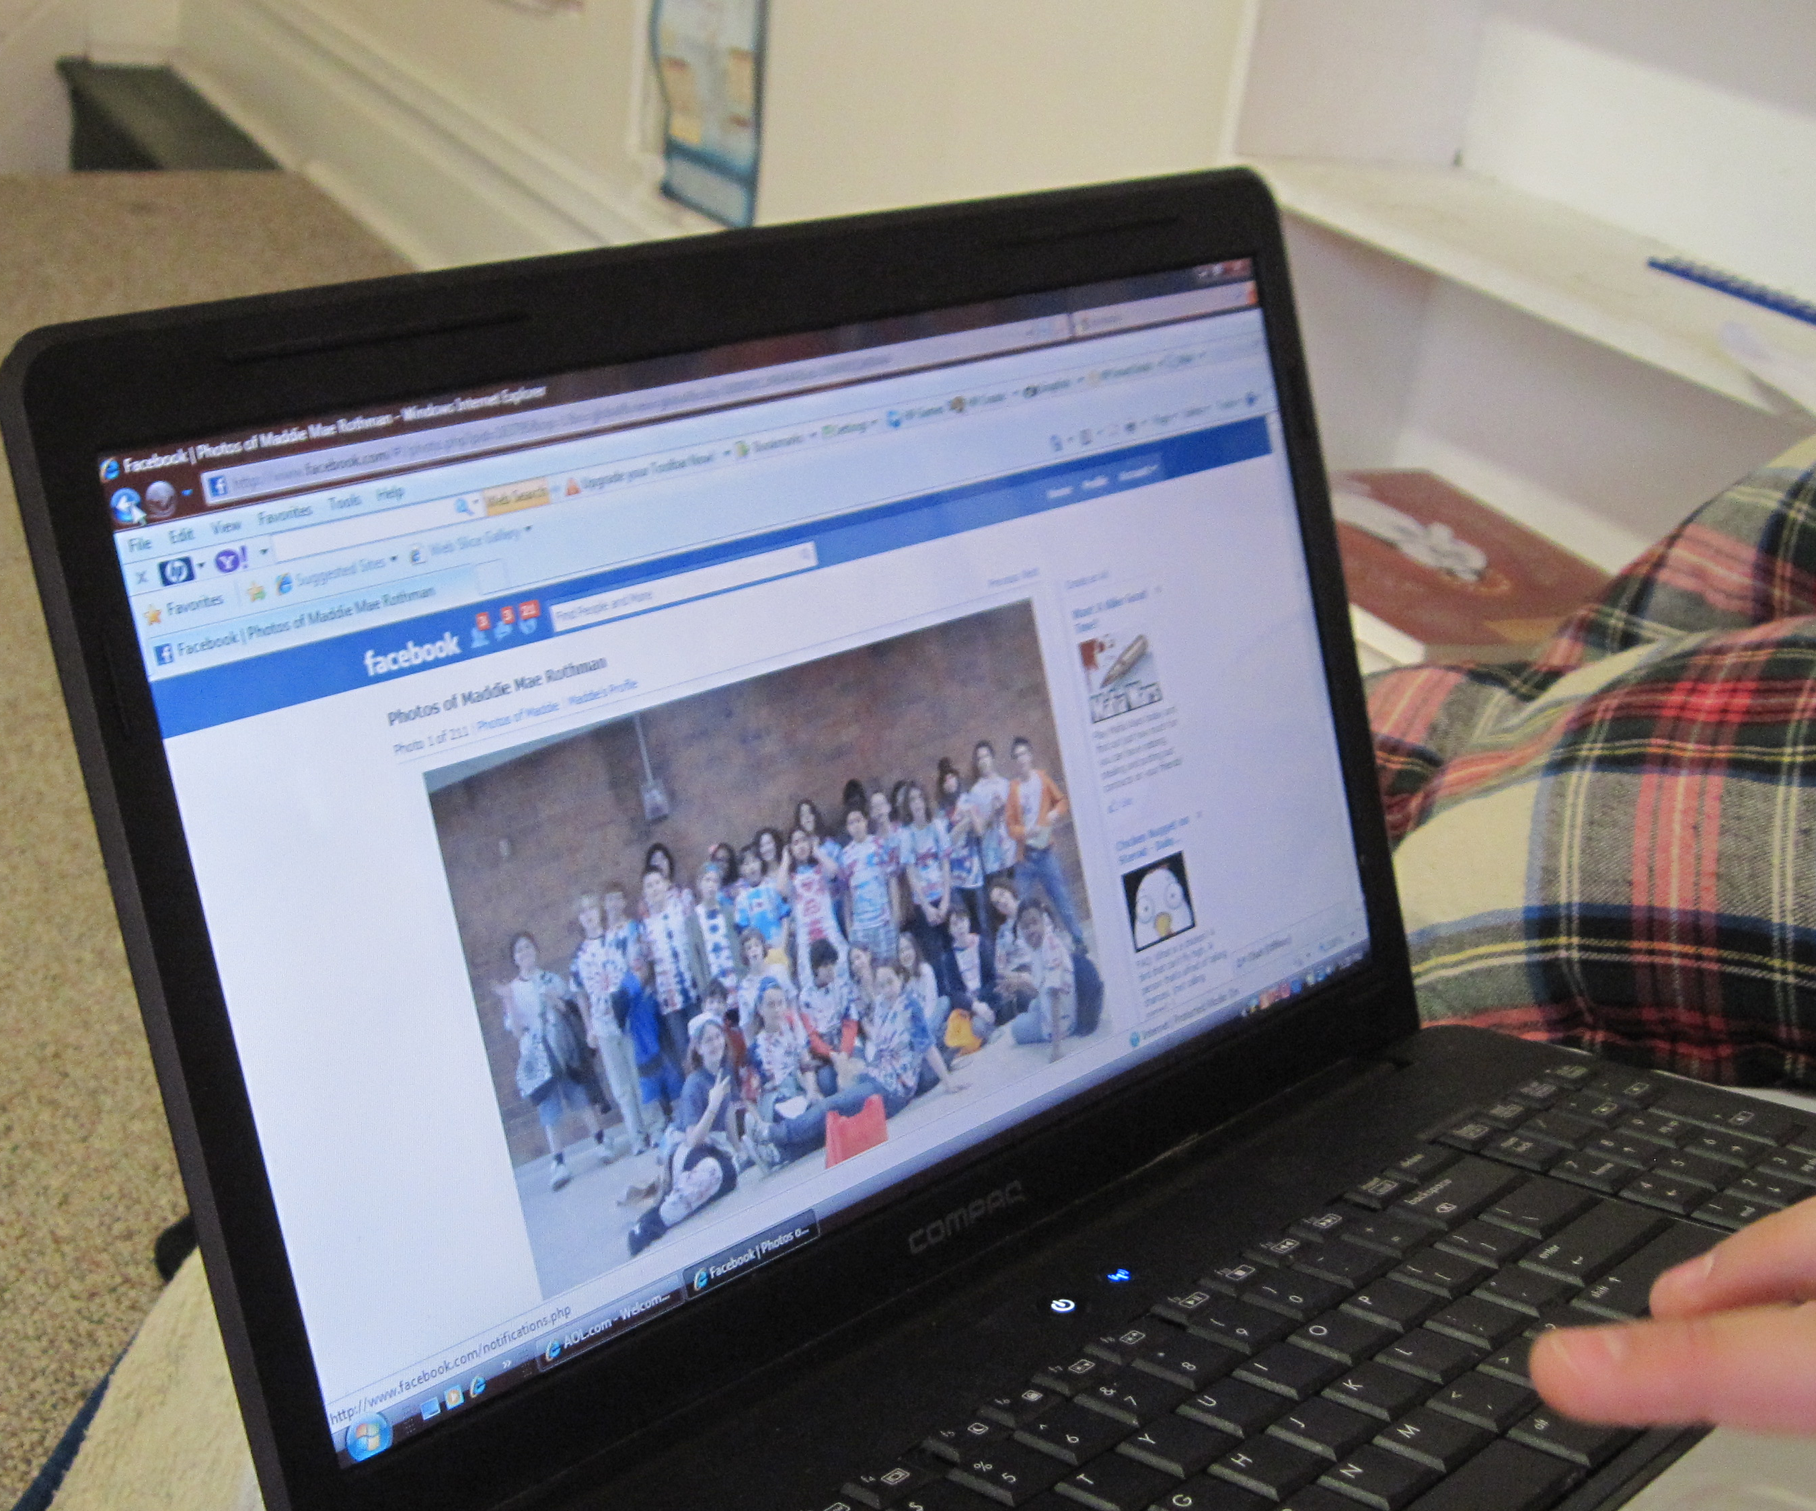
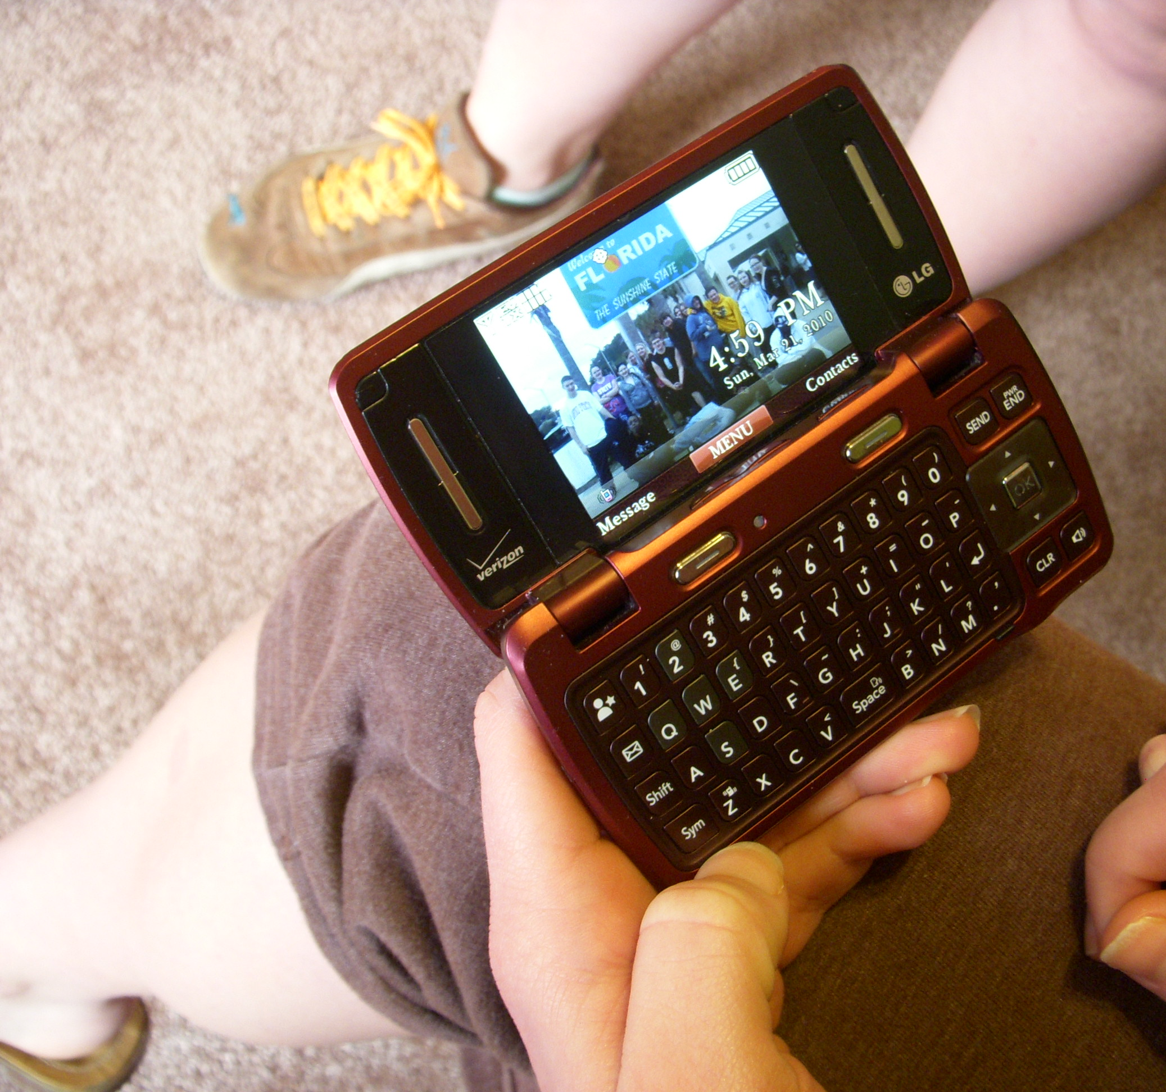
curation of self
William Odom, John Zimmerman, Jodi Forlizzi | Human-Computer Interaction Institute | Carnegie Mellon University
Notes:
The use of virtual possessions for self exploration and experimentation was tightly linked to construction of value with them.

Slide 31
curation of self
online places enabled more fluid expression of identity
desire to breakdown boundary between virtual and material
William Odom, John Zimmerman, Jodi Forlizzi | Human-Computer Interaction Institute | Carnegie Mellon University
Notes:
-In some cases, online places enabled more control over expression and curation of different aspects of identity presented to….
-There was a desire to breakdown boundaries and make the possessions involved in social interactions happening across virtual and material environments more available.

Slide 32
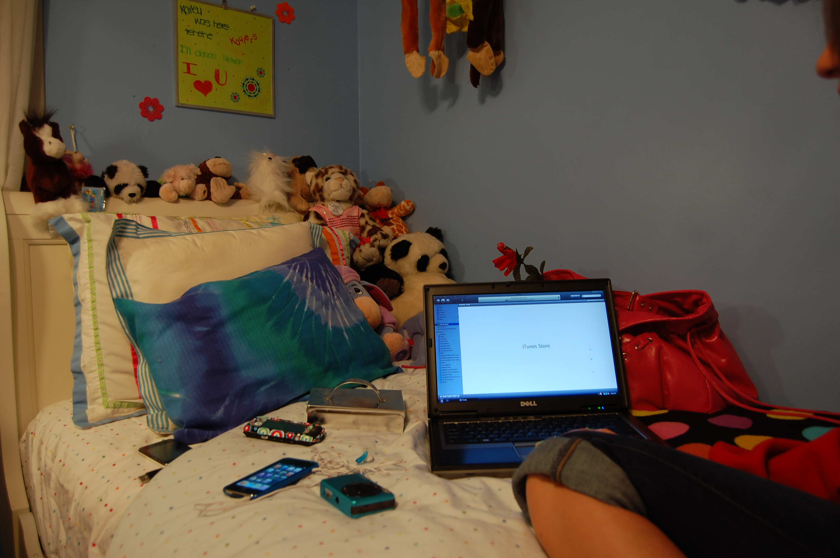
exploring presence, form and behavior
design opportunities
making virtual possessions more present
re-imaging the forms of virtual things and collections
enhancing with socially reactive behaviors
William Odom, John Zimmerman, Jodi Forlizzi | Human-Computer Interaction Institute | Carnegie Mellon University
Notes:
General opportunity in …present. Beyond presence, there also seem to be opportunities for re-imagining the forms of these things and behaviors they could enhanced with. For example, the form through which a person’s entire body of text messages or other digital collections could be dramatically re-imagined to open up new engagements with them. Virtual things could be made ‘socially’ reactive to different people as they enter and exit a room to help create new ways of selecting and presenting different aspects of a person’s identity to groups they encounter. This opens up questions about how new forms and behavior might shape how value and attachment is formed with virtual things.

Slide 33
potential paradoxes and consequences
William Odom, John Zimmerman, Jodi Forlizzi | Human-Computer Interaction Institute | Carnegie Mellon University
Notes:
In the paper we also highlight several potential issues the HCI community should consider when developing new technologies and systems in this space.
For example….

Slide 34
potential paradoxes and consequences
people reinvent themselves by selecting which elements of their past to keep and which to let go
how a person might dispossess a virtual thing is unclear
William Odom, John Zimmerman, Jodi Forlizzi | Human-Computer Interaction Institute | Carnegie Mellon University
Notes:
People actively reinvent themselves by selecting which elements of their past to keep and which to let go.
While VPs can potentially support identity construction processes, how a person might dispossess a virtual thing is unclear.
Shared possessions (e.g. photos + metadata) could pose problems as consensus is required across various members on dispossession

Slide 35
potential paradoxes and consequences
virtual possessions can support reflection on life experiences
could create an exacting history of who we are leaving little space for romanticizing the past
William Odom, John Zimmerman, Jodi Forlizzi | Human-Computer Interaction Institute | Carnegie Mellon University
Notes:
The persistent archiving of virtual possessions over time offers new opportunities to support reflection on life experiences;
however it also creates an exacting history of who we are, leaving little space for romanticizing about the past and forgetting experiences we no longer wish to relive

Slide 36
potential paradoxes and consequences
social boundaries not fully formed for future practices
prototyping to probe potential consequences
William Odom, John Zimmerman, Jodi Forlizzi | Human-Computer Interaction Institute | Carnegie Mellon University
Notes:
The key issue: social boundaries do not yet exist around these future practices are not fully formed. We need to prototype and make new artifacts to probe where boundaries might lie and where potential consequences might emerge.
These issues and several others could be useful framing mechanisms for future research in HCI as we determine future socially beneficial design interventions

Slide 37
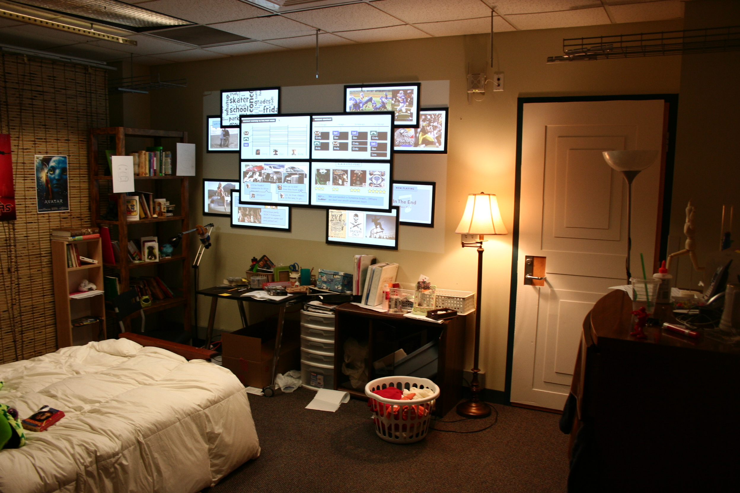
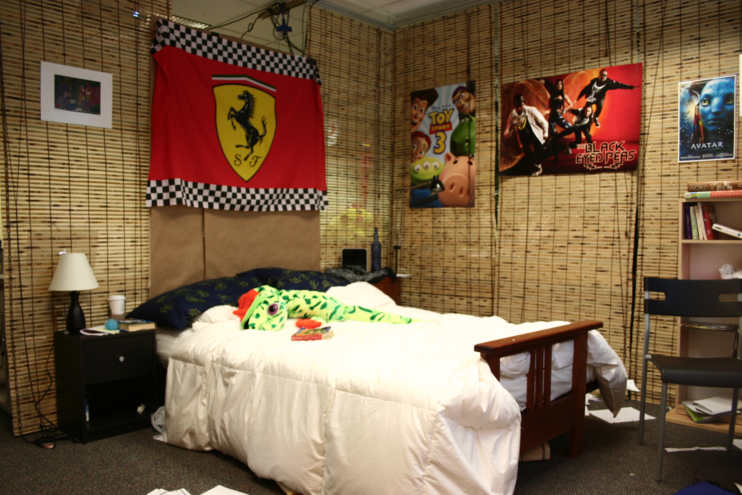
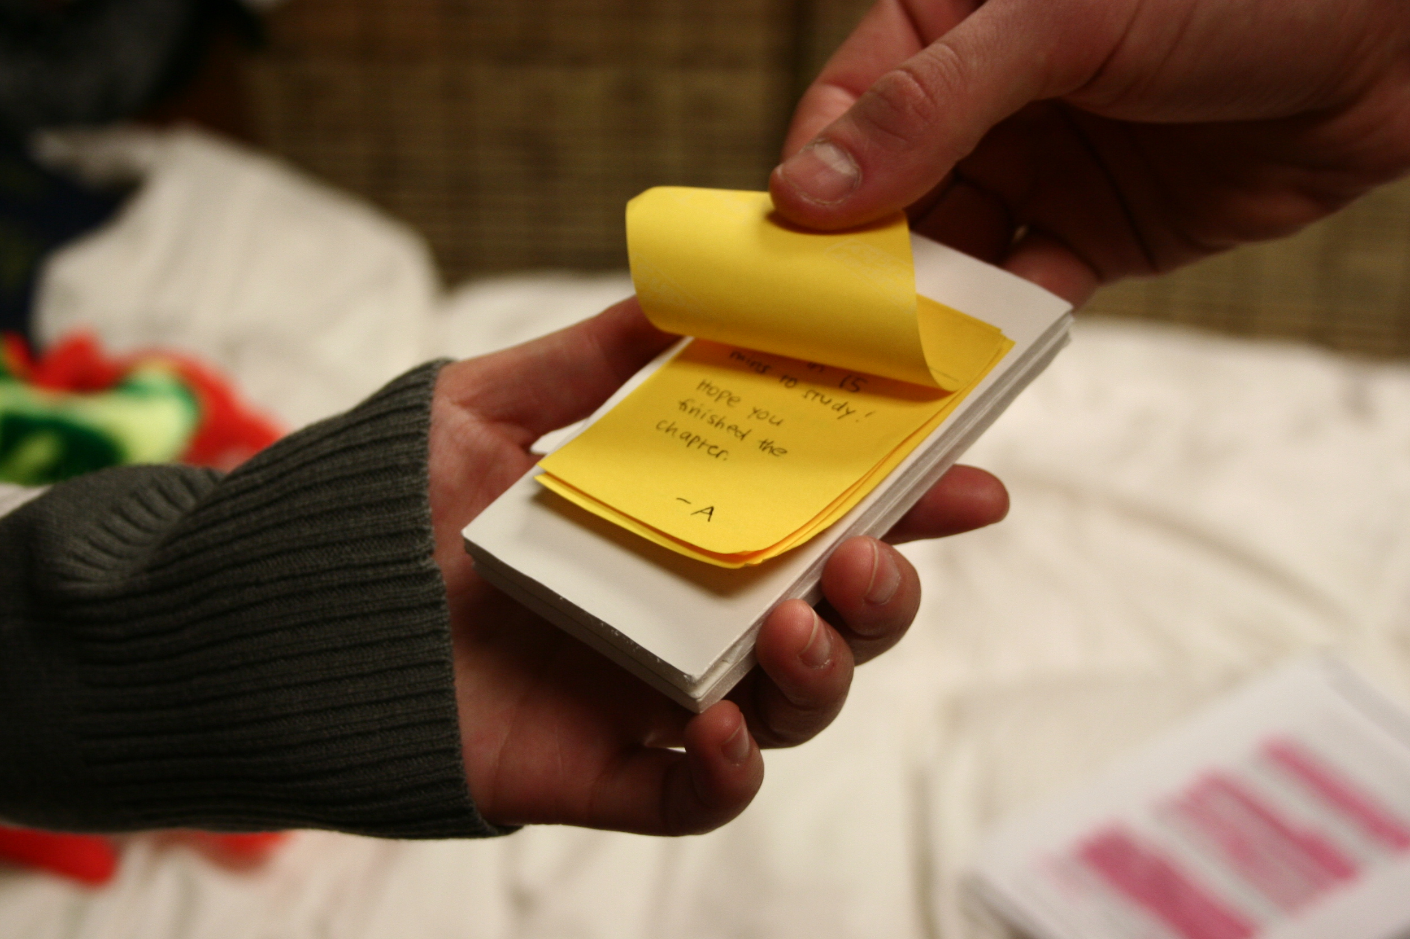
future work
William Odom, John Zimmerman, Jodi Forlizzi | Human-Computer Interaction Institute | Carnegie Mellon University
Notes:
We developed an interactive bedroom to begin critically probing these issues.

Slide 38
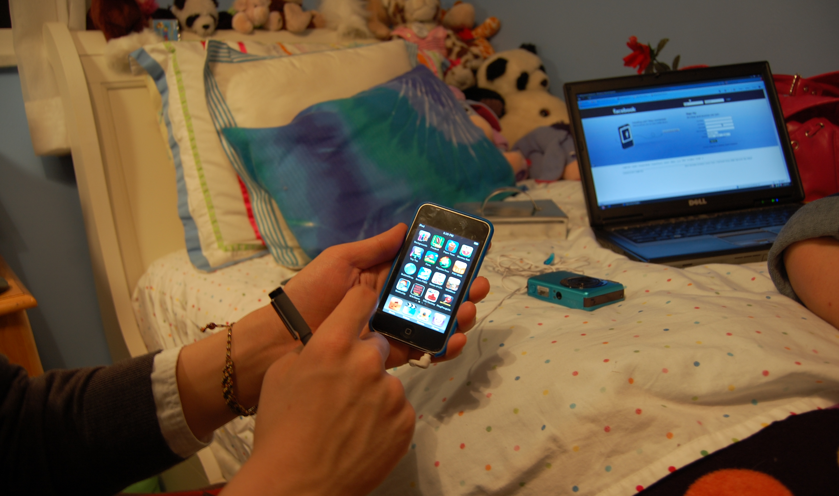
William Odom, John Zimmerman, Jodi Forlizzi | Human-Computer Interaction Institute | Carnegie Mellon University
Notes:
Ultimately we hope this research will lead to further critical inquiry into how people in the future might interact and live with their virtual things in more meaningful and self determined, and values-oriented ways.

Slide 39
William Odom, John Zimmerman, Jodi Forlizzi
Human-Computer Interaction Institute
Carnegie Mellon University
This work is supported by NSF grant IIS-1017429 and Google
William Odom, John Zimmerman, Jodi Forlizzi | Human-Computer Interaction Institute | Carnegie Mellon University

Slide 42
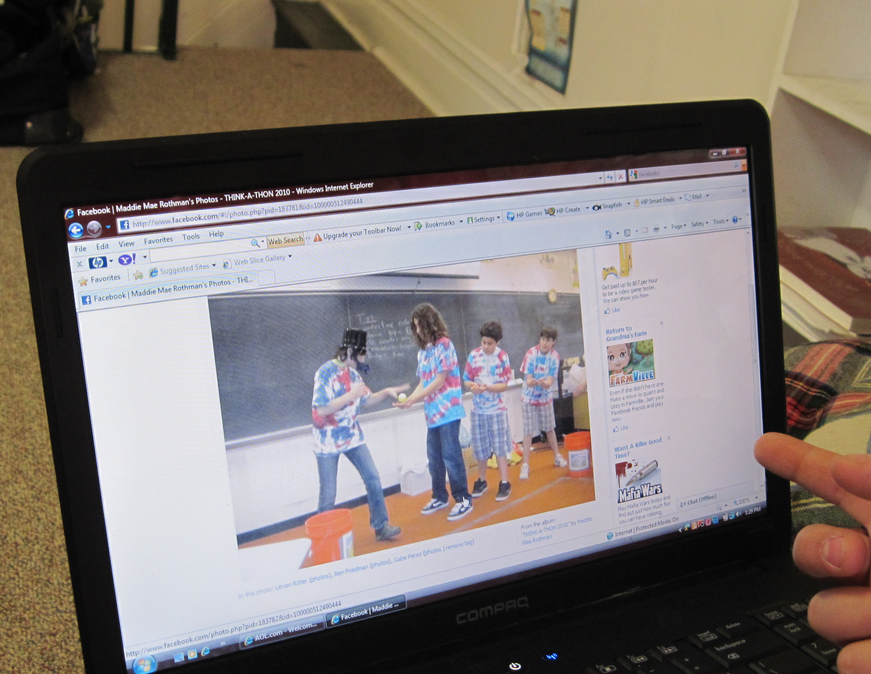
metadata and sharing
“…linking you all together. …you’re showing something happened that made you think of them. (Mary)
William Odom, John Zimmerman, Jodi Forlizzi | Human-Computer Interaction Institute | Carnegie Mellon University
Notes:
In online places, some teens used the ‘tag’ function in Facebook to link to a set of friends that extended beyond the people in a specific photo. Mary describes this practice, saying “…it’s a way to get their attention and get them to comment on the photo or, if they don’t, …it’s linking you all together. …you’re showing something happened that made you think of them.” Metadata helped support sharing practices and value emerged from the creation of metadata instead of the virtual possession itself.

Slide 43
potential paradoxes and consequences
William Odom, John Zimmerman, Jodi Forlizzi | Human-Computer Interaction Institute | Carnegie Mellon University
Notes:
While virtual possessions can increase a sense of social connectedness across individuals and groups, they could also work to amplify differences and reinforce cliques

Slide 44
potential paradoxes and consequences
can increase a sense of social connectedness
could work to amplify differences and reinforce cliques
William Odom, John Zimmerman, Jodi Forlizzi | Human-Computer Interaction Institute | Carnegie Mellon University
Notes:
While virtual possessions can increase a sense of social connectedness across individuals and groups, they could also work to amplify differences and reinforce cliques

Slide 45
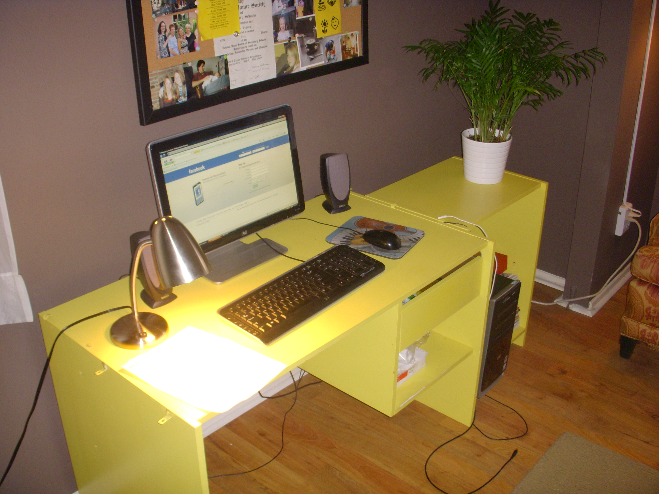
potential paradoxes and consequences
William Odom, John Zimmerman, Jodi Forlizzi | Human-Computer Interaction Institute | Carnegie Mellon University
Notes:
New technologies for presentation of virtual possessions could provide people with valuable portraits of their identity; however they could equally self obsession through creating the ongoing obligation to curate multiple selves

Slide 46
potential paradoxes and consequences
new technologies could provide valuable portraits of identity
could promote self obsession through creating the ongoing obligation to explicitly curate multiple presentations of self
William Odom, John Zimmerman, Jodi Forlizzi | Human-Computer Interaction Institute | Carnegie Mellon University
Notes:
New technologies for presentation of virtual possessions could provide people with valuable portraits of their identity; however they could equally self obsession through creating the ongoing obligation to curate multiple selves. In general all of these issues point to the fact that new opportunities could create new obligations

Slide 47
method
in depth interviews with 21 teenagers
what kinds of virtual things do they use?
how does value emerge with these kinds of possessions?
William Odom, John Zimmerman, Jodi Forlizzi | Human-Computer Interaction Institute | Carnegie Mellon University
Notes:
To investigate this emerging space, we conducted in depth interviews with 21 teens to explore what kinds of virtual things they use and how they form attachments to them. <cut>

