Slide 1
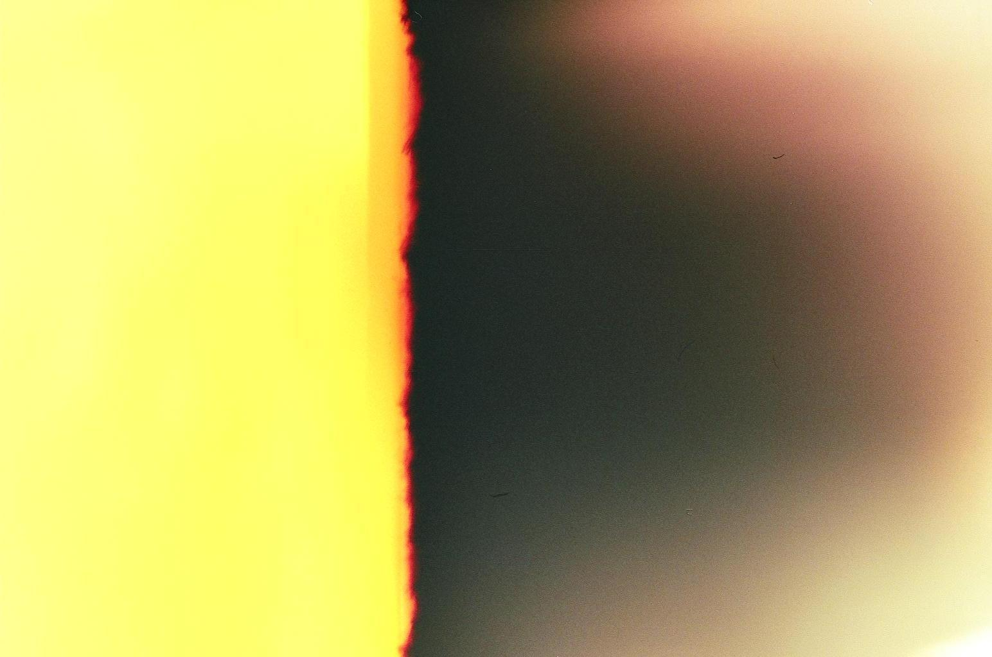
Passing On & Putting To Rest
understanding bereavement in the context
of interactive technologies
William Odom¹, Richard Harper², Abigail Sellen², David Kirk³, Richard Banks²
Carnegie Mellon University¹
Human-Computer Interaction Institute
Microsoft Research Cambridge²
Socio-Digital Systems
University of Nottingham³
Mixed Reality Lab

Slide 2
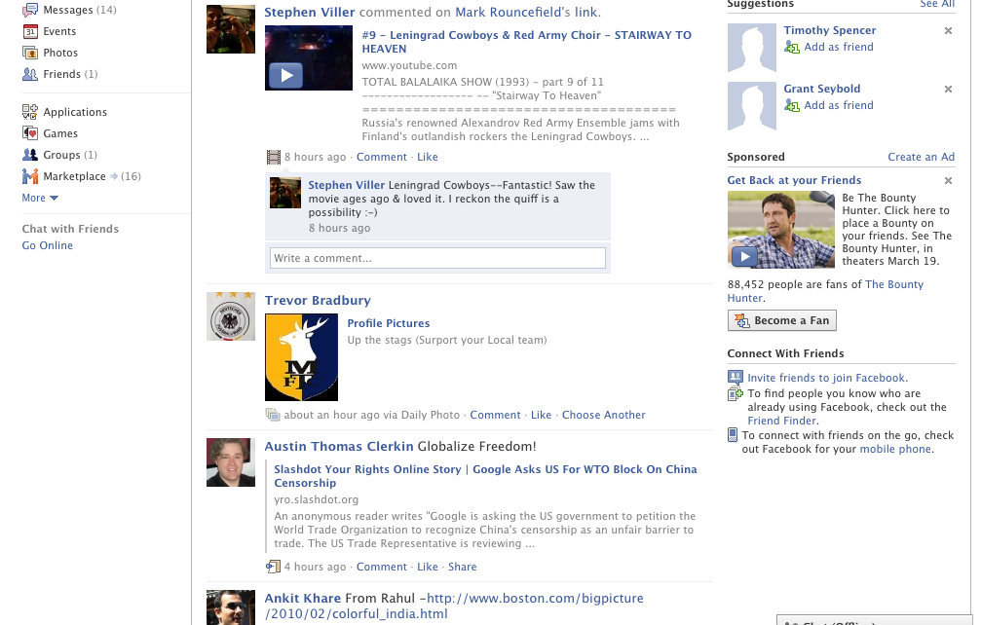
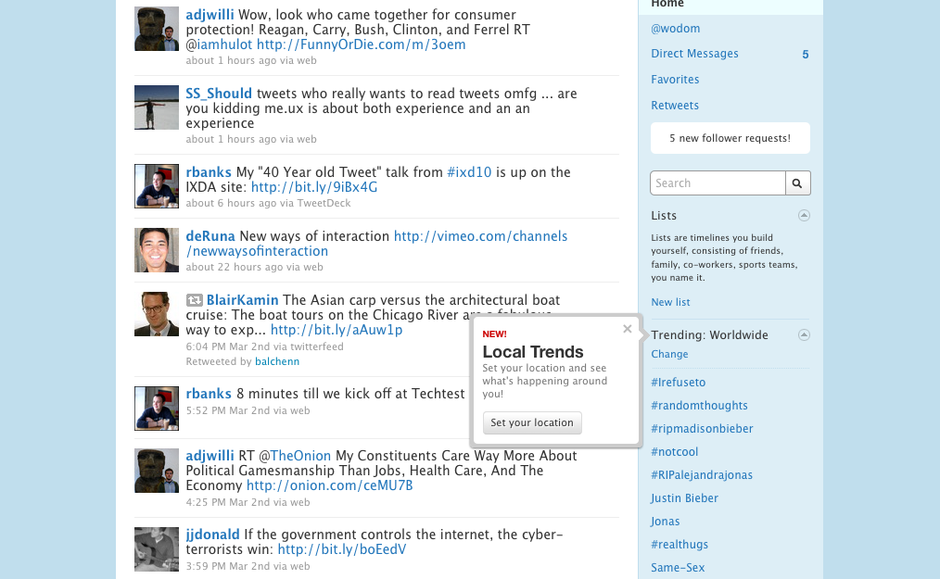
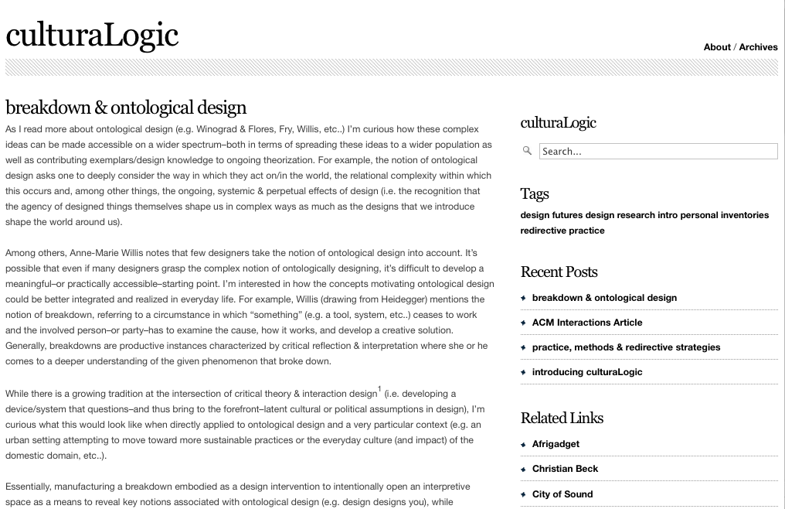
Notes:
So I want to start by mentioning how new technological trends are compelling us to confront a range of problems and issues about death and bereavement. For example, deceased users’ social networking web pages often persist after their passing, typically without measures in place to appropriately handle this content.

Slide 3
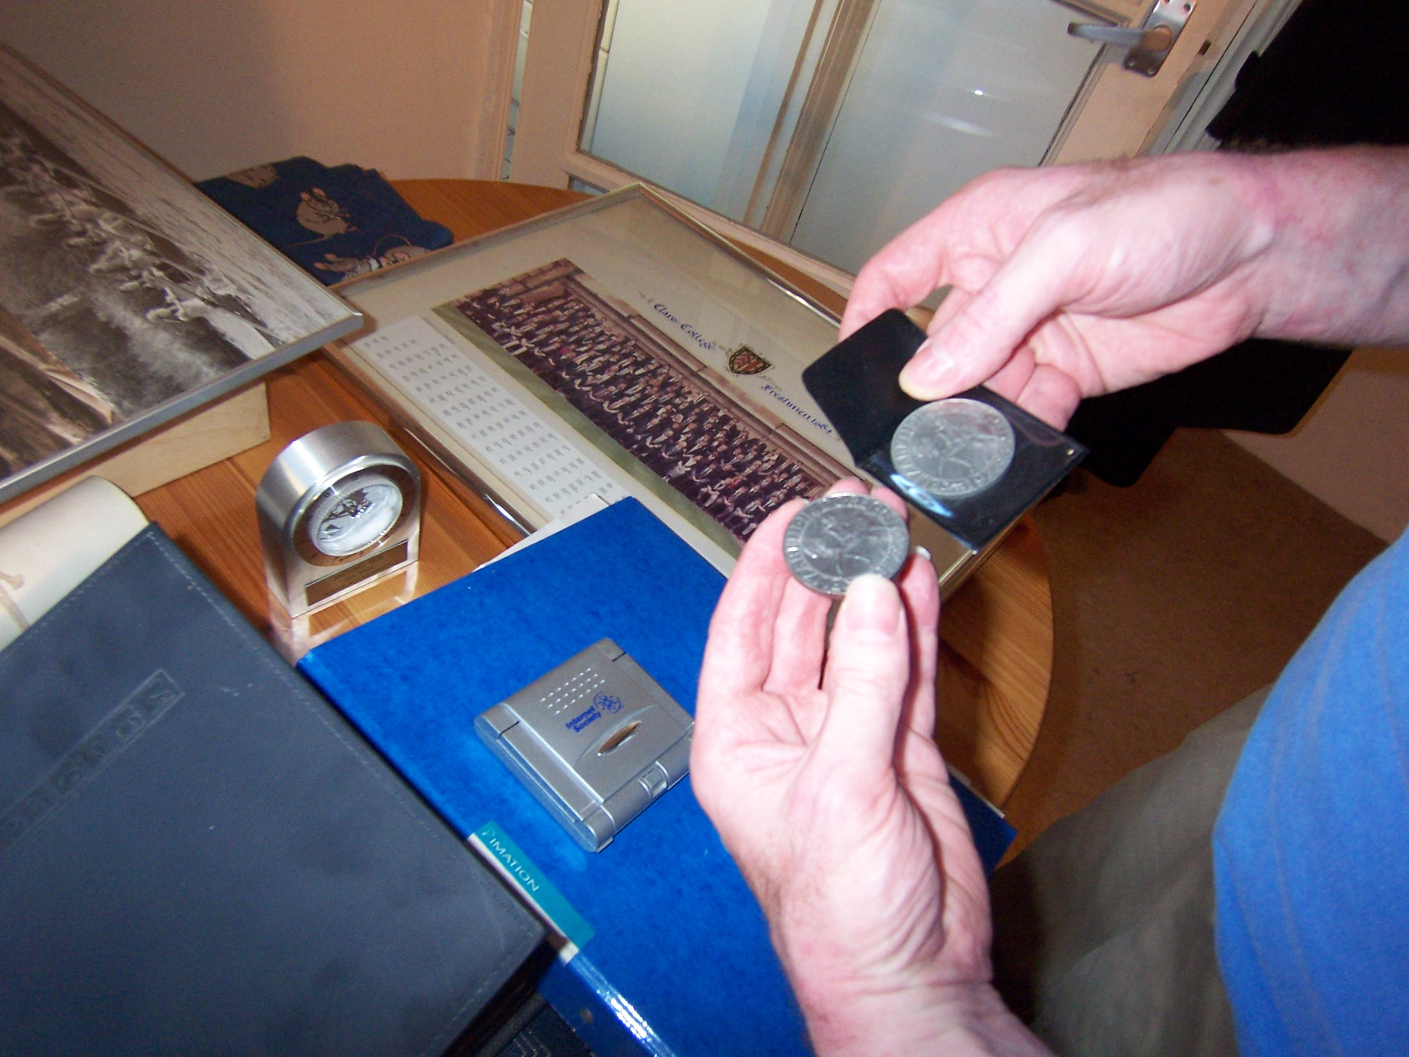
Notes:
Also, in contrast to the physical artifacts and heirlooms seen here…

Slide 4
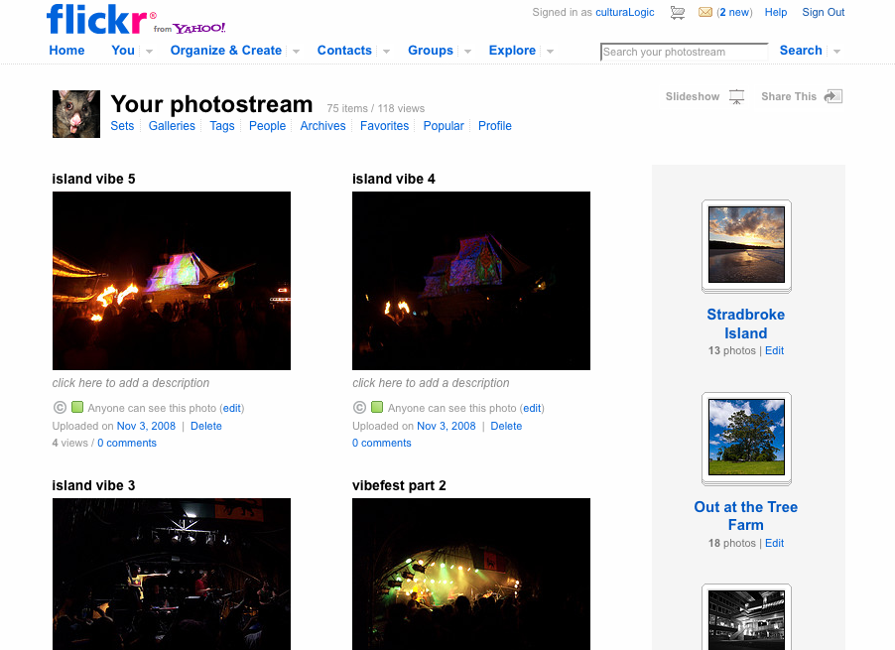
Notes:
There are few mechanisms to enable people to pass information to loved ones (or withhold information from them).

Slide 5
we’re seeing a vast proliferation of digital data…

Slide 6
we’re seeing a proliferation of digital data…
we’re seeing a vast proliferation of digital data…
how will our digital remains persist after we are gone?
how will they be managed?

Slide 7
we’re seeing a proliferation of digital data…
we’re seeing a vast proliferation of digital data…
how will our digital remains persist after we are gone?
how will they be managed?
the sensitive treatment of meaningful digital artifacts is a largely unaddressed but increasingly relevant issue to HCI

Slide 8
introduction
researching issues related to bereavement presents complex practical, theoretical and ethical challenges
Notes:
At the same time, researching issue related to bereavement is complex….<slide>…that deserve careful framing and treatment

Slide 9
introduction
adopt a sociological perspective to unpack complications encountered in field research
aim: conceptualize how HCI might begin to understand and address issues related to bereavement
sensitize the design space to processes that unfold after a death
Notes:
in this project we adopted a sociological perspective to unpack complications and tensions encountered across our field research…

Slide 10
outline
literature review
+sociological approach
field study method
+participants; questions
findings
+bequeathing & inheritance
+the doing of bereavement
implications
+sensitizing concerns
+design considerations

Slide 11
literature review
anthropology
psychology
sociology
contemporary interest in social sciences
HCI
Notes:
There are many different ways to understand death and In the paper we review various histories and approaches in the social sciences. In this presentation I’m going focus on a quick and simple introduction to sociology…

Slide 12
literature review
anthropology
psychology
sociology
contemporary interest in social sciences
HCI
Notes:
In the paper we offer a much longer discussion of these areas, here I’ll briefly review them to give the gist in an oversimplified way
<<get rid of black slide & give a sense of the wealth of things we looked at—this a fundamental part of the paper>>

Slide 13
sociology
the personal experience of and confrontation with death, not as biological fact, but as a social one
emphasis on patterning of social relationships
Sudnow, D. (1967). Passing On: The Social Organization of Dying. Englewood Cliffs, New Jersey.
Berger, P. L. & Luckman, T. (1966). The Social Construction of Reality: A Treatise in the Sociology of Knowledge, Garden City, NY: Anchor Books.
Notes:
The sociological perspective was beneficial to use in that the... [personal experience of and confrontation with death…]

Slide 14
social death
Sudnow’s work explored institutionalization of death & dying
social death does not have to do with death of the body, but with the death of relationships people have with the deceased
emphasizes distinction between death and bereavement
Sudnow, D. (1967). Passing On: The Social Organization of Dying. Englewood Cliffs, New Jersey.
Notes:
In particular we looked at the works of David Sudnow and the social organization of death. Sudnow’s work explored institutionalization of death & dying, and the patterning of relationships between hospital workers and patients… This is a significant point that I’ll come back to… first I want to quickly note that..

Slide 15
social death & bereavement
How do relationships between the bereaved and departed loved ones unfold over and shift over time? What forms do they take on and how are they managed?

Slide 16
participants
11 participants recruited through forums and local counselor
all from south eastern region of the United Kingdom
loss of spouse, close family member, and/or close friend in past 1-6 years
age breakdown is roughly 2 participants per generation
(e.g. ages 20-60)
no participants reported strong religious or spiritual affiliations
Notes:
recruited through advertisements in online forums,
bereavement community email lists, local newspaper, local
bereavement counselor

Slide 17
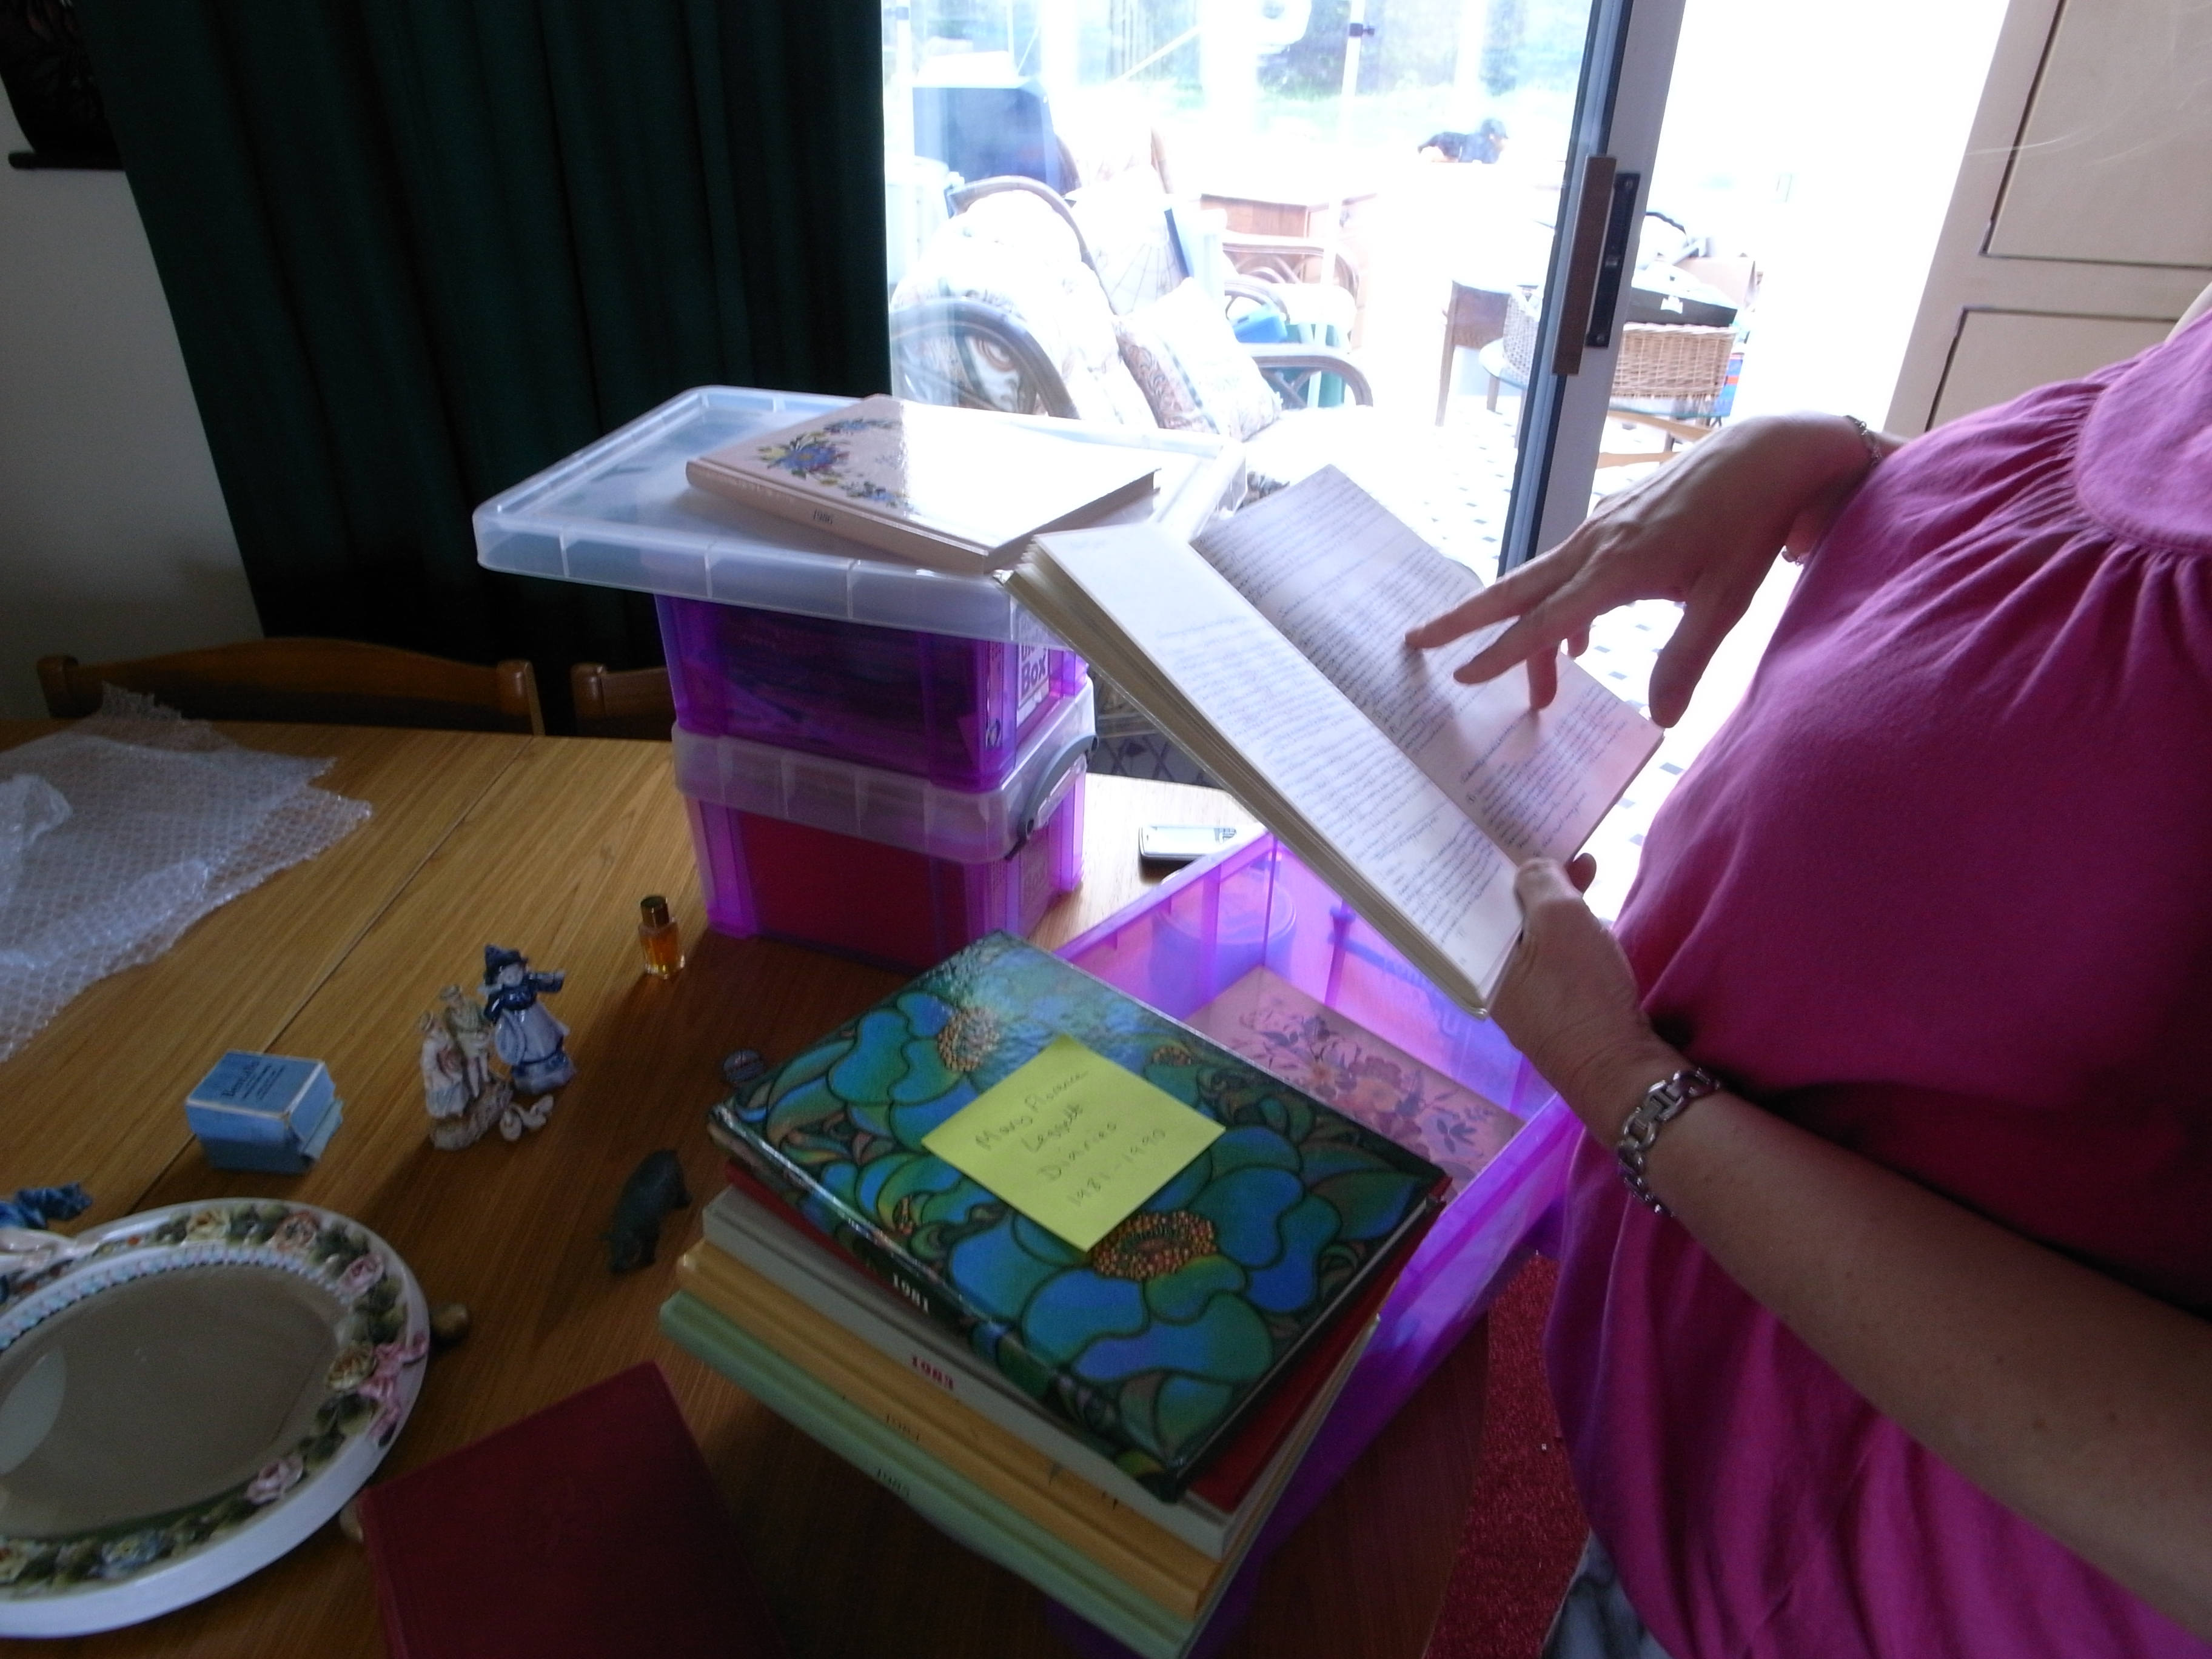

Slide 18
retrospective reflections
how long has it been since you have lost your loved one?
how often do you think about him or her?
how do you remember him or her?
what was left behind?

Slide 19
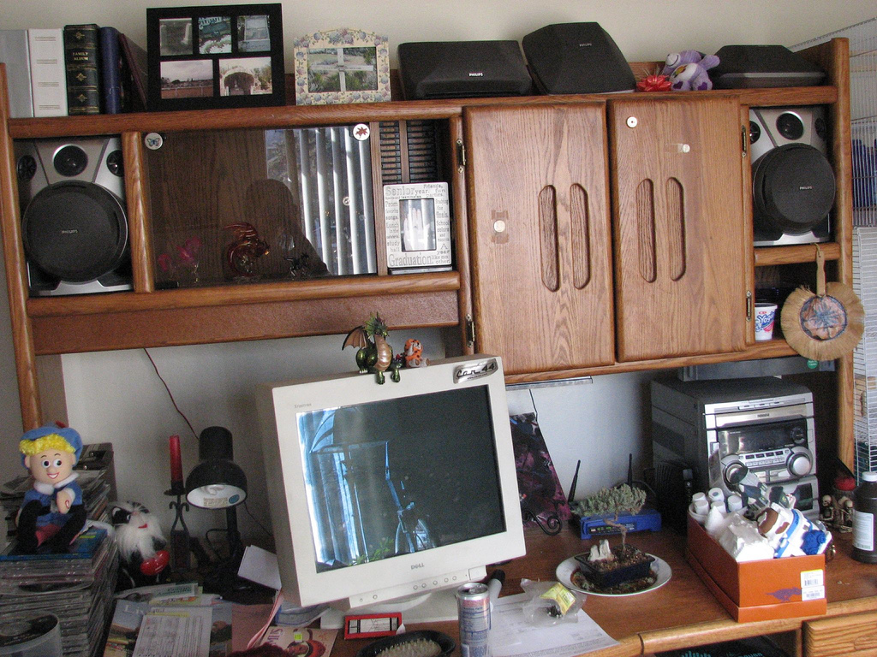
prospective reflections
do you think about how your own legacy will live on?
what digital or physical things will represent you?
what kind of stories do they evoke?

Slide 20
communicating with the dead
relationships appeared to peculiarly linger on
early and often emergent theme made it clear bereavement is
about relationships
a key problem of relationships is that even when someone dies, that relationship doesn’t want to end

Slide 21
“I put his mobile phone in his coffin with him, right next to his ear. He got commiserated with his mobile. I would text ‘miss you’ or the score when Arsenal won [football] matches or …something about the happy times we had together. Things like that.” (P9)
Notes:
This example reflects the way in which many of our participants talked about the departed in relatively mundane ways, despite the shock and grief of bereavement, and while these kinds of relationships unfold gradually and in peculiar ways, they nonetheless seem to persist.

Slide 22
bequeathing
the act of bequeathing objects has certain properties
the process of passing things down invokes the
social relationship
the peculiarity of the relationship is its asymmetric:
the bereaved are left to come to grips with why they were chosen to be the bearer of particular things
Hallam, E., Hockey, J. 2001. Death, Memory and Material Culture, Oxford, Berg.
Finch, J., Mason, J. 2000. Passing On: Kinship & Inheritance in England. Routledge.
Notes:
…In what follows we will describe themes that emerged during our interviews when exploring our participants’ perceptions of digital and physical artifacts bequeathed to them.

Slide 23
bequeathed objects
objects of personal significance
idiosyncratic aspects of personal relationships
examples: old pipe, collections of figurines, a sword, musical instruments, a pocket watch, a bullet
objects of historical legacy
classic family heirlooms, ownership for many decades
examples: early photos of long deceased family members, paintings illustrating family crests, family bibles
Notes:
Artifacts bequeathed to our participants came in diverse forms and related to their lives in various ways. Three categories that emerged are: (i) objects of personal significance, (ii) objects of historical legacy and (iii) objects of anticipated legacy. Here I’ll give a brief overview, they are described more in depth in the paper….

Slide 24
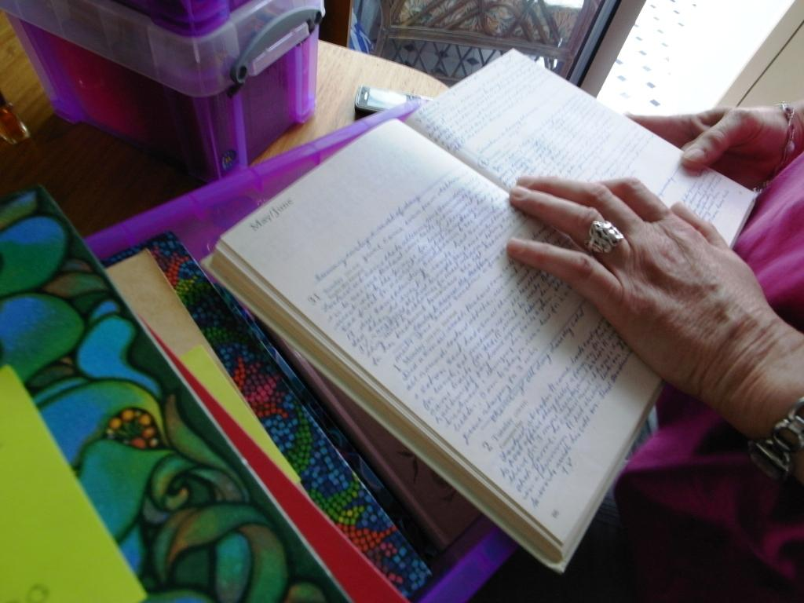
objects of anticipated legacy
owed to the lives of the departed & anticipated to become historical legacy heirlooms
examples: toolset, artworks produced by family members
exemplar: 30+ years worth of diary entries recorded by grandmother & mother
Notes:
A particularly compelling example emerged in P2’s discussion of her extensive collection of journals composed by her late grandmother and late mother, which collectively housed entries for nearly every day over the past 3 decades.

Slide 25
“So many of the diaries just say things like ‘Cleaned kitchen. Joy went to rehearsal all day. I did some gardening. Took a nap. ‘ …just really dull, ordinary, everyday things [that] seem so boring, but now they’re really important ...there’s a whole of social history of our lives in there.” (P2)
Notes:
For example, P2 reflects on how the systematic recordings of mundane information now richly evoke the past.

Slide 26
“It hasn’t been easy having them ...but I think they felt like it was necessary so they can remind us of the dull stuff and the good times and the hard times.
...it’s their lives and in a way my life and I think they will become part of my daughters’ lives.” (P2)
Notes:
P2 further reflects on being bequeathed this collection and its potential legacy within her family.. P2 recognizes the value that these collections could take on for her children.
<add more description to this slide / discussion?>

Slide 27
bequeathing & complications
bequeathed objects were not always described as positive
many instances represented strange paradoxes
participants could neither come to terms with objects nor get rid of them
(i) miscommunications in the exchange
(ii) burden of unfiltered collections

Slide 28
miscommunication in exchange
physical ex: silver goblet, rock collection, collections of clothes
digital ex: final chat transcript, photos, digital video will
felt obligated hold onto objects, even when these things were becoming sources of stress and discomfort
Notes:
Participants feeling unable to understand why they were selected to be the bearer of particular objects.

Slide 29
“My Grandfather collected rocks. I never knew
that. I didn’t collect [rocks] with him ...but for some reason
he wanted me to have it.
What do you do with such a thing!
... I keep it under my bed for now.” (P1)

Slide 30
burden of unfiltered contents & collections
inability to make sense of unfiltered inherited archives
physical ex: huge archive of paper documents, box various mementos owned by mother
digital ex: a computer (hard drive), and mobile phones cluttered with personal and work-related text messages
Notes:
These were typically objects of perceived importance among miscellany.

Slide 31
“I simply don’t know what to do with it. I feel like I can’t go through it, there could be anything on there. …but I don’t want to wipe it. I considered just pulling out the hard drive and putting it in a box and getting rid of the tower.” (P7)
Notes:
This participants describes how they’ve yet to make progress dealing with a computer inherited from his late friend. <quote>
This quote highlights the trepidation other participants also conveyed, which is fear that they will find something not intended for them… here you can see he considers preserving only the hard drive but still with no plan over what to do with it…

Slide 32
burden of unfiltered contents & collections
obligated to manage collections, while simultaneously burdened to deal with unfiltered information
the digital amplified this problem:
+complications over not knowing where to begin
+tensions around unexpected encounters
Notes:
So bequeathing & inheritance marked key ways the dead in a sense communicated to the living, and these examples mark some of many tensions that arose. This then naturally leads to the question of how do the dead persist and the living reciprocate attempt these social exchanges and where do key tensions arise?

Slide 33
complications with interactive systems
social networking systems complicated shifting social relationships with the departed
core problem: lack of established mechanisms to appropriately mark a departed person’s account
Notes:
a diverse range of complications emerged, one theme had to do with conflicts relating to privacy and appropriateness of action

Slide 34
“Janet died in a bad bus accident abroad. It was all over the news and a reporter used quotes from her Facebook [page]. …they put quotes of what her boyfriend had last written and what she had last posted.
…it felt like a big invasion of privacy and disrespectful to anyone that did know her.”(P4)
Notes:
Here, a lack of measures to treat this space differently led to the projection of deeply personal information into the public realm.

Slide 35
tensions, privacy and choice
beyond accessibility, tensions are rooted in the inability to treat these online spaces differently when a person has passed away
not to suggest spaces ought to be deleted
more sophisticated layers of choice and privacy should be considered in the system design
Notes:
a desire highlighted by several of our participants as they prospectively considered their own online accounts.

Slide 36
recognized opportunities for interactive systems
despite these problems potentially novel aspects of these systems emerged
instances where new online space was specifically demarcated for remembrance
Notes:
Despite these problems our participants also pointed toward potentially novel aspects of these systems, particularly in instances where new online space was specifically demarcated for remembrance.
<participants pointed out potentially novel aspects –> then point to the quote.. for example…>

Slide 37
“I went to Al’s funeral, which was ok but I didn’t have a chance to talk to many people…
But, this [memorial] website was more interactive in the sense that I could write what I wanted to say and other people could read it and I could read what they had to say. …I found that valuable …to be aware of all the different dimensions of relationships this person had with others.” (P2)
Notes:
This example and others suggest rich opportunities for creating socially constructed narratives reflective of the relationships formed throughout a person’s life, if adequate measures are in place to demarcate these spaces.

Slide 38
rituals & techniques for managing the relationship
people managed relationships with the departed through physical & digital artifacts
care taken to preserve and hideaway some artifacts, ex:
+encrypting digital files deep in directory structure
+storing files on external media elsewhere in the home
+filing funeral paraphernalia deep in desk drawers
Notes:
We also encountered several rituals ad techniques for managing relationships with the departed, which were largely reflected in the management of physical and digital things… In some cases it was deeply important for some participants to preserve and hideaway some artifacts..

Slide 39
“It’s the technological equivalent to putting them in the back cupboard. You put [them] away because you need to ...you have to ...you know they’re there …but they get covered up ...life keeps moving on.” (P6)
Notes:
For example, P6 reflects his encrypted files, “<quote>.” This is exemplary of how these objects are visceral markers of the departed’s death; and they are hidden and sedimented as a way of moving past the biological moment of death, signifying an important act in the transition of the relationship.

Slide 40
rituals & techniques for managing the relationship
ritualized uses of artifacts reflect on the departed
artifacts could be invoked and then fade into the background
physical artifacts: candles, a windup clock, photo albums, various trinkets belonging to departed, decaying statue
digital artifacts: mobile phone text message archives, locally stored email archives
Notes:
Our participants also reported diverse uses of artifacts in ritualized ways to engage in periods of reflection on the departed. A key quality of these artifacts was their ability to be invoked and then be put away or simply fade into the background. A sample of non-digital artifacts included candles (P1), a windup clock (P5), photo album (P3, P9, P10, P11), and trinkets held in a jacket that belonged to the departed (P2).
We also encountered several participants (P4, P8, P9, P11) in possession of digital archives of text messages received prior to a loved one’s passing.

Slide 41
“Now and then I bring them out. ...[I] see things he’s written to me, like ‘I hope today went ok’ and I think about why he sent that and what was going on then. ...I know I can always find them, but it’s also important I can put them away” (P8)
Notes:
P8 reported possessing over 200 text messages sent from her departed husband, which highlighted many momentous and mundane aspects of their relationship.
These messages are saved on a flash memory card, which is stored separately in an ornate box only taken out during the ritual. “<quote>.”
-ritualistic
-

Slide 42
rituals & techniques for managing the relationship
digital artifacts played key roles in the bereaved’s management of relationships with the departed
once the ritual comes to a close, aspects of the relationship can be put away by the bereaved on their own terms

Slide 43
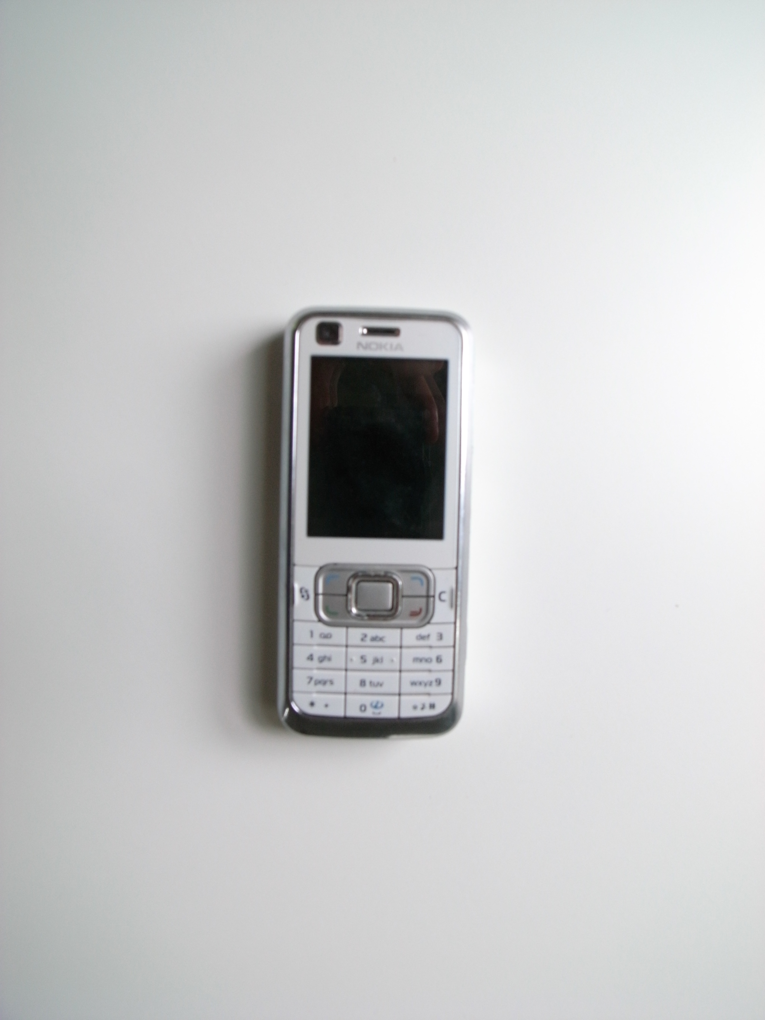
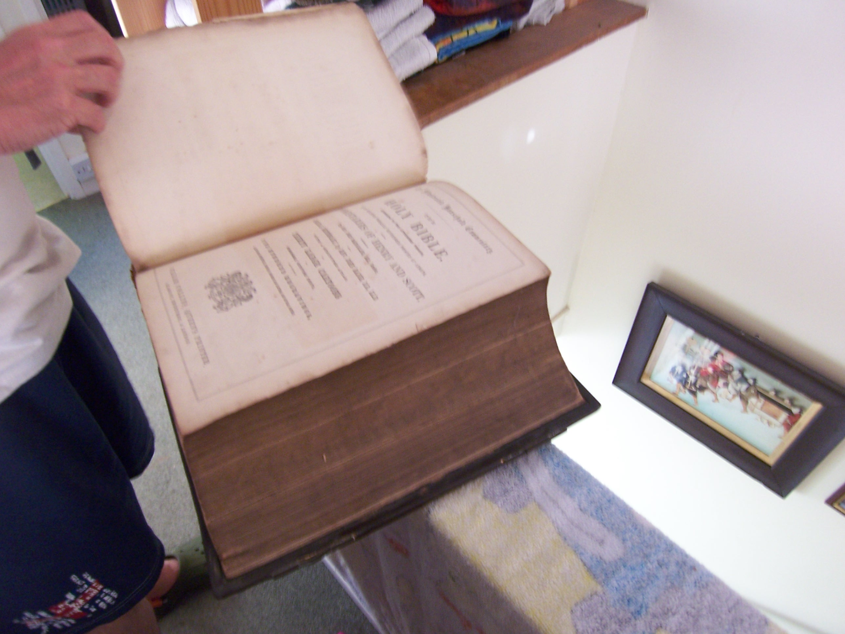
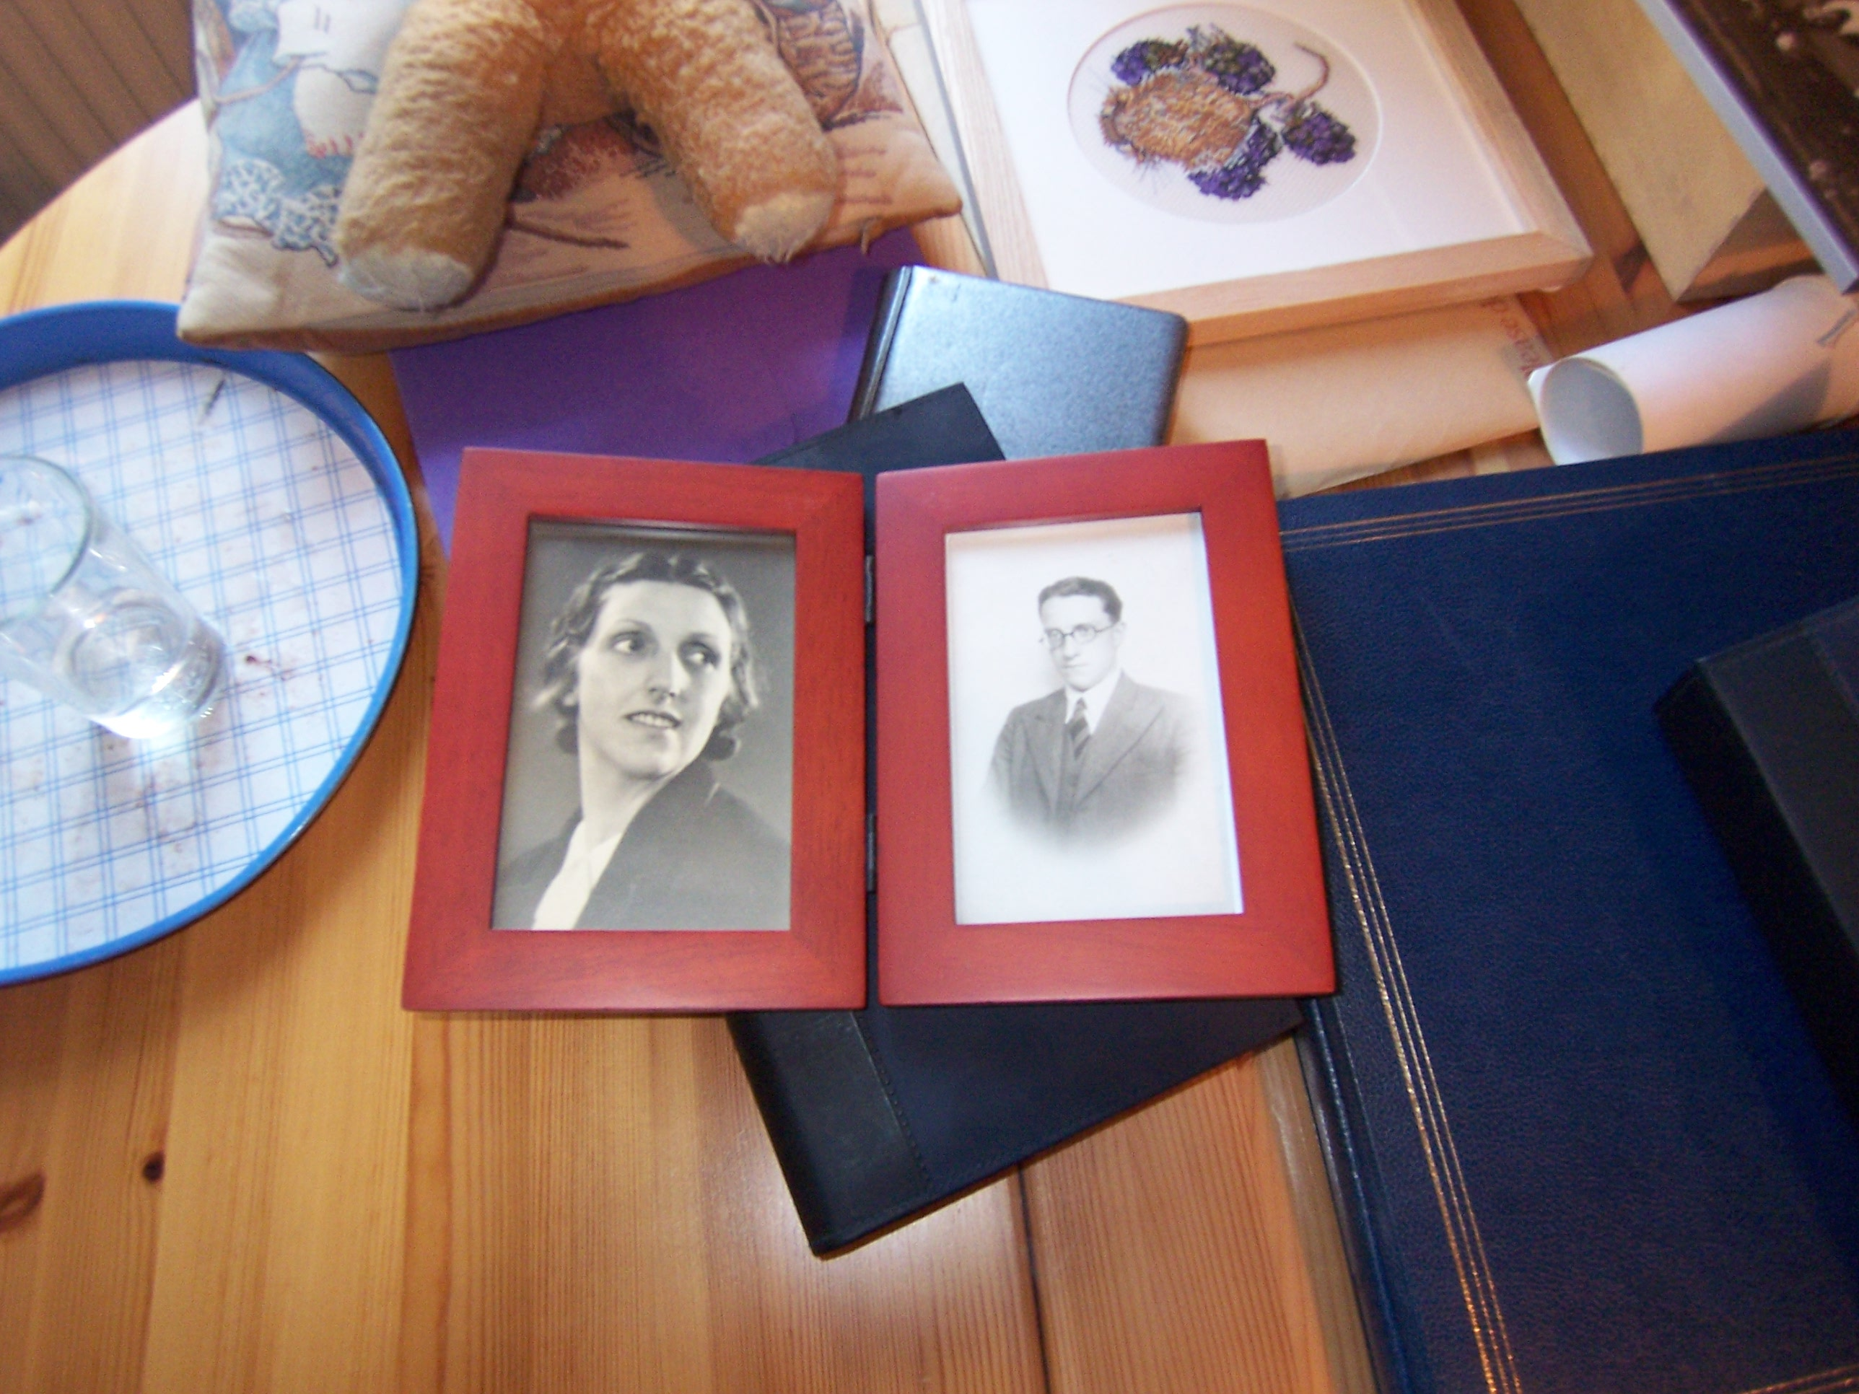
conclusion
Notes:
This has just been a glimpse of instances arising from the fieldwork we conducted. BUT it makes it clear bereavement and its attendant issues are complex. On one hand, digital systems raise issues of ownership, access and persistence as well as several new opportunities for supporting these kinds of relationships, engaging in rituals, creating new kinds of treasured content.
Considering the paucity of work in HCI on the topic, we propose two concerns to help sensitize the design space.

Slide 44
designing for deep storage & sedimentation
ownership was a highly significant part of maintaining and putting aspects of the relationship to rest over time
How could systems be designed to enable users to allocate groups of content for deep storage?
How could the safety of the contents be peripherally conveyed to owners?
How should deep storage archives endure when owners themselves pass away?
Notes:
this suggest deeper levels of choice to be designed into interactive systems that enable people to demarcate content for deep storage and treat it differently from other data in the system…

Slide 45
clarifying exchanges through contextualizing content
being unable to make sense of why they received an object or archive caused key complications; amplified in the digital
How could ascription of information to digital objects demarcate the significant from the trivial within personal archives?
How could these tools expressively evoke the social bonds characterizing exchanges such as bequeathing and inheritance?
Notes:
How could the ascription of information to digital objects help demarcate the significant from the trivial within vast personal digital archives?
How could tools expressively evoke the personal and familiar bonds characterizing social exchanges like bequeathing in more satisfying ways?

Slide 46
emphasizing reciprocity & engagement
enabling people to craft and deliver smaller selections of digital materials to loved ones
What are the most appropriate starting points to design for reciprocity in sensitive and meaningful ways?
How could new meaning and value emerge from interactions with these selections over longer periods of time?
Notes:
Despite the potential to pass on massive archives of information, there may be virtues in enabling people to craft and deliver selections of digital materials….
This stands in contrast to a lifelogging perspective in that it emphasizes engaging interactions with a distilled set of artifacts, opposed to passive maintenance of a life’s record.

Slide 47
marking shifting status & state
no clear mechanisms to treat online spaces of the departed differently
How could loved ones more flexibly push the webpage of the departed into a condition signifying their change of state?
What design decisions could lead to socially constructed record of a person’s life, and how should they be passed on?
Notes:
As P2 saliently highlighted, online spaces could be leveraged to create a unique platform for personal and public expression related to the departed’s life.

Slide 48
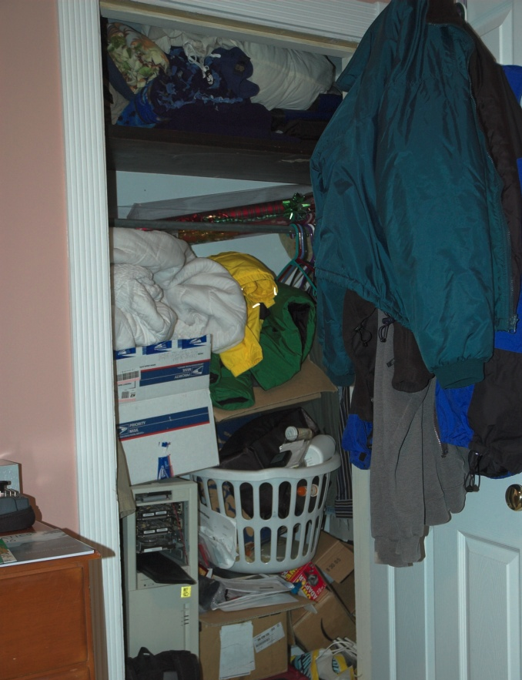
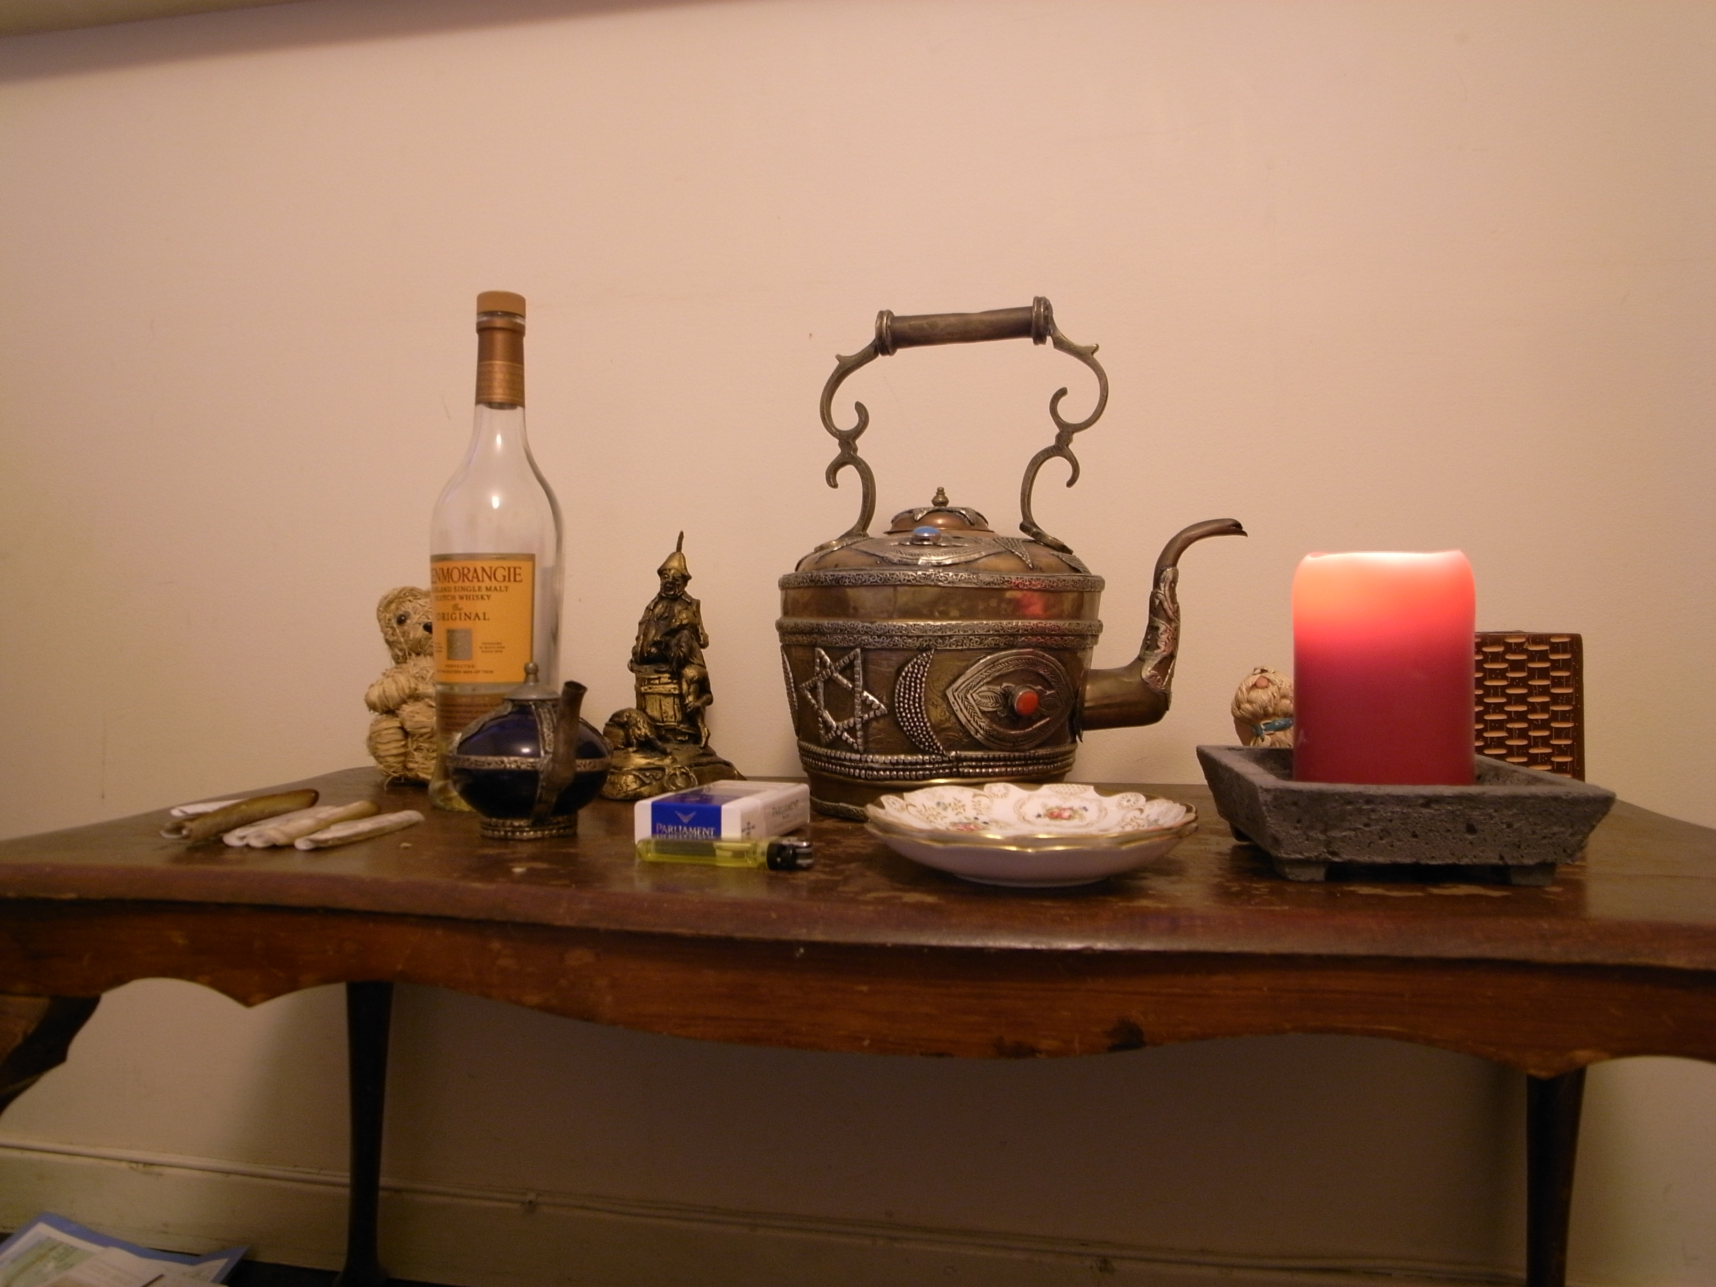
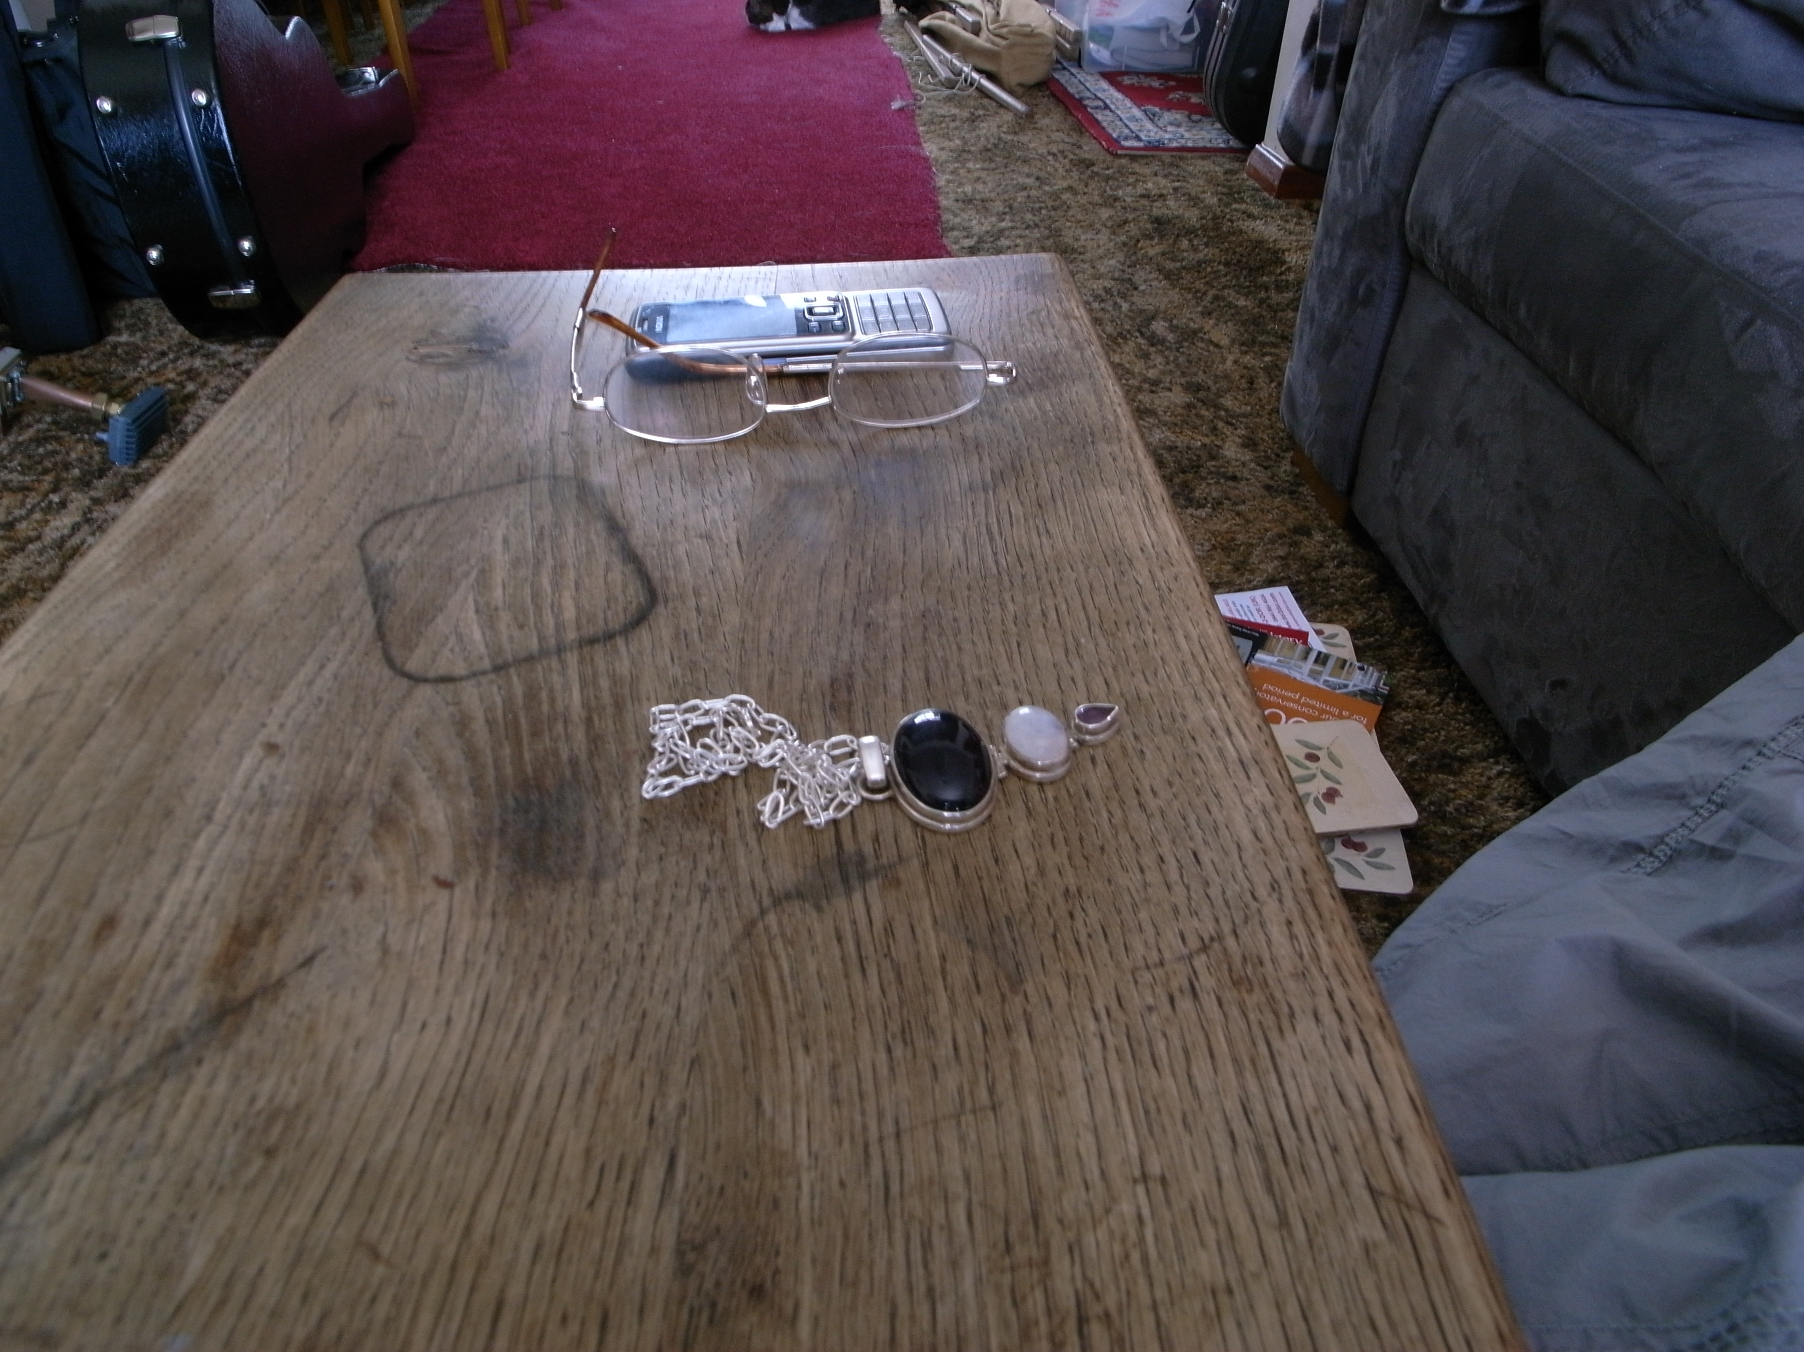
conclusion
Notes:
So ultimately I think this study brings up questions that we all will inevitably face. The aim here is to both raise questions about and inspire future research into how technologies might be designed to better support people as they face choices of passing on or putting to rest aspects of social relationships, now and well into the future.

