Slide 1
citizen science & bus transit: understanding challenges & opportunities for automatic-vehicle locator systems
kevin huang | angela lamas-butler | william odom | jordan patton
mentor: john zimmerman
p&t 2009

Slide 2
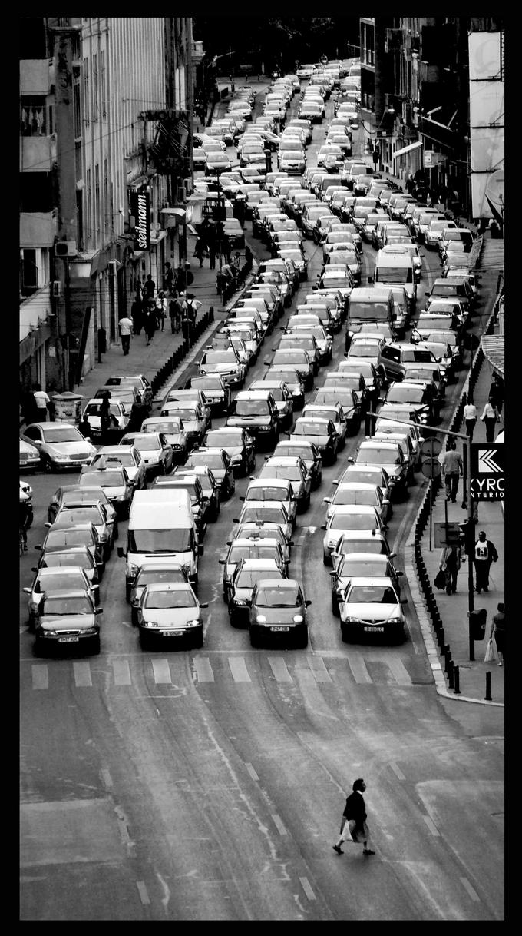

Slide 3
intro + motivation
automobiles = CO2
US cars emit more than 333 million tons of carbon dioxide each year
accounts for more than 20 percent of the nation’s total carbon dioxide emissions
Environmental Defense Fund http://www.edf.org/page.cfm?tagID=1135
Sagar, A.D. (1995). Automobiles and global warming: Alternative fuels and other options for carbon dioxide emissions reduction. Environmental Impact Assessment Review 15, 241-274.

Slide 4
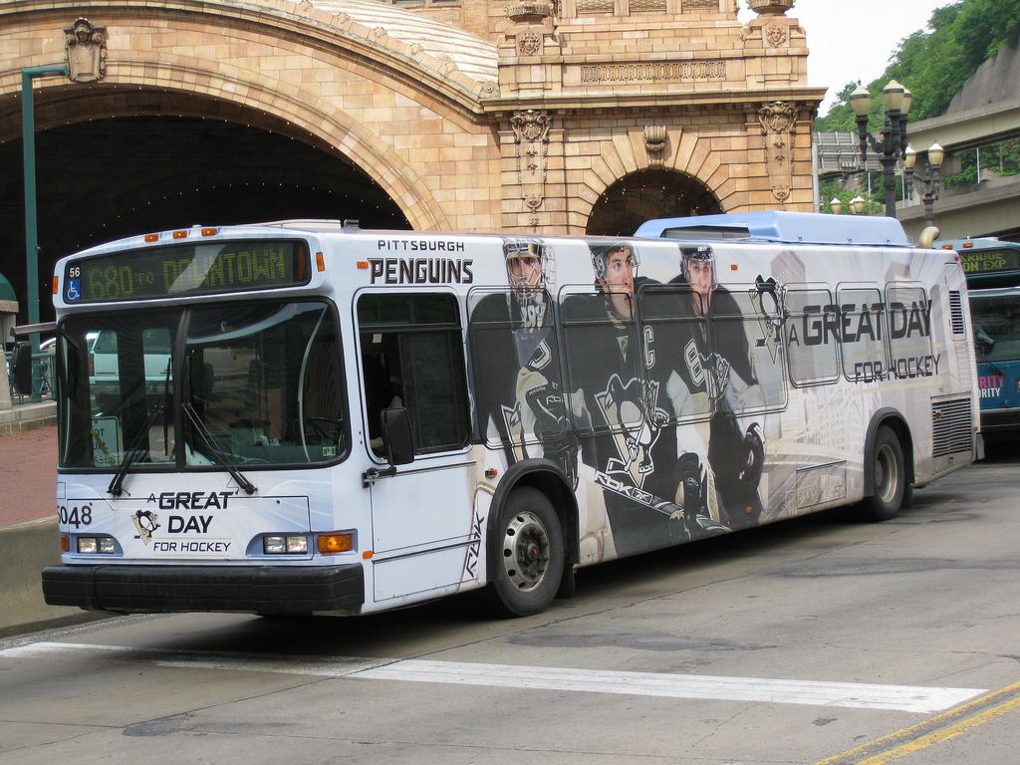
intro + motivation
automobiles = CO2
US cars emit more than 333 million tons of carbon dioxide each year
accounts for more than 20 percent of the nation’s total carbon dioxide emissions
Sagar, A.D. (1995). Automobiles and global warming: Alternative fuels and other options for carbon dioxide emissions reduction. Environmental Impact Assessment Review 15, 241-274.

Slide 5
intro + motivation
one person switching to public transit can reduce carbon emissions by 4800 pounds per year
bus transit = 58% all public transport in US
1 full bus is 6X more efficient than a car
American Public Transportation Association. (2008). Public Transportation Fact Book. Washington D.C.
Willis, Terri. Cars: an Environmental Challenge. Chicago: Chicago Press, 1992.

Slide 6
understanding the problem
key barriers to increasing citizen ridership
fundamental problem: understanding when a bus on a given route is due to arrive at a respective bus stop
Schwartz, M. B. (1980). Motivations and barriers to riders’ acceptance of bus transit. Transport, 19:4, 53-62.

Slide 7
understanding the problem
“roughly 85% of all calls were riders asking Where is my bus?”
“often the calls came because the rider could not reconcile the schedule they had with the buses they saw or did not see arriving at a stop.”
[Zimmerman et al., p. 6]
Collins, C., Grude, A., Scholl, M., and Thompson, R. 2007. txt bus: wait time information on demand. In Ext. Abs of CHI '07, 2049-2054.
Zimmerman et al. (2010, under review). Understanding the space for co-design in riders’ interactions with a transit service.

Slide 8
existing technology
previous field research in Pittsburgh
lack of available information:
1. where buses are at any given time in the city
2. levels of capacity those busses were at

Slide 9
existing technology
Automatic Vehicle Locator (AVL)
GPS-based bus tracking
implemented across select US cities:
Seattle
Atlanta
Kansas City
Milwaukee

Slide 10
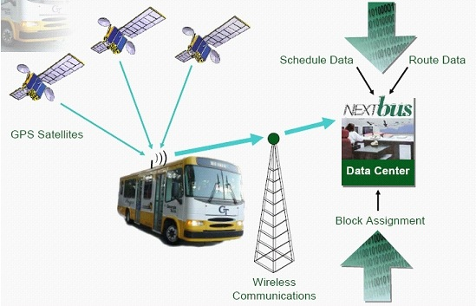
existing technology

Slide 11
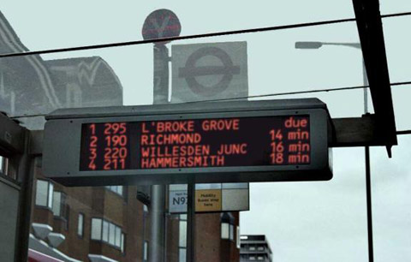
existing technology

Slide 12
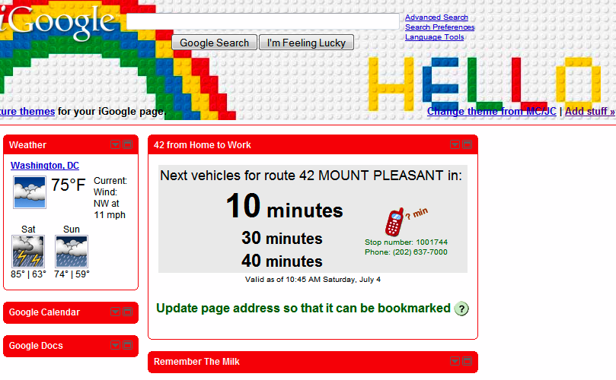
existing technology

Slide 13
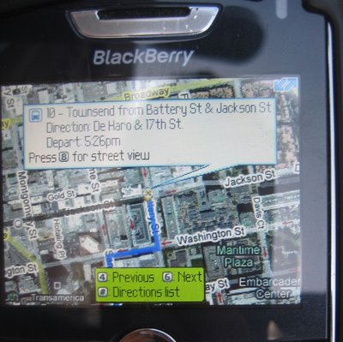
existing technology

Slide 14
existing technology
case studies indicated AVL implementation has resulted in significant increases of ridership (up to 40%) from one year to the next
United States Transportation research board. (1999). Evaluation of the Benefits of Automated Vehicle Location Systems for Medium Sized Transit Agencies. Washington D.C.
Hickman, M. (2004). Bus Automatic Vehicle Location (AVL) Systems. in Gillen, D. & Levinson, D. (eds.) Assessing the Benefits and Costs of ITS. 58-88.
Casey, C. (2003). Real-time information: Now arriving. MetroMagazinehttp://www.metromagazine.com/Article/Story/2003/04/Real-Time-Information-Now-Arriving.aspx Last accessed: September 22, 2009.

Slide 15
existing technology
many cities have not adopted bus transit AVLs
(including Pittsburgh)
$70,000,000 initial cost for Pittsburgh
+
big upkeep
NextBus New Contract Press Releases. http://www.nextbus.com/corporate/press/
Hickman, M. (2004). Bus Automatic Vehicle Location (AVL) Systems. in Gillen, D. & Levinson, D. (eds.) Assessing the Benefits and Costs of ITS. 58-88.

Slide 16
citizen science
mobile phone → personal instruments
“enable individuals to become active participants and stakeholders as they publicly collect, share, and remix measurements of their city that matter most to them” [p. 414]
Paulos, E., Honicky, R., Hooker, B. (2008). Citizen Science: Enabling Participatory Urbanism. In Foth (ed) Handbook of Research on Urban Informatics: The Practice and Promise of the Real-Time City. Hersey: New York.
Tang, K. P., Keyani, P., Fogarty, J., and Hong, J. I. 2006. Putting people in their place: an anonymous and privacy-sensitive approach to collecting sensed data in location-based applications. In Proc. of CHI '06, 93-102.

Slide 17
paucity of HCI research
no citizen science-oriented HCI research projects to date have targeted issues of bus transit OR citizen-enabled public services

Slide 18
research questions
What are the requirements for designing and implementing a citizen-enabled AVL system?
In what ways might citizens be leveraged to improve the perceived value of citizen-enabled AVL systems?
How can we detect co-ridership in order to leverage it to reduce battery drain and increase data reliability?

Slide 19
contribution
Discussion on why any citizen-enabled must be highly automated and key opportunities for improving the value of citizen-enabled AVLs
A series of socially and technically-oriented design recommendations for future citizen-enabled AVL systems

Slide 20
methods
two stage project
exploratory interviews with frequent users of commercial AVL systems
survey of existing technical opportunities; development & testing of co-ridership detection application

Slide 21
methods / qualitative research
8 participants (3 female & 5 male)
frequent users of commercial AVL systems
recruited from San Francisco & Seattle areas via online advertisement forums
demographics / screener survey
semi-structured phone interview (30-45 mins)

Slide 22
methods / participant sample
ages mid-20s [P4, P5, P8]
mid-30s [P2, P3, P7]
mid-40s [P1]
mid-60s [P6]
occupations student, reporter, I.T. consultant, business consultant, computer programmer, office administrator, graphic designer

Slide 23
methods / interviews
aim: prompt discussion on range of issues
personal experiences
When you think back to the past week, can you describe your experiences of when you used the NextBus system? For example, how do you access it? What time of day? Where were you? Did you encounter any problems? How did you deal with them?
contextual factors
When you think about the last time you got on the bus, what were you doing when you got on it? For example, did you have your hands full (with groceries or your cell phone, etc..)? What about over the past week?
patterns of use
Can you compare and contrast previous bus riding experiences to using NextBus? For example, has NextBus motivated you to ride the bus less, more, or about the same compared to before it was implemented?

Slide 24
methods / outcome
present examples that capture core themes
outline broader thematic design recommendations highlight key opportunities for future citizen-enabled AVL systems

Slide 25
methods / technical component
GPS - iPhone app (Trails)
Accelerometer - E-Watch
Four scenarios
1. Same bus, sitting together
2. Same bus, front and back
3. Different buses, back to back
4. Different buses, crossing from opposite directions

Slide 26
user research / motivations
combined expense of owning a car and finding parking
“In San Francisco, it’s really difficult to park. Traffic in certain parts of the city can be really overwhelming. …it’s perfectly convenient to take [public] transit to get around now.” (P7)

Slide 27
user research / motivations
combined expense of owning a car and finding parking
secondary motivation → sustainability (P2, P3, P4)
“One of the biggest problems I had was getting around and getting places on time [on the bus]. …I hate to drive but sometimes I would have to. …We recently got rid of one of our cars, you know we’re trying to live be more green. …I use the bus system to pretty much get around everywhere now” (P4)

Slide 28
user research / motivations
2. value of real time bus location information
“It was like night and day once they installed it. I can't imagine trying to get around now without it. ...I don't think I would ride the bus nearly otherwise” (P3)
“I’m much more likely to ride the bus when I know exactly when it’s going to be there as opposed to standing around for half an hour” (P8)
Notes:
while they might seem simple or obvious these findings begin to suggest that the system will need to be near fully automated to be successful in a citizen enabled setting

Slide 29
user research / context of use
Three distinct situations
home
terminal destination returning to home (e.g. work)
navigating through an urban setting (to find most optimal route)
Platforms
personal computers (P1-P8)
work computers (P1, P2, P3, P4)
mobile phones,
low-end cell phones (P1, P4)
GPS-enabled smart phones (P3, P5, P7, P8)

Slide 30
user research / context of use
Home
All participants reported using their personal computer when accessing NextBus from home.
“Everyday I wake up and get ready to go to campus and check online [on my computer] to see when the bus is coming. …I leave about 5 minutes before it comes so I don’t have to wait. ..if the site is down, if it’s not important, I probably won’t just go wait [at the bus stop]” (P4)
“If I’m in my home, I use NextBus online to see when I can leave to catch a bus. …The computer is what I go to first” (P8).

Slide 31
user research / context of use
Work
Participants frequently reported using PCs to check NextBus when at work and planning their journeys back home
“I check it everyday before leaving work, sometimes a couple times …I don’t want to miss the bus you know but I’m not in a hurry to wait” (P4)
“yeah well sometimes it’s down. I hate that. …I usually try to get a ride from somewhere here [at office]. …if I can’t I walk down [to the stop] and wait” (P1)

Slide 32
user research / context of use
Urban Setting
Participants frequently reported using PCs to check NextBus when at work and planning their journeys back home
“I use my blackberry to figure out the best one [bus] to take if I’m out and a meeting switches to another location or something comes up. …you could say it’s more in an unanticipated kind of way. …no I don’t use it once I’m at the stop unless the bus doesn’t come at all, but that doesn’t happen often. …the whole point of is getting to the bus” (P3).

Slide 33
user research / context of use
emergent theme
most citizens require reliable AVL information outside of the bus stop context to ensure they will be motivated to ride the bus in the first place.
contrasts original assumption that information provided directly at the bus stop would be highly valued by citizens

Slide 34
user research / context of use
P1 reflects on the presence of NextBus marquees installed in shelters in San Francisco:
“I mean they’re nice to have, but I usually already know when the bus is coming when I’m there. …it’s not that they aren’t useful but they city probably spent a lot of money on them when they could’ve used it on something else” (P1).

Slide 35
user research / context of use
contextual input
time spent at bus shelters presents a key space to encourage citizens to contribute to the system
all participants reported that their hands were rarely free when a bus arrived and usually occupied both with payment materials and other extraneous objects

Slide 36
user research / context of use
contextual input
“I had a backpack with about 40 lb. of books in it, a coffee, and my wallet that I had pulled out to show my pass. Generally, I have some sort of backpack with me. I try to have my a hand free so I can show my pass” (P7)
“I always have a few books with me [in hand] … I pay with change if I have the right amount. …so yeah my hands are full …and my phone stays in my pocket or backpack” (P4)

Slide 37
user research / context of use
general implication
citizens’ lack of hand availability when buses arrive and generally throughout the journey suggests the citizen-enabled AVL system will need to largely be automated
system will be ineffective if relying on solely on manual input of bus location data from citizens
Notes:
need to leverage technical application opposed

Slide 38
user research / context of use
design opportunities
we found an emergent trend of citizens’ accessing AVL information prior to arriving at the actual bus stop
what kinds of additional types of information would be considered valuable to citizens when accessing the service from remote locations (e.g. home, work)?
participants reported several problems & emergent desires that suggest several concrete opportunities to increase the perceived value of a citizen-enabled service
Notes:
need to leverage technical application opposed

Slide 39
qualitative research findings
First…
an observation about our constituents.
(riders of public transit)

Slide 40
qualitative research findings
A community of consumers
Don’t want to be friends
Do want better service
Would work together for public good
Goal: Treat users as respected customers.
“…it’s not the kind of thing you’re going to get deeply involved in with someone. You’re all going where you’re going.” (P2)

Slide 41
qualitative research findings
Keeping that in mind...
Our findings suggest several key areas where
improvements could be made.
Let’s examine those areas.

Slide 42
qualitative research findings
Chaining information
Google Maps ➔ Muni ➔ NextBus (P3)
Multiple rides on the NextBus site
Bus exchanges (hour window with ticket)
Goal: Provide full-trip information.
Directions to nearest stop
Bus/train arrival times
Directions from destination stop
“If they could… link together multiple transfers in a very accurate way [it] would be very helpful.” (P7)

Slide 43
qualitative research findings
Vehicle capacity
More informed decision about using public transit
Walk, drive, wait for next bus
Protection from bad weather
Improve customer service
Goal: Provide vehicle capacity information.
Citizen-enabled (reported by observers)
Automated (RFID)
“The bus is too full to accept any new passengers, so the driver would just wave and move on.” (P8)

Slide 44
qualitative research findings
Shelter information
Location (move without warning)
Capacity (exposed to bad weather)
Safety (avoid using public transit)
Goal: Provide information about shelters.
Potentially addressed by user input
Very strong opportunity for citizen-enabled AVL
“Yeah if I knew if one was full and it’s raining I would look for another stop.” (P3)

Slide 45
qualitative research findings
Exceptional circumstances
Traffic, special needs riders
Buses break down
Data source fails
Goal: Handle exceptions gracefully.
Not currently addressed by automated AVL
Organically catch / flag exceptions with citizen-enabled AVL
“...the sign just says ‘no data.’ ... That means they’re not getting updates from the buses themselves. Something’s died in the system.” (P7)

Slide 46
qualitative research findings
Communication with service providers
…is generally a massive failure, resulting in:
Loss of goodwill and transit riders
Increased customer service costs (phone line)
Difficult to recover trust
Must build trust from the start

Slide 47
qualitative research findings
Goal: Communicate openly with constituents.
Treat as respected customers
Listen to feedback; address concerns
Citizen-enabled AVL could provide feedback, enable communication
“You can call the Muni office or the BART but you’re not going to get any help from them. ...you hardly ever even talk to a real person.” (P1)

Slide 48
technical findings / GPS Results
Shows latitude and longitude correlations
Has large errors
Largely influenced by weather

Slide 49
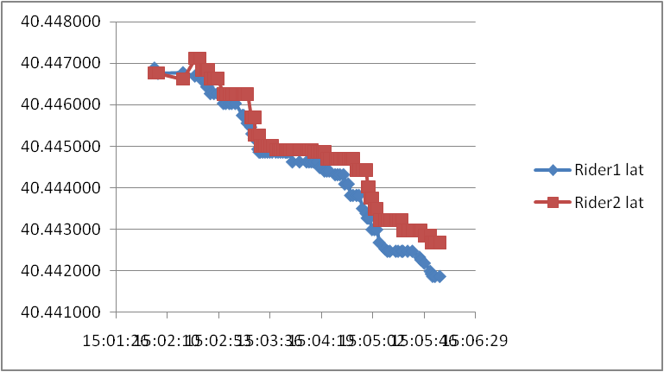
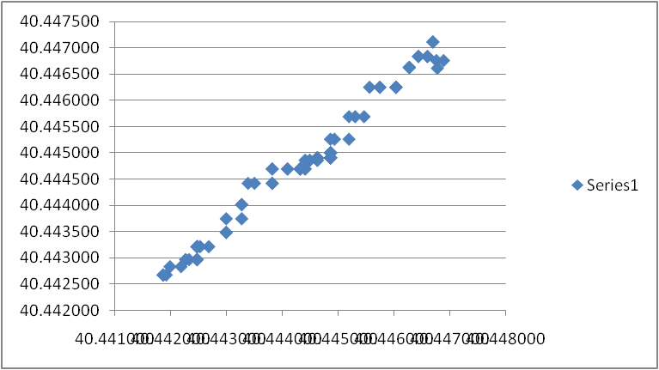
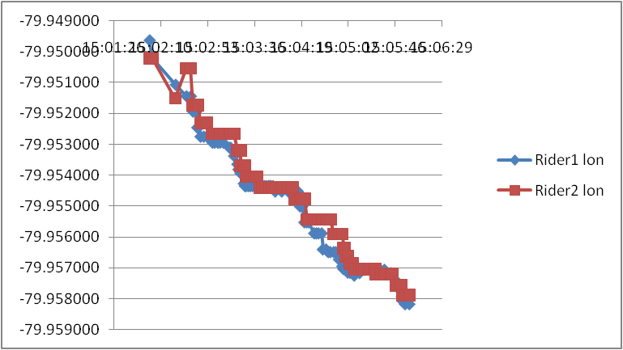
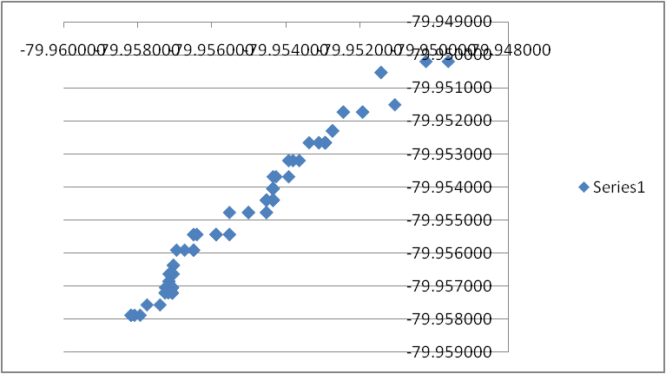
Same Bus, Front and Back
R = 0.988
R = 0.985

Slide 50
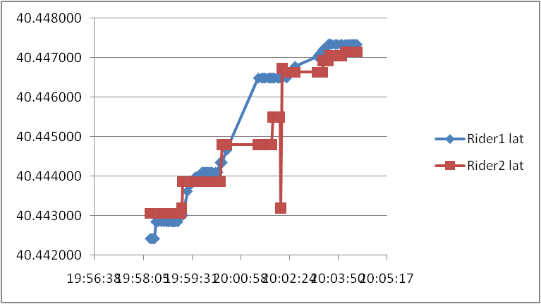
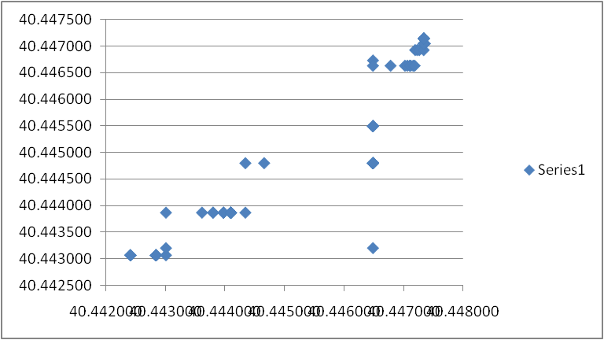
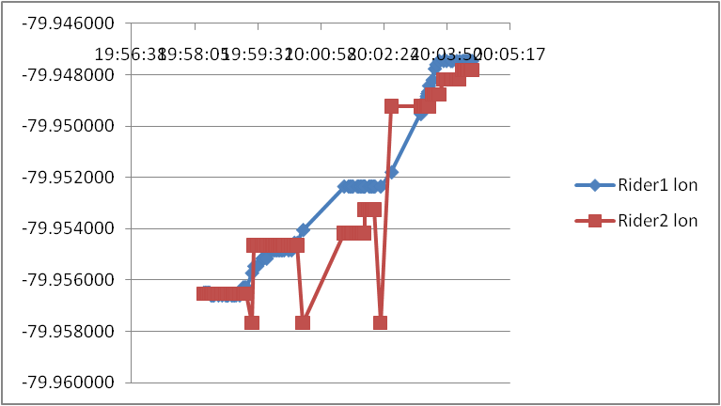
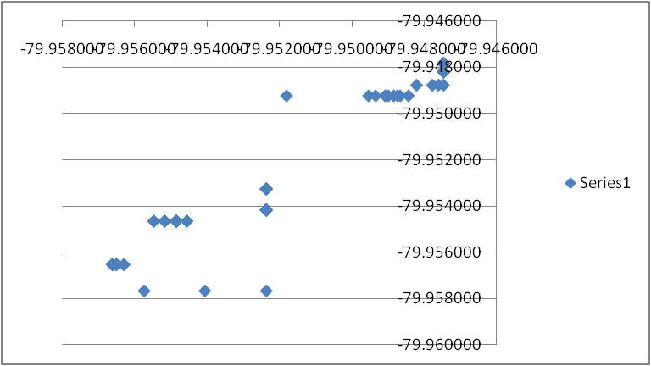
Same Bus, Both in Middle
Rainy and very windy
R = 0.93
R = 0.95

Slide 51
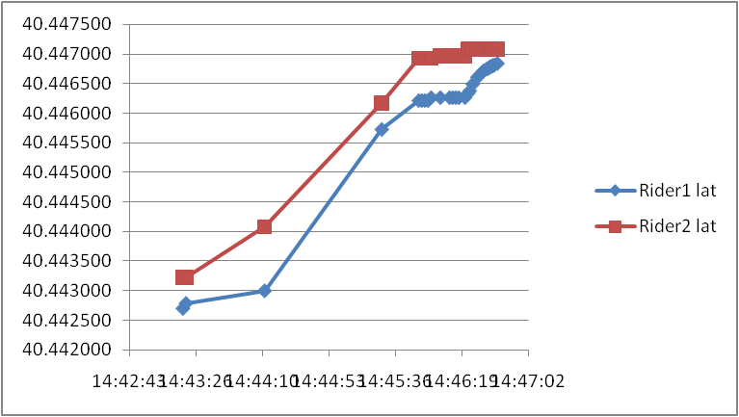
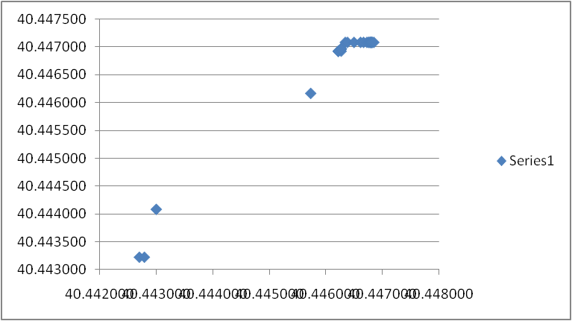
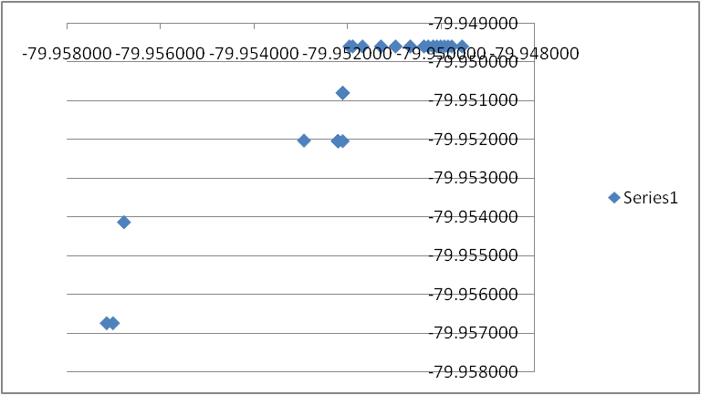
Different Buses, Back to Back
R = 0.98
R = 0.93

Slide 52
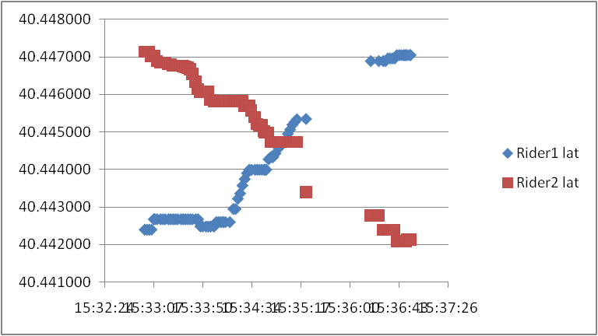
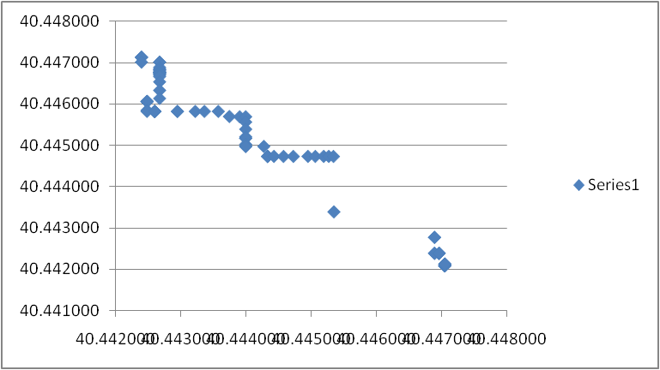
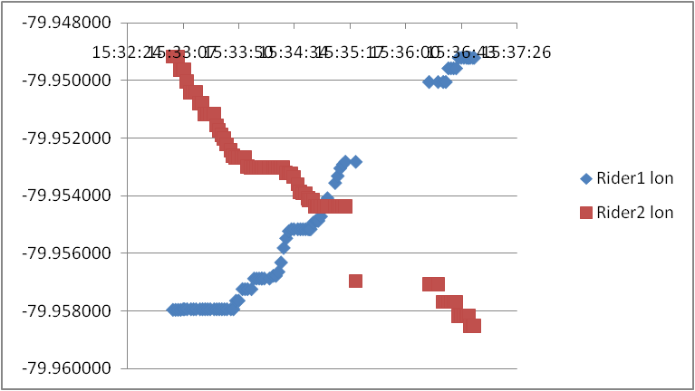
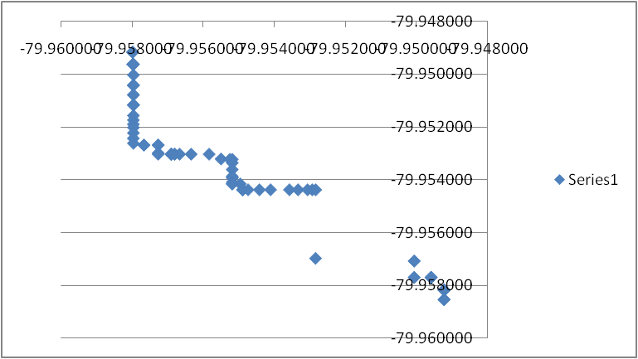
Different Buses, Crisscrossing
R = -0.97
R = -0.95

Slide 53
Accelerometer Results
Shows close temporal correlation
Can see the bumps for riders occur simultaneously in graphs
Bus ride has significant turbulence that can be detected by accelerometers

Slide 54
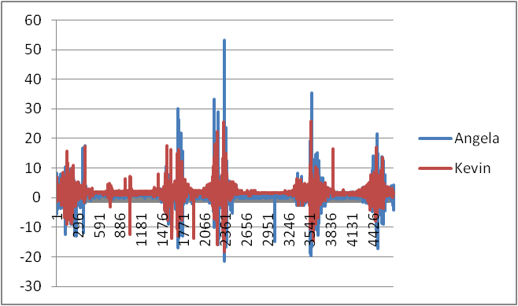
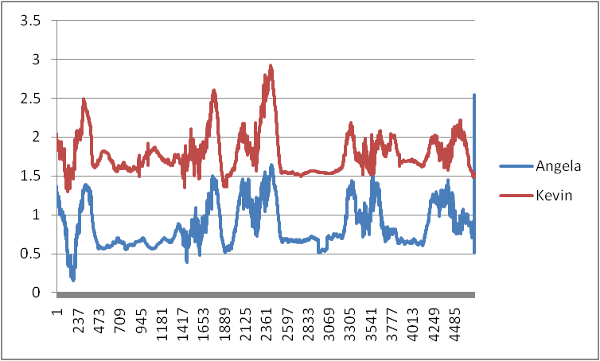
Same Bus – Same Side
Raw Data
Smoothed Using Moving Average

Slide 55
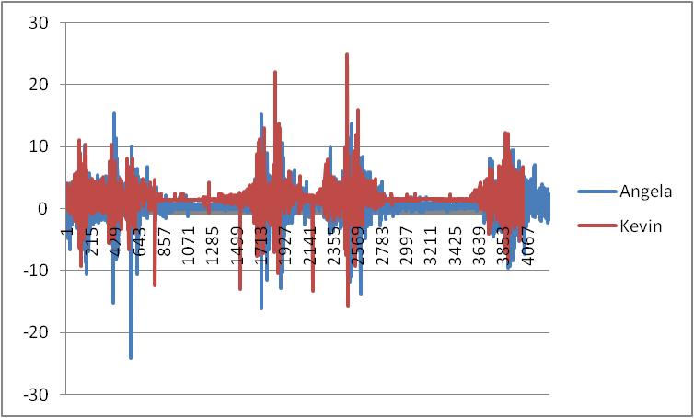
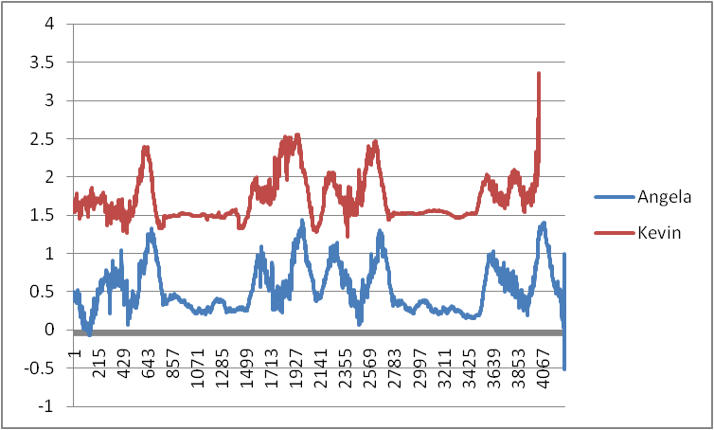
Same Bus Front and Back
Kevin in the back of bus
Raw Data
Smoothed Using Moving Average

Slide 56
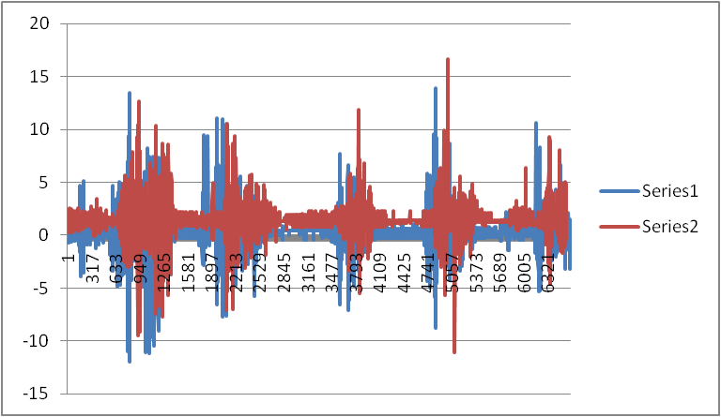
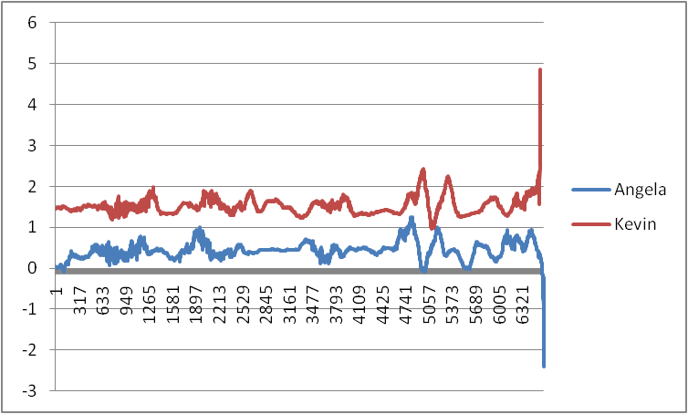
Same Bus Across Aisle

Slide 57
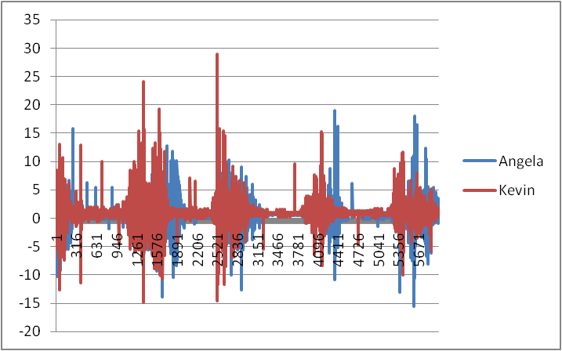
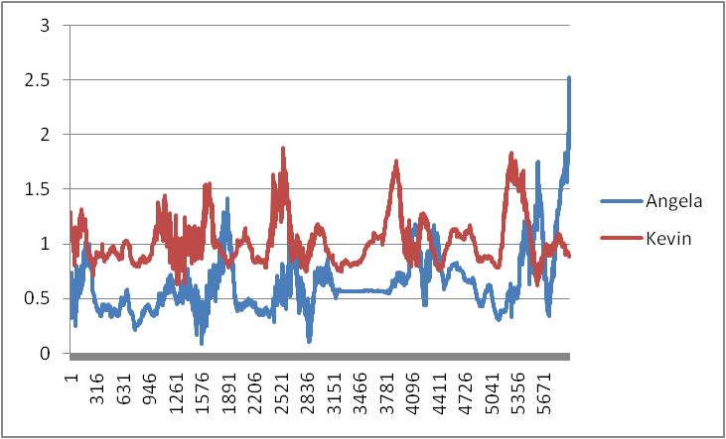
Different Buses Back to Back
Kevin in the front bus

Slide 58
Future Analysis
Dynamic Time Warp
Same bus should have low offset and low error
Back to back buses would have high offset and low error
Different buses should have high offset and high error

Slide 59
references
American Public Transportation Association. (2008). Public Transportation Fact Book. Washington D.C.
Arsenault, J., Shetye, P., von Dehsen, L., Yoo, D., Zimmerman, J. (2009). Design Research On Accessible Transportation. Unpublished Project Report.
Carton, P. (2008). Apple vs. RIM vs. Android Operating System.http://blog.changewave.com/2008/04/smart_phone_apple_rim_google.html last accessed 9/9/09.
Casey, C. (2003). Real-time information: Now arriving. MetroMagazinehttp://www.metromagazine.com/Article/Story/2003/04/Real-Time-Information-Now-Arriving.aspx Last accessed: September 22, 2009.
Collins, C., Grude, A., Scholl, M., and Thompson, R. 2007. txt bus: wait time information on demand. In Ext. Abs of CHI '07, 2049-2054.
DiSalvo, C. Nourbakhsh, Holstius, Akin, and Louw. (2008). The Neighborhood Networks Project: A Case Study of Critical Engagement and Creative Expression Through Participatory Design. In Proc. of PDC 2008, 41-50.
Hickman, M. (2004). Bus Automatic Vehicle Location (AVL) Systems. in Gillen, D. & Levinson, D. (eds.) Assessing the Benefits and Costs of ITS. 58-88.
Hopey, D. (2009). Pittsburgh re-classified as failing to meet smog limits. Pittsburgh Post Gazette. http://www.post-gazette.com/pg/09018/942685-113.stm last accessed 9/9/09.

Slide 60
references
Irwin, A. (1995). Citizen Science: A study of people, expertise and sustainable development. Routeledge.
ParkScan. http://parkscan.org/ last accessed 9/9/09.
Paulos, E., Honicky, R., Hooker, B. (2008). Citizen Science: Enabling Participatory Urbanism. In Foth (ed) Handbook of Research on Urban Informatics: The Practice and Promise of the Real-Time City. Hersey: New York.
Sagar, A.D. (1995). Automobiles and global warming: Alternative fuels and other options for carbon dioxide emissions reduction. Environmental Impact Assessment Review 15, 241-274.
Schwartz, M. B. (1980). Motivations and barriers to riders’ acceptance of bus transit. Transport, 19:4, 53-62.
Steinfeld, A., Maisel, J., Steinfeld, E. (2009). The Value of Citizen Science to Promote Transit Accessibility. First International Symposium on Quality of Life Technology.
Tang, K. P., Keyani, P., Fogarty, J., and Hong, J. I. 2006. Putting people in their place: an anonymous and privacy-sensitive approach to collecting sensed data in location-based applications. In Proc. of CHI '06, 93-102.
Watson, A., Bates, R., Kennedy, D. (eds.) (1998). Air Pollution, The Automobile, and Public Health. National Academy Press: Washington, D.C.
Willis, Terri. Cars: an Environmental Challenge. Chicago: Chicago Press, 1992.
Zimmerman et al. (2010, under review). Understanding the space for co-design in riders’ interactions with a transit service.

